Slide 1
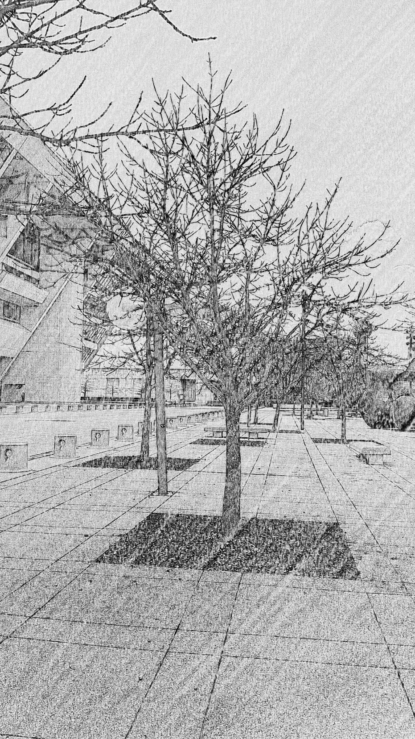
ARTICLE X
LANDSCAPE AND TREE CONSERVATION REGULATIONS
URBAN FOREST CONSERVATION
Division 51A-10.130
City Plan Commission Briefing – June 22, 2017

Slide 2
ARTICLE X
LANDSCAPE AND TREE CONSERVATION PRESERVATION REGULATIONS
Division 51A-10.100. In General
Division 51A-10.120. Landscaping
Division 51A-10.130. Urban Forest Conservation
Tree Preservation, Removal, and Replacement

Slide 3
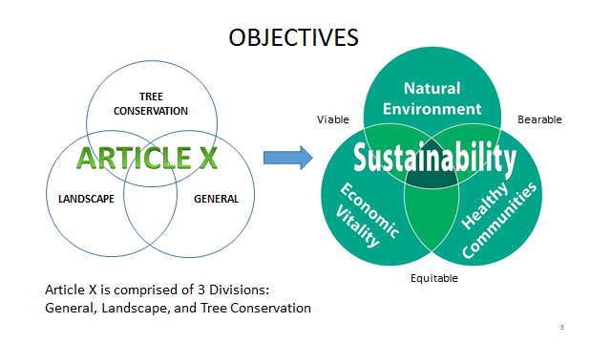
Sustainable Development

Slide 4
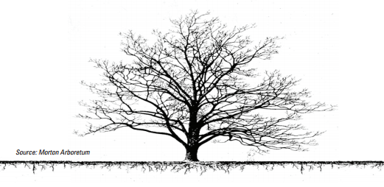
Approach
1990 Council resolution through Today – “protection and preservation of trees”.
Consideration of the physical history of Dallas land and project into the future for the Dallas urban forest
Align with future plans, goals, and purposes for the City – forwardDallas, Council policies and ordinances
Balance Tree Removal and Tree Replacement (Mitigation)
Benefits and Costs
Tree replacement (mitigation) options based on incentives, reductions, and credits for sustainable development of the property. Taking into consideration future growth of the trees and public health of the community.
Flexibility in options for mitigation to encourage sustainable landscapes with a greater potential for larger and prevailing tree growth and the retention of existing trees to safely fulfill their lifespans.

Slide 5
Benefits And Costs
BENEFITS OF TREES:
Improve air quality and human physical and mental health conditions.
Save home and community energy.
Reduce stormwater runoff.
Improve water quality and reduce soil erosion.
Provide wildlife food and habitat.
Enhance property values and improve customer activity in commercial uses.
Enhance recreational activities.
COSTS OF TREES:
Tree surveys and evaluations
Quality nursery stock
Regular maintenance
Removal of dead large trees
Improper location can damage infrastructure

Slide 6
ARTICLE X
LANDSCAPE AND TREE CONSERVATION PRESERVATION REGULATIONS
Division 51A-10.100. In General
Division 51A-10.120. Landscaping
Division 51A-10.130. Urban Forest Conservation
Tree Preservation, Removal, and Replacement

Slide 7
URBAN FOREST CONSERVATION
(10.130)
Div. 10.130. Tree Preservation, Removal, and Replacement
Div. 10.130. Urban Forest Conservation
.131 Application of Division
.132 Tree Removal Applications
.133 Reserved
.134 Replacement of Removed or
Seriously Injured Trees
.135 Alternative Methods of
Compliance with Tree
Replacement Requirements
.136 Preservation of Protected Trees During Construction or Other Disturbance
.137 Violation of this Division
.138 Appeals
.139 Fines
.140 Criminal Responsibility and Defenses to Prosecution
.131 Application of Division
.132 Tree Removal Applications
.133 Historic Trees
.133.1 Transplanted Trees
.134 Replacement of Removed or
Seriously Injured Trees
.135 Alternative Methods of Compliance with Tree Replacement Requirements
.136 Conservation and Maintenance of Protected Trees During Construction or Other Disturbance
.137 Violation of this Division
.138 Appeals
.139 Fines
.140 Criminal Responsibility and Defenses to Prosecution

Slide 8
Application of Division
(10.131)
.131 Application of Division
.132 Tree Removal Applications
.133 Reserved Historic Trees
.133.1 Transplanted Trees
.134 Replacement of Removed or Seriously Injured Trees
.135 Alternative Methods of
Compliance with Tree
Replacement Requirements
.136 Preservation Conservation and Maintenance of Protected Trees
During Construction or Other
Disturbance
.137 Violation of this Division
.138 Appeals
.139 Fines
.140 Criminal Responsibility and Defenses to
Prosecution
Overlay districts and planned developments may vary the regulation. (10.131(a))
Exception for a single family or duplex use on a lot less than 2 acres and in a residential district applies. The exception is lifted (property is considered vacant) when a demolition permit for the property is submitted. (10.131(b))
The exception is restored when: (10.131(b))
  Demolition permit is closed (not expired) by the building official (proving return of SF/Dup use)
  Certificate of completion is given for a new SF/Dup structure for occupancy

Slide 9
Application of Division (10.131(b))
Exception Single Family/Duplex Use
Single Family/Duplex Use
In a Residential District
Less than 2 acres
SF/Duplex use on lot
No tree protection or mitigation required
Area trees protected
and mitigation
Required (per Art. X Tree List)
House
“Unrestricted Zone”
Less than 2 acres
Demo Permit – date issued determines intent to remove use
Trees protected and mitigation required for entire lot
Vacant
OR
House
demoed
Lots 1 ac & less
Building Permit issued for a SF/Duplex in a Residential District
Allows an “Unrestricted Zone” – no trees are protected and no mitigation required
Greater than 1 ac to 2 ac
Building Permit closed
SF/Duplex use on lot
No tree protection or mitigation required
Building New House
Building Permit closed
SF/Duplex use on lot
No tree protection or mitigation required
New
House
Complete
New
House
Complete

Slide 10
Tree Removal Applications
(10.132)
.131 Application of Division
.132 Tree Removal Applications
.133 Reserved Historic Trees
.133.1 Transplanted Trees
.134 Replacement of Removed or Seriously Injured Trees
.135 Alternative Methods of
Compliance with Tree
Replacement Requirements
.136 Preservation Conservation and Maintenance of Protected Trees
During Construction or Other
Disturbance
.137 Violation of this Division
.138 Appeals
.139 Fines
.140 Criminal Responsibility and Defenses to
Prosecution
Amended the conditions to state when and where a tree removal application or building permit must be posted on a tree removal property (10.132(a))
Building Permit for Construction
Tree Removal Application Approval
  Grading Permit
  Demolition Permit
  Public Right-of-Way
Application is not required:
  Lot is excepted
  Defense to Prosecution
  Unprotected tree

Slide 11
Tree Removal Applications
(10.132)
.131 Application of Division
.132 Tree Removal Applications
.133 Reserved Historic Trees
.133.1 Transplanted Trees
.134 Replacement of Removed or Seriously Injured Trees
.135 Alternative Methods of
Compliance with Tree
Replacement Requirements
.136 Preservation Conservation and Maintenance of Protected Trees
During Construction or Other
Disturbance
.137 Violation of this Division
.138 Appeals
.139 Fines
.140 Criminal Responsibility and Defenses to
Prosecution
Forest Stand Delineation may be used to provide an ecological assessment of the property and measure tree canopy coverage, when applicable. May be used for: (10.132(b)(5))
  Tree canopy cover assessment for upland stands of young (up to 40 years) age class juniper / mesquite / Class 3 tree mixed stands.
  Tree canopy cover credit for single family and duplex construction.
  Sustainable Development Incentives.
  Tree canopy cover assessment where trees are removed without authorization.
  Tree canopy cover assessment on properties five acres or larger with institutional, community service, and recreation uses, when applicable (site management).
  Forest analysis for baseline documentation to create a conservation easement.
  Forest analysis for establishment of a community management plan.

Slide 12
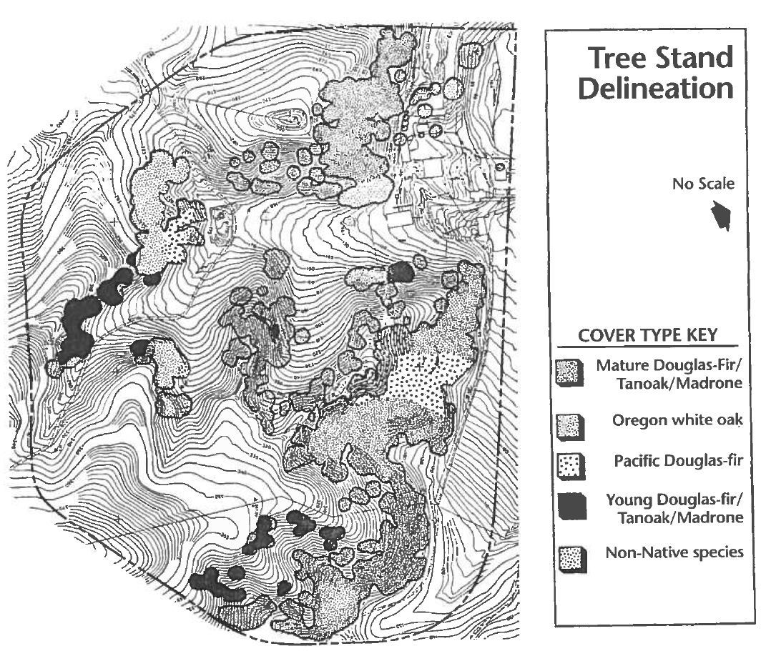
Tree Removal Applications (10.132)
Forest Stand Delineation Example
Provide general overview of
opportunities and constraints
on the site.
Identify existing vegetation
both in quantity and quality.
Show patterns and extent of
tree cover, tree cover types,
and sensitive land areas like
slopes and riparian areas.

Slide 13
Tree Removal Applications (10.132)
Development Impact Waiver
.131 Application of Division
.132 Tree Removal Applications
.133 Reserved Historic Trees
.133.1 Transplanted Trees
.134 Replacement of Removed or Seriously Injured Trees
.135 Alternative Methods of
Compliance with Tree
Replacement Requirements
.136 Preservation Conservation and Maintenance of Protected Trees
During Construction or Other
Disturbance
.137 Violation of this Division
.138 Appeals
.139 Fines
.140 Criminal Responsibility and Defenses to
Prosecution
Development impact area waiver (10.132(f))
Similar in function as an ‘unrestricted zone.’
Optional waiver request by the owner for the building official to waive tree mitigation requirements for a portion of the property in the development impact area.
Requires the property over 2 acres to meet extensive Sustainable Development Incentive qualifications (10.135). Smaller properties have minimal qualifications.
A full waiver is limited to 1) 70% of the area of the tree removal property, and 2) a separate calculation for the number of required parking spaces. A pro-rated reduction would apply to any overage.
The building official shall deny the waiver if the property should fail to meet the provisions (plan review to inspection).

Slide 14
Historic Trees
(10.133)
.131 Application of Division
.132 Tree Removal Applications
.133 Reserved Historic Trees
.133.1 Transplanted Trees
.134 Replacement of Removed or Seriously Injured Trees
.135 Alternative Methods of
Compliance with Tree
Replacement Requirements
.136 Preservation Conservation and Maintenance of Protected Trees
During Construction or Other
Disturbance
.137 Violation of this Division
.138 Appeals
.139 Fines
.140 Criminal Responsibility and Defenses to
Prosecution
Added Historic Trees which, only by agreement of the property owner, may be designated “Historic” and approved by City Council (10.133)

Slide 15
Transplanted Trees
(10.133.1)
.131 Application of Division
.132 Tree Removal Applications
.133 Reserved Historic Trees
.133.1 Transplanted Trees
.134 Replacement of Removed or Seriously Injured Trees
.135 Alternative Methods of
Compliance with Tree
Replacement Requirements
.136 Preservation Conservation and Maintenance of Protected Trees
During Construction or Other
Disturbance
.137 Violation of this Division
.138 Appeals
.139 Fines
.140 Criminal Responsibility and Defenses to
Prosecution
The building official must authorize the plan for credit.
Procedures must conform with ANSI operational and safety standards and ISA best management practices.
Tree replacement credit is provided for the property based on the size of the large, healthy established tree being transplanted.
Transplanted trees are not removed trees.

Slide 16
Replacement of Removed or Seriously Injured Trees (10.134)
.131 Application of Division
.132 Tree Removal Applications
.133 Reserved Historic Trees
.133.1 Transplanted Trees
.134 Replacement of Removed or Seriously Injured Trees
.135 Alternative Methods of
Compliance with Tree
Replacement Requirements
.136 Preservation Conservation and Maintenance of Protected Trees
During Construction or Other
Disturbance
.137 Violation of this Division
.138 Appeals
.139 Fines
.140 Criminal Responsibility and Defenses to
Prosecution
Trees must be replaced when removed under building permits, tree removal applications, unauthorized removals, or in removal from a public right-of-way (10.134(a))

Slide 17
Exceptions to Tree Replacement
All trees in the City of Dallas are protected and subject to replacement upon removal, except when:
  The property, or area in the property, is excepted from the regulations (10.131)
  The tree is unprotected (by species or less than 8-inch diameter)
  The tree is determined by the building official to be in a condition which warrants removal without a permit (Sec. 51A-10.140)

Slide 18
Replacement of Removed or Seriously Injured Trees (10.134)
.131 Application of Division
.132 Tree Removal Applications
.133 Reserved Historic Trees
.133.1 Transplanted Trees
.134 Replacement of Removed or Seriously Injured Trees
.135 Alternative Methods of
Compliance with Tree
Replacement Requirements
.136 Preservation Conservation and Maintenance of Protected Trees
During Construction or Other
Disturbance
.137 Violation of this Division
.138 Appeals
.139 Fines
.140 Criminal Responsibility and Defenses to
Prosecution
Exception to tree replacement requirements for an UNRESTRICTED ZONE on SF/Du lots less than 1 acre. (10.134(b))
Changed quantity of caliper inches required to be replaced (10.134(c))
  Currently: 1” to 1”
  Proposed: Tree Classification (takes into account size, location, species, benefit to the urban environment)

Slide 19
Replacement of Removed or Seriously Injured Trees (10.134)
Tree Classification
.131 Application of Division
.132 Tree Removal Applications
.133 Reserved Historic Trees
.133.1 Transplanted Trees
.134 Replacement of Removed or Seriously Injured Trees
.135 Alternative Methods of
Compliance with Tree
Replacement Requirements
.136 Preservation Conservation and Maintenance of Protected Trees
During Construction or Other
Disturbance
.137 Violation of this Division
.138 Appeals
.139 Fines
.140 Criminal Responsibility and Defenses to
Prosecution
Tree Classification for mitigation: (10.134(c))
Historic Trees: 3:1 (300%) (10.133)
Significant: 1.5:1 (150%) (10.101(55))
(Post Oaks 12” or greater; American elm, cedar elm, chittamwood, common persimmon, eastern red cedar, green ash, all other oaks, pecan, all walnut species, and white ash at 24” or greater)
Class 1 trees 1:1 (100%) (10.101(9))
(Tree located in a primary natural area or geologically similar area to 50 above the escarpment zone)
Class 2 trees 0.7:1 (70%) (10.101(10))
(Tree that is not otherwise classified)
Class 3 trees 0.4:1 (40%) (10.101(11))
(Arizona ash, black willow, cottonwood, hackberry, honey locust, mesquite, mimosa, mulberry, ornamentals, pinus spp., Siberian elm, silver maple, sugarberry or a small tree)

Slide 20
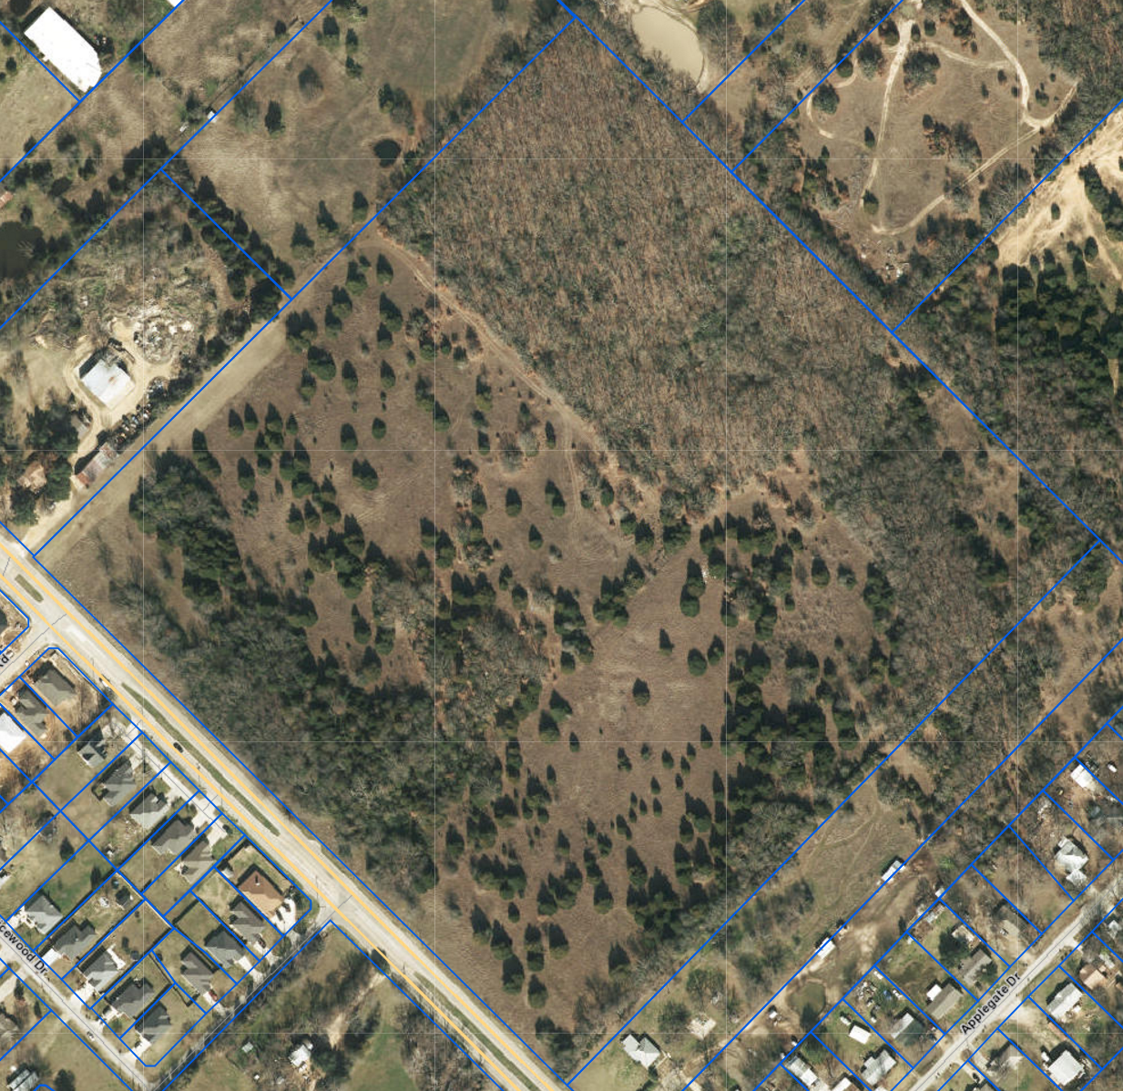
Replacement of Removed or Seriously Injured Trees (10.134)
Forest Stand Delineation to Determine Mitigation

Slide 21
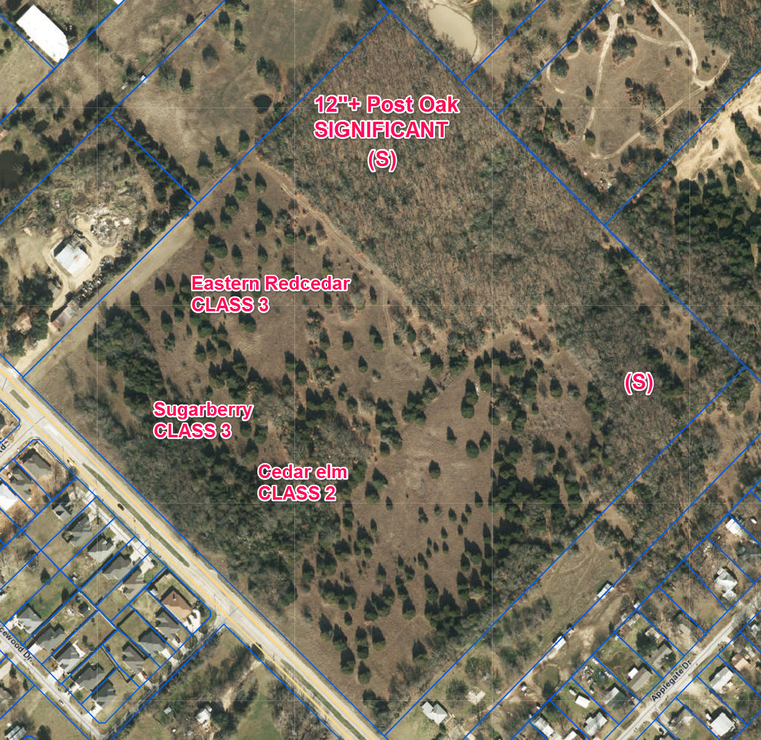
URBAN FOREST CONSERVATION
(10.134)
Replacement of Removed or Seriously Injured Trees (10.134)
Forest Stand Delineation to Determine Mitigation

Slide 22
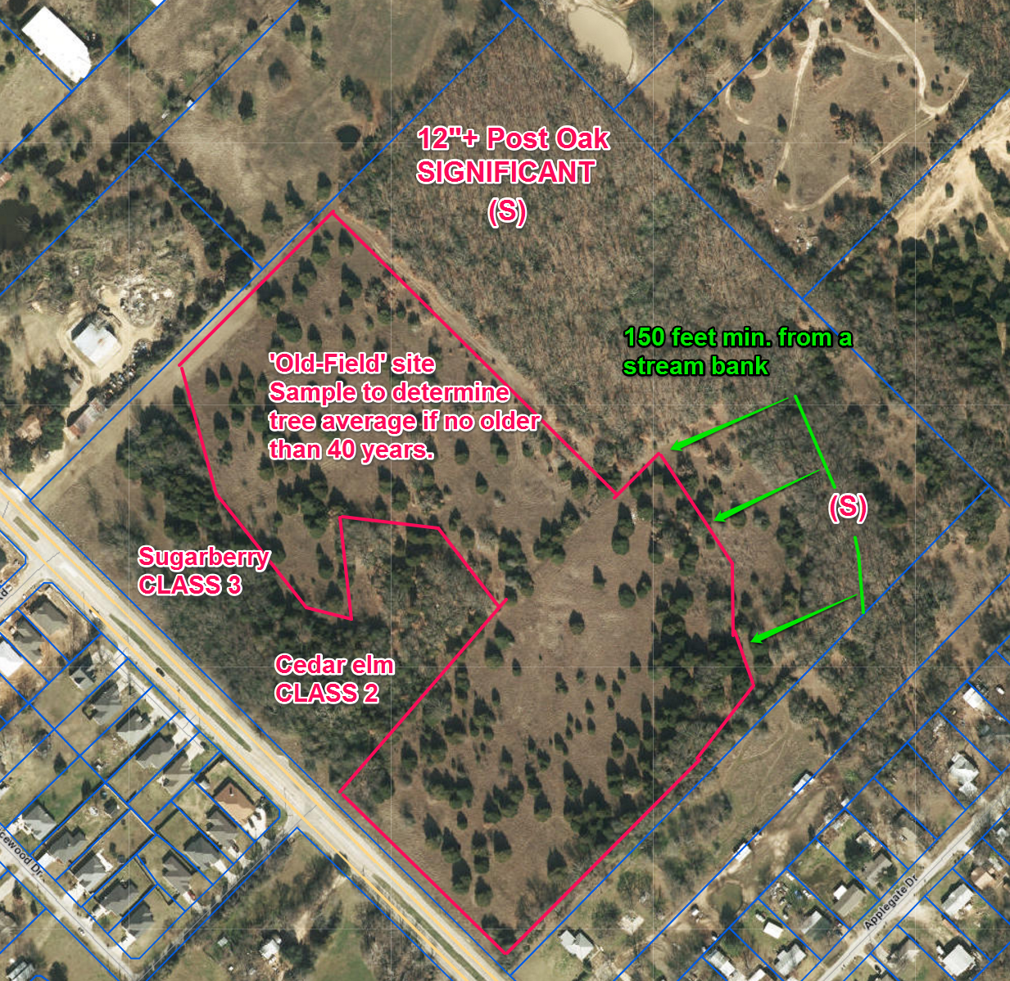
URBAN FOREST CONSERVATION
(10.134)
Replacement of Removed or Seriously Injured Trees (10.134)
Forest Stand Delineation to Determine Mitigation

Slide 23
Replacement of Removed or Seriously Injured Trees (10.134)
.131 Application of Division
.132 Tree Removal Applications
.133 Reserved Historic Trees
.133.1 Transplanted Trees
.134 Replacement of Removed or Seriously Injured Trees
.135 Alternative Methods of
Compliance with Tree
Replacement Requirements
.136 Preservation Conservation and Maintenance of Protected Trees
During Construction or Other
Disturbance
.137 Violation of this Division
.138 Appeals
.139 Fines
.140 Criminal Responsibility and Defenses to
Prosecution
For tracts 2 acres and larger, no one species may constitute more than 35% of the replacement trees on the site (10.134(c)(2))
Amended ordinance to place Approved Trees list in a separate document and referenced in the Landscape and Tree Manual (10.109)
Trees to be determined:
LARGE (10.101(35))
MEDIUM (10.101(39))
SMALL (10.101(56)) trees
based on tree height and canopy
width.

Slide 24
Replacement of Removed or Seriously Injured Trees (10.134)
.131 Application of Division
.132 Tree Removal Applications
.133 Reserved Historic Trees
.133.1 Transplanted Trees
.134 Replacement of Removed or Seriously Injured Trees
.135 Alternative Methods of
Compliance with Tree
Replacement Requirements
.136 Preservation Conservation and Maintenance of Protected Trees
During Construction or Other
Disturbance
.137 Violation of this Division
.138 Appeals
.139 Fines
.140 Criminal Responsibility and Defenses to
Prosecution
Amended the Timing provisions: (10.134(c)(5))
  Mitigate within 30 days
  Allow for up to 6 months with affidavit
    If a building permit is submitted within the period, the replacement requirements may be attached.
    If a permit is not submitted, the replacement must occur within one month (30 days) of the initial 6-month expiration date.
  Multi-phased residential subdivisions and commercial developments may submit a professionally designed comprehensive tree replacement plan for the subdivision to be implemented.
    Primary mitigation completed prior to construction.
    Remaining mitigation resolved with project.

Slide 25
Replacement of Removed or Seriously Injured Trees (10.134)
.131 Application of Division
.132 Tree Removal Applications
.133 Reserved Historic Trees
.133.1 Transplanted Trees
.134 Replacement of Removed or Seriously Injured Trees
.135 Alternative Methods of
Compliance with Tree
Replacement Requirements
.136 Preservation Conservation and Maintenance of Protected Trees
During Construction or Other
Disturbance
.137 Violation of this Division
.138 Appeals
.139 Fines
.140 Criminal Responsibility and Defenses to
Prosecution
Use of Forest Stand Delineation to determine mitigation reduction for old field and undeveloped lots (10.134(c)(6))
On lots greater than 5 acres with institutional or recreational uses, the FSD may be used as a site management tool to calculate the number of Legacy trees required to be planted to maintain or increase the canopy to a standard level (10.134(c)(7))

Slide 26
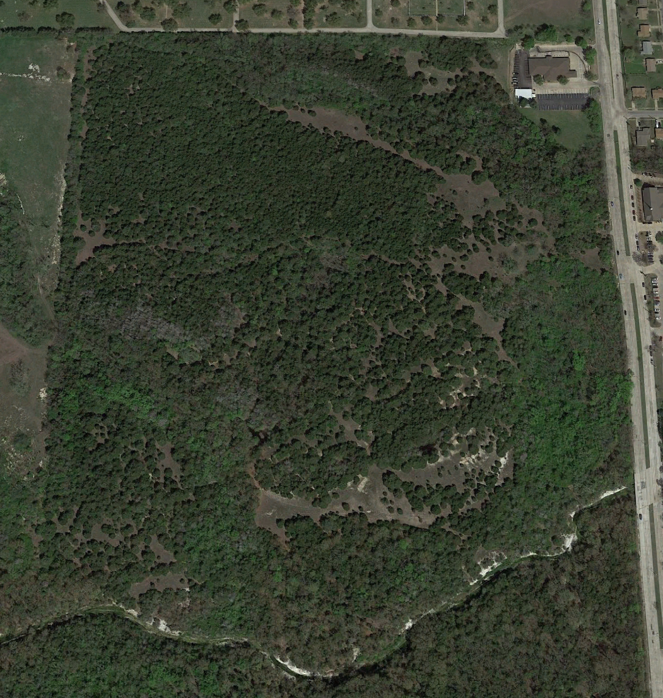
Replacement of Removed or Seriously Injured Trees (10.134)
Forest Stand Delineation Process - Old-Field Lots
The 2015 Google Earth view shows the existing conditions on the property.
A FSD can distinguish predominant young juniper stands distinguished from older stands, or those of other species.
Field assessment is required to assure boundaries of the stratified forest survey.
Historical ground and aerial imagery, or other records, can provide more confirmation on the age and history of the tree stand.
Notes:
I’ve looked at one property in the City of Dallas which shows elements of the environments we are considering. This is a 2015 image of a property off University Hills and north of Camp Wisdom. Ricketts Branch runs across the southern portion of the property. Laureland Cemetery is to the north.
A FOREST STAND DELINEATION on a portion of this property can distinguish a PREDOMINANT young juniper (eastern redcedar) stands distinguished from older stands, or THOSE OF OTHER SPECIES.
Field assessment is ALSO required so it is not just an aerial review. The walk through must assure boundaries of the STRATIFIED (or sectioned) survey. Also historical ground and aerial imagery and records can provide more confirmation on the age and history of the tree stand.
All this is doing is a little historical research for the property to establish an age class and general size per tree.

Slide 27
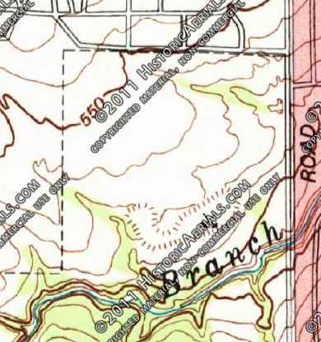
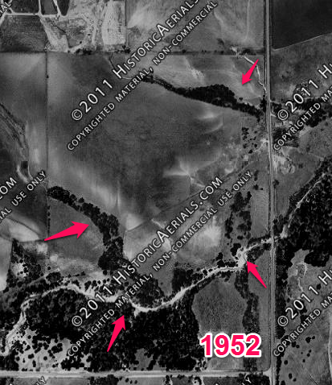
Forest Stand Delineation Process
Determine condition of an Old-Field Lot
Topographic and historical images are available commercially or through educational centers with free viewing online, or available with payment. Soil surveys are also available online.
All images from Historic Aerials.com
Notes:
Re-orienting ourselves to where north is up, I have gone to a resource for historic aerial images called HistoricAerials.com to be able to VIEW images of the property dating back a number of decades. For this area, watermarked images are available going back to 1952. Also, either here or other locations, a topographic map can be made available showing contours of the property and the location of the creek and historic changes to the area.
Comparing these two images, you can see the dark pattern of tree lined drainages and vegetated areas distinguished from cultivated farm and pasture areas as the vegetation follows the lower contours. These images can give us a historical perspective which is difficult to gather once you see the expanse of trees on the property today.

Slide 28
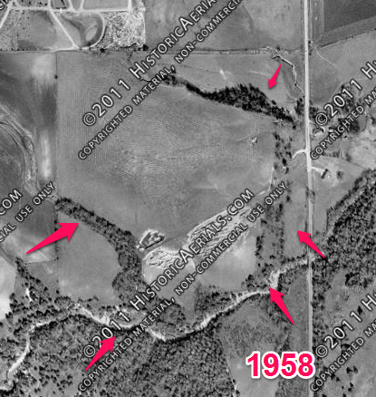
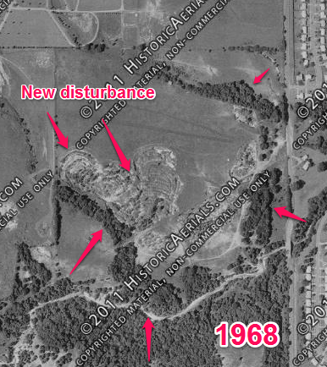
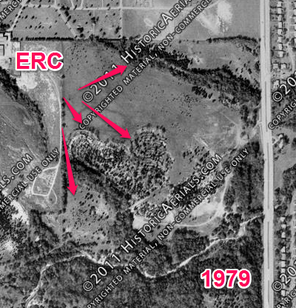
Forest Stand Delineation Process
Old-Field Lot
Visible site changes are seen over two decades, from 1958 to 1979.
All images from Historic Aerials.com
Notes:
We can then progress with additional images from 1958 to 1979 and identify how the land was disturbed with some mining operations. At some time approaching and then after 1968, it appears the mined areas began to establish the eastern redcedar into the area. The trees were seeding and spreading across the plain to the north and east.

Slide 29
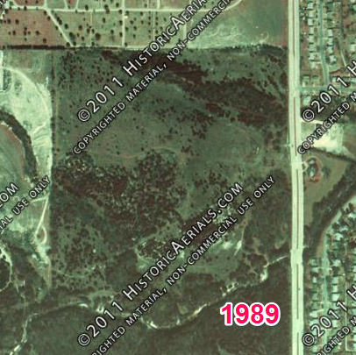
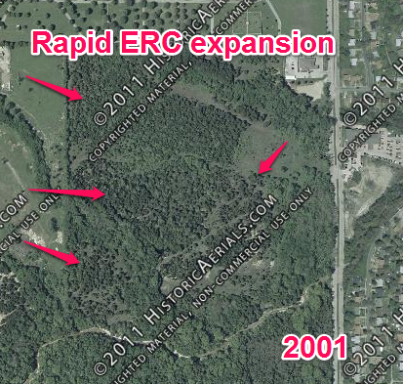
Forest Stand Delineation Process
Old-Field Lot
Tree expansion from 1989 – 2001
All images from Historic Aerials.com
Notes:
It was in 1989 we can see significant growth in the mined area, but it was in a fairly rapid pace between 1989 to 2001 the spread of the tree exploded across the area and started growing in stature to where they were highly noticeable in aerial images.

Slide 30
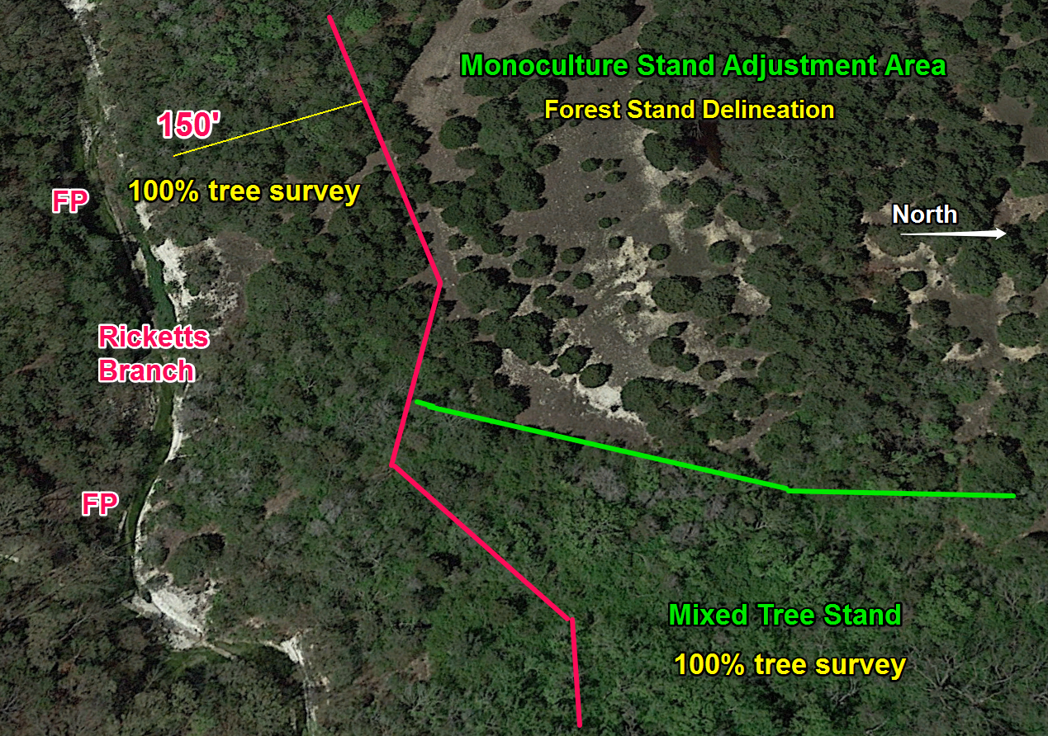
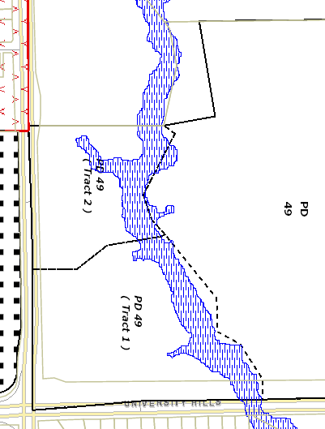
Forest Stand Delineation Process
Old-Field Lot
Eastern redcedar monoculture tree stand
Measure distance from floodway and the stand border from aerials and field assessment.
Notes:
On the map to the lower left, NORTH is to your right. The close up image to the right is oriented the same way. The floodplain (Ricketts Branch) is to the west.
All protected trees (including the eastern redcedar) within 150 feet of the floodplain (being the red line) must be called out on a tree survey if the area is to be disturbed. If left alone, this distance may be reduced after assessment of the plat. The lighter green areas to the left and bottom of the image are identifying a mixed stand of hardwood and juniper trees which must be assess in the tree survey when these are to be disturbed.
The green line delineates the MONOCULTURE tree stand to the north and west from the older and more established hardwood mixed tree stand to the south and east.

Slide 31
Alternative Methods of Compliance
(10.135)
.131 Application of Division
.132 Tree Removal Applications
.133 Reserved Historic Trees
.133.1 Transplanted Trees
.134 Replacement of Removed or Seriously Injured Trees
.135 Alternative Methods of
Compliance with Tree
Replacement Requirements
.136 Preservation Conservation and Maintenance of Protected Trees
During Construction or Other
Disturbance
.137 Violation of this Division
.138 Appeals
.139 Fines
.140 Criminal Responsibility and Defenses to
Prosecution
10.135 Alternative Methods of Compliance with Tree Replacement Requirements
  Mitigation
  Mitigation by Legacy Trees
  Habitat preservation and restoration areas
  Sustainable development incentives
  Tree Canopy Cover Credit for single family and duplex uses
  Conservation Easement
  Provide trees to city property, or
Plant within 5 miles on other property
(h) Reforestation Fund

Slide 32
Alternative Methods of Compliance
(10.135(a)(b)(c))
10.135 Alternative Methods of Compliance with Tree Replacement Requirements
  Mitigation
  Mitigation by Legacy Trees
  Habitat preservation and restoration areas
  Sustainable development incentives
  Tree Canopy Cover Credit for single family and duplex uses
  Conservation Easement
  Provide trees for city property, or
Plant within 5 miles on other property
(h) Reforestation Fund
  Provides alternative methods of tree replacement when conditions will allow for its use on the tree removal property (10.135(a))
  Legacy trees may be planted according to soil and area requirements for planting a Legacy tree and receive 12” replacement credit per tree (10.135(b))
  Habitat preservation and restoration is credited by the square footage of area for a tree mitigation reduction (10.135(c))

Slide 33
Alternative Methods of Compliance
(10.135(d))
Sustainable Development Incentives
  Comprehensive tree mitigation process which credits retained and future tree growth with use of sustainable development practices.
  Extensive tree mitigation requirements may be relieved by using tree preservation and new tree installation to replace a tree canopy cover over the property.
  The canopy cover goal for the property is established and the rate of mitigation reduction is determined by the amount of canopy cover attained as compared to the goal.
10.135 Alternative Methods of Compliance with Tree Replacement Requirements
  Mitigation
  Mitigation by Legacy Trees
  Habitat preservation and restoration areas
  Sustainable development incentives
  Tree Canopy Cover Credit for single family and duplex uses
  Conservation Easement
  Provide trees for city property, or
Plant within 5 miles on other property
(h) Reforestation Fund

Slide 34
Alternative Methods of Compliance
(10.135(d))
Sustainable Development Incentives
10.135 Alternative Methods of Compliance with Tree Replacement Requirements
  Mitigation
  Mitigation by Legacy Trees
  Habitat preservation and restoration areas
  Sustainable development incentives
  Tree Canopy Cover Credit for single family and duplex uses
  Conservation Easement
  Provide trees for city property, or
Plant within 5 miles on other property
(h) Reforestation Fund
  Each healthy tree preserved retains a square footage of tree canopy cover.
  Each large or medium landscape tree adds 300 sf in credit.
  Each Legacy tree provides:
    Large tree = 1200 sf
    Medium tree = 750 sf

Slide 35
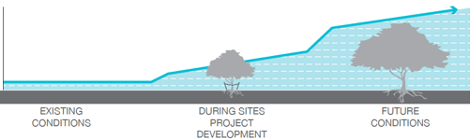
Sustainable Development Incentives
Legacy Tree Concept
Plant: 3-in. large tree in
500 sf minimum soil area
1500 cf soil volume
Soils preparation/protection
Site maintenance
LEGACY TREE
Credit: 12-in. diameter, or
1200 sf tree canopy
Image: SITES v. 2 Rating System
1. Conserve and manage existing trees.
2. Establish tree planting conditions for long-term successful growth.
3. Plant quality trees for projected tree growth.
4. Attain mitigation reduction based on tree projections.
5. Protect and grow tree canopy cover to reach canopy goal percentage for lot.
6. Maintain landscaping.

Slide 36
Alternative Methods of Compliance
(10.135(d))
Sustainable Development Incentives
10.135 Alternative Methods of Compliance with Tree Replacement Requirements
  Mitigation
  Mitigation by Legacy Trees
  Habitat preservation and restoration areas
  Sustainable development incentives
  Tree Canopy Cover Credit for single family and duplex uses
  Conservation Easement
  Provide trees for city property, or
Plant within 5 miles on other property
(h) Reforestation Fund
  Complete Streets typology determines the tree canopy goal for the adjacent development.
  Forest canopy goal for the City has not been established. The current overall coverage is about 29%, according to the Texas Trees Foundation ‘State of the Urban Forest’ report of 2015.
  Street Typology Goal Canopy Cover
  Residential 40%
  Mixed Use 35%
  Commercial & Freeways 30%
  Industrial 25%
  Parkways 45%

Slide 37
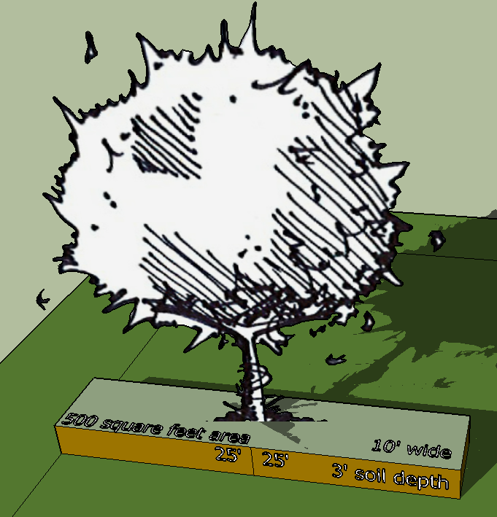
Alternative Methods of Compliance
(10.135(d))
Sustainable Development Incentives
Tree measurement planting to maturity
Large trees must be planted in a minimum 500 s.f. soil area (1500 c.f. @ 3’ soil depth).
Credit: 1200 s.f. canopy
Medium trees must be planted in a minimum 400 s.f. soil area (1200 c.f. @ 3’ soil depth).
Credit: 750 s.f. canopy

Slide 38
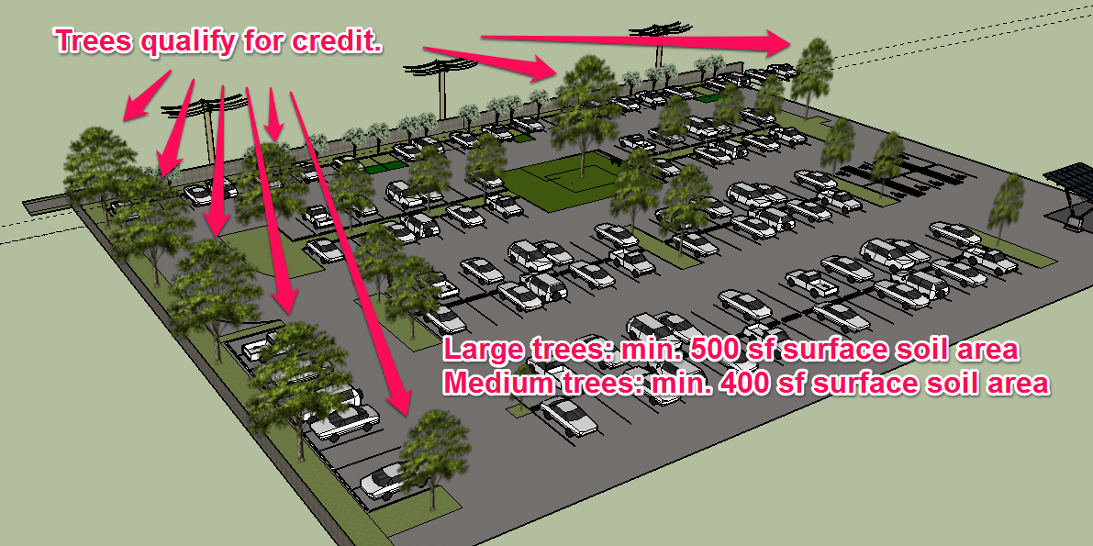
Sustainable Development Incentives
Example
Soil volume, surface area and future canopy clearance standards must be achievable for all planted Legacy trees. Existing trees must meet soil retention requirements.
The prerequisite SDI conditions must be applied and completed with inspection.

Slide 39
Sustainable Development Incentives
SDI Process
Pre-Development
Plan Review/Design
Implementation
50%
Canopy
cover
20% Preserved
Site trees: 109 required
Utilized buffers fully
Enhanced parking lot
65,340 sf tree canopy preserved
Landscape (300sf): 60
Legacy trees (1200sf): 40
(18,000+48,000 = 66,000)
30% Tree Canopy Goal
15% New Trees
15% Preserved
15% Preserved
10 acre property
5 acres covered
1,000 inches mit.
Commercial: 30%
1.5 acres covered
½ of goal: 500” reduction
15% cover from landscape and large Legacy trees; 30% of 30% completed.
100% of goal

Slide 40
Sustainable Development Incentives
SDI Process
Pre-Development
Plan Review/Design
Implementation
50%
Canopy
cover
20% Preserved
Site trees: 109 required
Utilized buffers fully
Enhanced parking lot
65,340 sf tree canopy preserved
Landscape (300sf): 30
Legacy trees (1200sf): 20
30% Tree Canopy Goal
7.5% Planted
15% Preserved
15% Preserved
7.5% cover from landscape and Legacy trees; 22.5% of 30% completed.
Short of Goal!
10 acre property
5 acres covered
1,000 inches mit.
Commercial: 30%
1.5 acres covered
½ of goal: 500” reduction

Slide 41
Sustainable Development Incentives
SDI Process and Green Site Points
Pre-Development
Plan Review/Design
Implementation
50%
Canopy
cover
20% Preserved
Site trees: 109 required
Utilized buffers fully
Enhanced parking lot
65,340 sf tree canopy preserved
Landscape (300sf): 30
Legacy trees (1200sf): 20
(9,000+24,000 = 33,000)
1,000-500-250= 250” remain to be mitigated
30% Tree Canopy Goal
Green Site Points
7.5% Planted
15% Preserved
15% Preserved
10 acre property
5 acres covered
1,000 inches mit.
Commercial: 30%
1.5 acres covered
½ of goal: 500” reduction
7.5% cover from landscape and Legacy trees; 22.5% of 30% completed.
25% Short of Goal!

Slide 42
Sustainable Development Incentives
SDI Process and Green Site Points
Pre-Development
Plan Review/Design
Implementation
50%
Canopy
cover
250” remain to be mitigated.
-25”
-25”
-75”
-100”
-25”
Total: 250”
Complete!!
Point total for lots over 3 acs is based on 50 points or a greater tree canopy cover prior to review.
Sustainable Landscape Plan – 5 pts.
Tree Preservation Plan – 5 pts.
#2 Enhanced buffer zone increase – 15 pts.
#5 Parking lots – 20 pts.
#7 Public deed restriction – 5 pts.
50 points attained.
10 acre property
5 acres covered
1,000 inches mit.
SDI: Reduced requirements by 75% (250” remain)

Slide 43
Alternative Methods of Compliance
(10.135(e))
10.135 Alternative Methods of Compliance with Tree Replacement Requirements
  Mitigation
  Mitigation by Legacy Trees
  Habitat preservation and restoration areas
  Sustainable development incentives
  Tree Canopy Cover Credit for single family and duplex uses
  Conservation Easement
  Provide trees for city property, or
Plant within 5 miles on other property
(h) Reforestation Fund
  Available to all Single Family and Duplex construction sites.
  A canopy goal of 40% is set.
  Healthy existing trees and new nursery stock trees may be provided to achieve the tree canopy goal for the completion of tree mitigation for the property.
  Boundary trees on lot lines and adjoining properties may be used in the canopy cover calculation if the tree root system is protected.

Slide 44
Alternative Methods of Compliance
(10.135(f))
10.135 Alternative Methods of Compliance with Tree Replacement Requirements
  Mitigation
  Mitigation by Legacy Trees
  Habitat preservation and restoration areas
  Sustainable development incentives
  Tree Canopy Cover Credit for single family and duplex uses
  Conservation Easement
  Provide trees for city property, or
Plant within 5 miles on other property
(h) Reforestation Fund
  Conservation easements have been amended to be a minimum of 20% of the size of the development impact area on the tree removal property.
  Protected inches preserved in the conservation easement must be equal to or greater than the number of inches to be mitigated.
  The easement requires a FSD for baseline documentation.
  Additional standards have been introduced to assure the easement is designed for preservation purposes.

Slide 45
Alternative Methods of Compliance
(10.135(g))
10.135 Alternative Methods of Compliance with Tree Replacement Requirements
  Mitigation
  Mitigation by Legacy Trees
  Habitat preservation and restoration areas
  Sustainable development incentives
  Tree Canopy Cover Credit for single family and duplex uses
  Conservation Easement
  Give to city’s park and rec department, or
Plant within 5 miles on other property
(h) Reforestation Fund
  When mitigation cannot be managed on site, other existing provisions are still available.
  Providing trees to the Park Dept
  Amended planting off-site to extend to 5 miles (previously 1 mile) away from the tree removal property.

Slide 46
Alternative Methods of Compliance
(10.135(h))
  Recommendation: The amount of the Fund payment is determined by using the formula for appraising the value of a tree, as derived by the Guide for Plant Appraisal.
  A set dollar cost per inch would be established using the formula to include regional calculations for tree cost.
  The proposed uses for the Fund have been increased to include a Master Plan, for funding management of the Fund, and public tree education, while assuring uses for planting trees on public property and for acquiring wooded property.
10.135 Alternative Methods of Compliance with Tree Replacement Requirements
  Mitigation
  Mitigation by Legacy Trees
  Habitat preservation and restoration areas
  Sustainable development incentives
  Tree Canopy Cover Credit for single family and duplex uses
  Conservation Easement
  Give to city’s park and rec department, or
Plant within 5 miles on other property
(h) Reforestation Fund

Slide 47
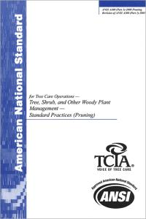
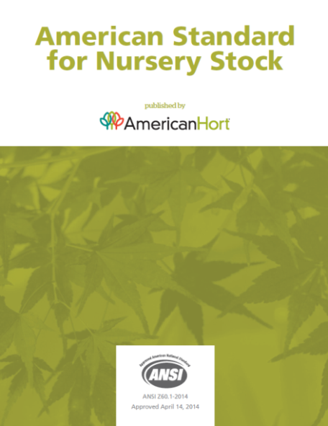
Conservation and Maintenance
(10.136)
.131 Application of Division
.132 Tree Removal Applications
.133 Reserved Historic Trees
.133.1 Transplanted Trees
.134 Replacement of Removed or Seriously Injured Trees
.135 Alternative Methods of
Compliance with Tree
Replacement Requirements
.136 Preservation Conservation and Maintenance of Protected Trees
During Construction or Other
Disturbance
.137 Violation of this Division
.138 Appeals
.139 Fines
.140 Criminal Responsibility and Defenses to
Prosecution
City trees must be established and maintained in conformity to ANSI technical and safety standards, ISA Best Management Practices, and American Standard for Nursery Stock provisions, as applicable.

Slide 48
Conservation and Maintenance
(10.136)
.131 Application of Division
.132 Tree Removal Applications
.133 Reserved Historic Trees
.133.1 Transplanted Trees
.134 Replacement of Removed or Seriously Injured Trees
.135 Alternative Methods of
Compliance with Tree
Replacement Requirements
.136 Preservation Conservation and Maintenance of Protected Trees
During Construction or Other
Disturbance
.137 Violation of this Division
.138 Appeals
.139 Fines
.140 Criminal Responsibility and Defenses to
Prosecution
Tree protection plan requirements have been enhanced with direction by ANSI A300 Standards for Tree Care Operations and ISA Best Management Practices.
Tree protection fencing requirements are the same as currently applied, except it must be secured and rigid six-feet tall fences in conditions of:
Enforcement of work site violations
Significant or historic tree
Sustainable Development Incentive tree protections in work zones
Sites under residential tree canopy cover credit in work zones

Slide 49
Urban Forest Conservation
(10.137, 10.138, 10.139, 10.140)
.131 Application of Division
.132 Tree Removal Applications
.133 Reserved Historic Trees
.133.1 Transplanted Trees
.134 Replacement of Removed or Seriously Injured Trees
.135 Alternative Methods of
Compliance with Tree
Replacement Requirements
.136 Preservation Conservation and Maintenance of Protected Trees
During Construction or Other
Disturbance
.137 Violation of this Division
.138 Appeals
.139 Fines
.140 Criminal Responsibility and Defenses to
Prosecution
Stop work orders are still applicable.
Mitigation of unauthorized tree removals may now be assessed by the building official on property where physical evidence of the removed trees has been destroyed without a survey. Assessment is completed by a Forest Stand Delineation of aerial imagery and other available evidence.
Appeals and fines standards remain the same.
Defenses to prosecution is amended to define the forms of infrastructure engineering on private property which qualify.

Slide 50
SCHEDULE
July 20, 2017 CPC Briefing and Agenda item for Action
Link to webpage:
http://dallascityhall.com/departments/sustainabledevelopment/planning/Pages/Code-Amendments.aspx
Phil Erwin, Chief Arborist philip.erwin@dallascityhall.com
Donna Moorman, Chief Planner donna.moorman@dallascityhall.com

