Slide 1

DCA 234-002(LG)
Development Code Amendment
Zoning Ordinance Advisory Committee (ZOAC)
October 22, 2024
La'Kisha Girder
Manager-Parks Planning
Partnership and Strategic Initiatives
Dallas Park and Recreation

Slide 2

Proposal
Consideration of amendments to Chapter 51A, the Dallas Development Code, Division 51A-4.1000, “Park Land Dedication”, and related sections, with consideration to be given to replacing Division 51A-4.1000 with a new Article XIV, “Park Land Dedication,” pursuant to the requirements of Texas House Bill 1526, 88th Legislature.
DCA234-002(LG)

Slide 3
Summary
The proposed code amendments recommends changes to park land dedication requirements for a fee-in-lieu of park land dedication for residential and lodging uses in the City of Dallas pursuant to the requirements of Texas Senate Bill 929, 88th Legislature. This amendment also recommends moving the park land dedication from Article 4 to Article 14 in Division 51(A).
DCA234-002(LG)

Slide 4
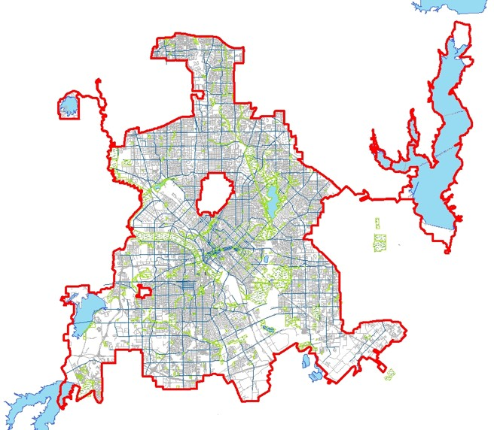
Location Map
DCA234-002(LG)

Slide 5
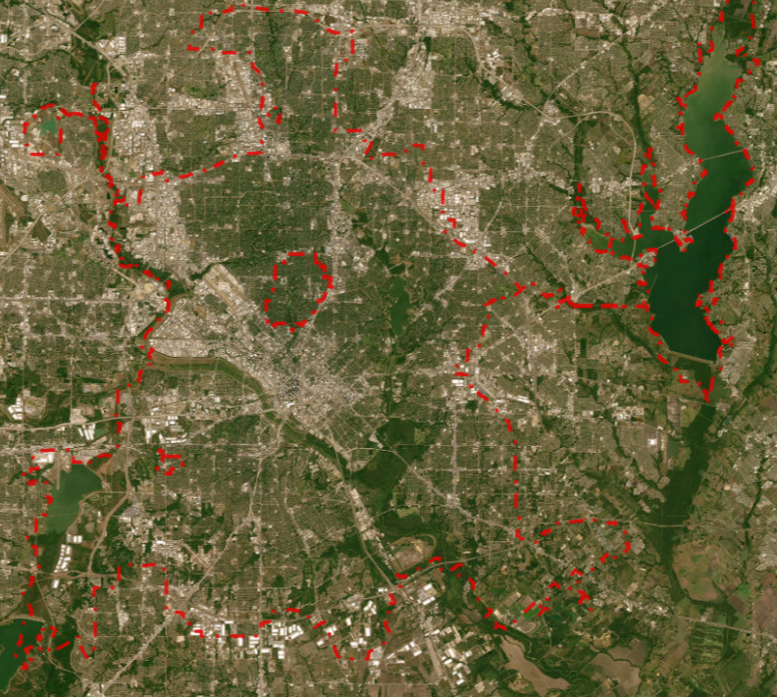
Aerial Map
DCA234-002(LG)

Slide 6
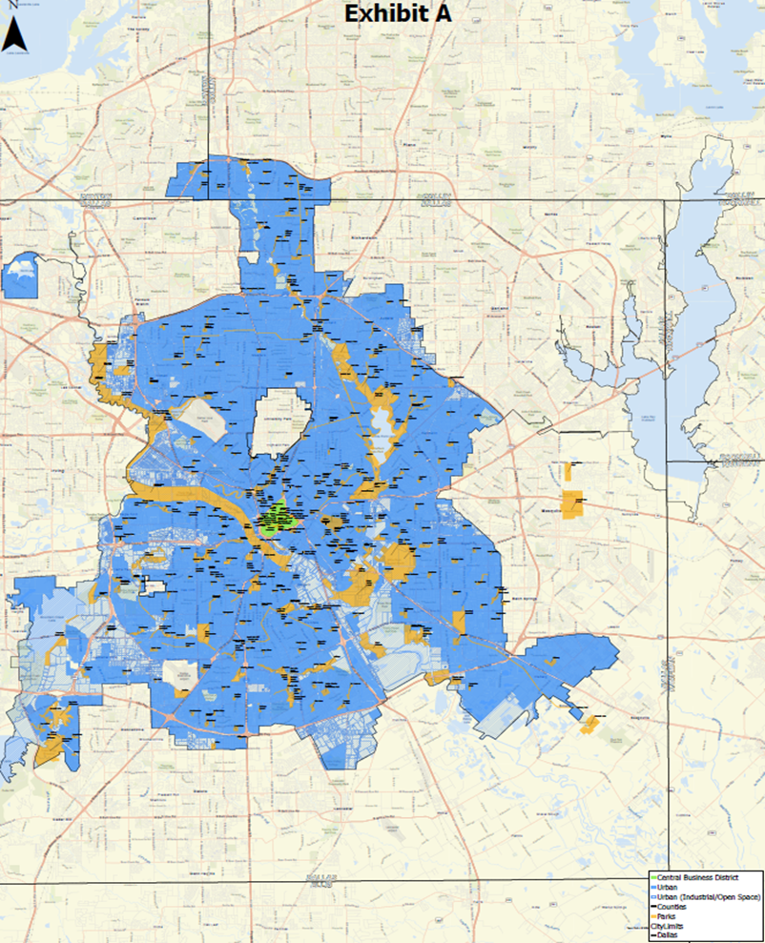
Background-Area Designation Map
DCA234-002(LG)

Slide 7
Background
Park Land Dedication Ordinance No. 30934 went into effect July 17, 2019, as Division 51A-4.1000. Park Land Dedication of the Dallas Development Code
  Required fees for fee-in-lieu and park development
  Ordinance established 7 park nexus zones to generate and spend fees
  Expenditure of fees was limited to land acquisition and park development
  Impacted single family, multifamily and hotel/motel developments
  Offered credits for certain types amenities and flexibility for dedicating land and developing parks within developments
Ordinance developed through a process of working with park advocates and representatives of the development community
Through implementing the ordinance, staff learned that the credits and flexibility were not utilized, and all developers chose to pay a fee for reasons related to simplicity and timing
DCA234-002(LG)

Slide 8
Background
In May 2023, the Texas Legislature amended Chapter 212 of the Local Government Code through H.B. No. 1526, which is applicable to all Texas municipalities with a population over 800,000
  Dallas
    Comprised of 5 counties-Collin, Dallas, Denton, Kaufman and Rockwall
    Has territory in 3 counties-Collin, Dallas and Denton
  Houston
  San Antonio
  Austin
  Fort Worth
H.B. No. 1526 will apply to all plan applications filed on or after January 1, 2024, necessitating modifications to our current ordinance
New state law required the establishment by City Council of density and dwelling unit factors as a component of establishing fees
On November 8, 2023, the public comment period was opened for discussion on the density and dwelling unit factors for all territory within the City of Dallas
Public comment period was closed on December 13, 2023
Dallas City Council adopted density and dwelling unit factors on January 10, 2024
DCA234-002(LG)

Slide 9
State Law-HB 1526
Affects multifamily and hotel/motel developments – excludes single family
Municipalities to determine whether to require land dedication, fee assessment or both
Establishes two ways to derive fees
  Calculation based upon formula that utilizes appraisal districts land values, number of units in a development, density factor, and dwelling unit factor
  Simple per unit cost not to exceed 2% median family income (MFI)
Limits City's ability to require a land dedication to no more than 10% of development site
If City chooses to require dedication, must purchase the land at fair market value less the fee calculation
Fees and/or land dedication must be satisfied prior to issuance of Certificate of Occupancy
Law is silent on nexus principle, uses of fees, reimbursements, and exemptions
Affordable housing units are excluded from the fee calculation
DCA234-002(LG)

Slide 10
State Law-HB 1526
For the purposes of crafting the new ordinance and calculating fees using the formula method, the City must:
  Assign all territory withing its boundaries using the draft land use designations from HB 1526:
    Suburban Area
    Urban Area
    Central Business District (CBD) Area
  Notifies appraisal districts to calculate average per acre land values for urban and CBD areas every ten years
Set a dwelling unit factor (parkland acres required per dwelling unit) not less than:
  .005 for multifamily units
  .004 for hotel/motel rooms
Set a density factor not less than:
  One (1) for the Suburban Area-Dallas does not have any territory designated as Suburban
  Four (4) for the Urban Area
  Forty (40) for the Central Business District (CBD) Area
DCA234-002(LG)

Slide 11
Current Ordinance
Land Dedication Requirements
  SF = 1 acre per 100 dwelling units
  MF 1 bed = 1 acre per 255 dwelling units
  MF 2+ beds = 1 acre per 127 dwelling units
  Hotel/Motel = 1 acre per 233 rooms
Fee-in-lieu total (including park development fees)
  SF = $1165 per dwelling unit
  MF 1 bed = $457 per dwelling unit
  MF 2+ beds = $917 per dwelling unit
  Hotel/Motel = $500 per room
Minimum size of land dedication is 1 acre unless special circumstances exist
  For developments that require a dedication of less than 1 acre, fee-in-lieu will be accepted
DCA234-002(LG)

Slide 12
Current Ordinance
Number is dwelling units is based upon the total increase in units in existence within 5 years of approval of preliminary plat or issuance of building permit
  Would exempt residential tear-downs and replacement of 1 new home
Private park land will be given 100% towards land dedication requirement if publicly accessible and is compliant with other standards
Private park land will be given a 50% credit towards land dedication requirement if it is completely private but is compliant with other standards
Dedicated land must meet certain standard requirements and shall not exceed 50% floodplain designation and shall not include storm water detention/retention areas
Fees paid to meet ordinance requirements must be spent within 10 years
Fees paid to meet ordinance requirements cannot be used for maintenance or staff/overhead expenses
Trees on dedicated parkland may be used to meet tree mitigation requirements in accordance with Article X
Exempts affordable housing units from parkland dedication fees
DCA234-002(LG)

Slide 13
Recommendations
Utilize ability to require land dedications on a case-by-case basis and charge a fee for all parkland dedication
Would only require a land dedication in areas of high need of park access
Redraw park dedication zone boundaries crafting 5 (from 7) that will create larger geographical areas
Will allow for more flexibility on where to invest resources
Funds will accrue more quickly
Staff recommends utilizing the maximum of 2% MFI (low fee) methodology
  2% for single family
  2% for multifamily uses (2 or more bedrooms)
  1% for multifamily uses (1 bedroom)
  1% for hotel/motel uses
Consider other uses of funds beyond land acquisition and park development such as staff costs for program implementation and oversight
DCA234-002(LG)

Slide 14
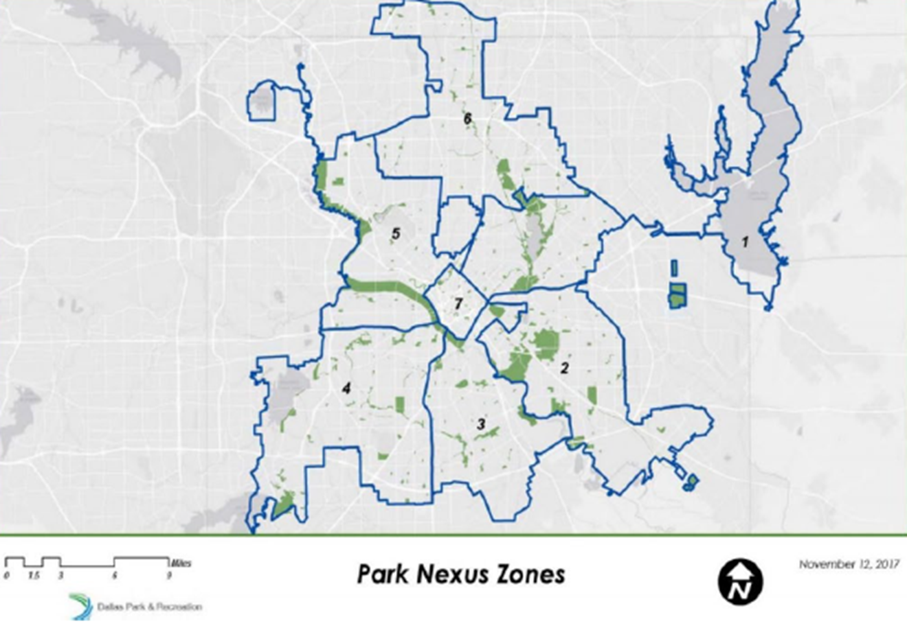
Park Nexus Zones (Current)
DCA234-002(LG)

Slide 15
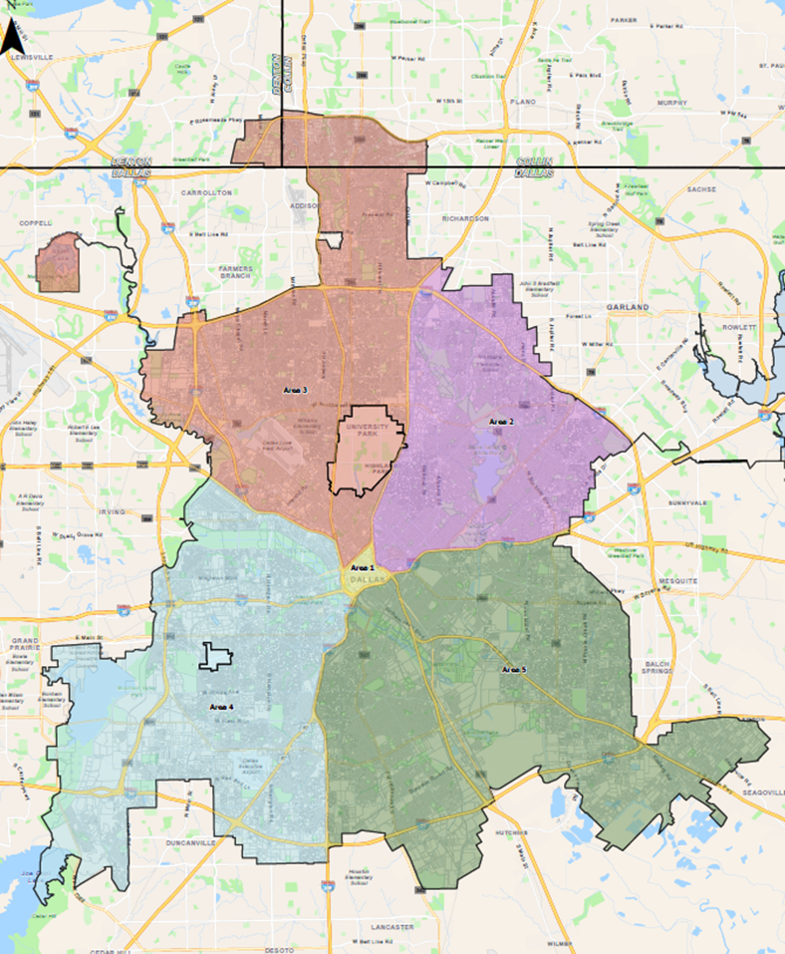
Park Nexus Zones (Proposed)
DCA234-002(LG)

Slide 16
Low Fee Calculation Formula
Single Family | Multifamily (1 bedroom) | Multifamily (2+ bedrooms) | Hotel/Motel
2% Dallas MFI (.02)($65,400) = $1,308 per dwelling unit | 1% Dallas MFI (.01)($65,400) = $654 per dwelling unit | 2% Dallas MFI (.02)($65,400) = $1,308 per dwelling unit | 1% Dallas MFI (.01)($65,400) = $654 per dwelling unit
DCA 234-002(LG)

Slide 17
Rationale for Low Fee Calculation
Simpler mathematic formula than standard calculation given by HB 1526 that allows for easier communication to the public and affected parties
Removes potential justification of appeals based upon appraisal district land values
Single family and multifamily (2 or more bedrooms) will pay the same rate
Hotel/motel uses will pay a lower rate as visitors are not the long-term beneficiaries of parkland dedication
Future fee increases will be tied to Consumer Price Index (CPI), which allows fee-in-lieu to keep up with inflationary costs
Reduces number of fees from two (fee-in-lieu and park development fee) into one (fee-in-lieu)
DCA234-002(LG)

Slide 18
Ordinance Revisions
The New Ordinance:
  Assigns all territory using the land use designations from HB 1526
  Urban Area
  Central Business District (CBD) Area
Requires appraisal districts to calculate average per acre land values for urban and CBD areas every 10 years (Next update: 2033)
Will utilize Consumer Price Index for fee adjustments for years 2-9
Will determine to set fees based on a fee-in-lieu to not exceed 2% of median family income based on the 5-year American Community Survey (ACS) Data
Will no longer charge a park development fee
In limited instances will require applicants to pay the fee-in-lieu and no more than 10% of the total acreage of the parcel based if parkland is needed to address park access in the area
Land dedication will have to meet the subdivision guidelines of the City of Dallas
DCA234-002(LG)

Slide 19
Ordinance Revisions (cont.)
The New Ordinance:
  Will require staff to write a parkland dedication determination letter within 30 days of the property owner’s request
  Will allow for an appeal process that requires review by the City Plan Commission, City Council and county courts if necessary (Collin, Dallas, and Denton counties)
  Will reduce number of park nexus zones from 7 to 5 while still complying with park nexus principles
  Affordable units are still exempt from parkland dedication, which is consistent with the current ordinance
  Will remove the ordinance from Section 51A-4.1000 to Section 51A-14.1000
DCA234-002(LG)

Slide 20
Draft Ordinance Language
Type of Development | Fee-in-lieu
Single family or duplex | Two percent of the median family income [$762.00] per dwelling unit
Multifamily [(one bedroom)] | One percent of the median family income per dwelling unit [$299.00]
[Multifamily (two or more bedrooms) | Two percent of the median family income $600.00
Hotel and motel | One percent of the median family income per dwelling unit [$327.00 per guest room]
[Type of Development | Park land development fee
Single family or duplex | $403.00 per dwelling unit
Multifamily (one bedroom) | $158.00
Multifamily (two or more bedrooms) | $317.00
Hotel and motel | $173.00 per guest room]
DCA234-002(LG)

Slide 21
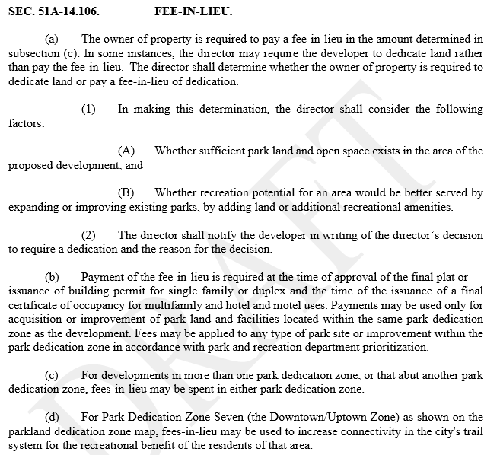
Draft Ordinance Language
DCA234-002(LG)

Slide 22
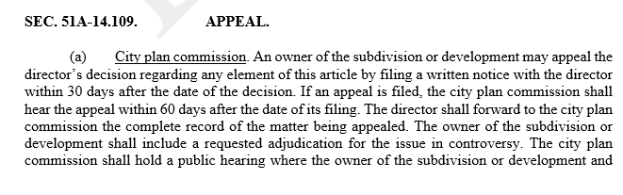
Draft Ordinance Language
DCA234-002(LG)

Slide 23
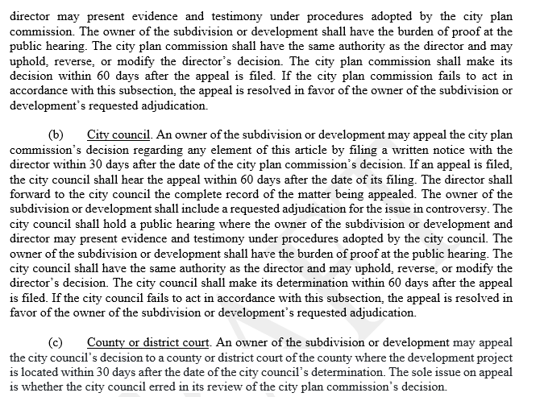
Draft Ordinance Language
DCA234-002(LG)

Slide 24
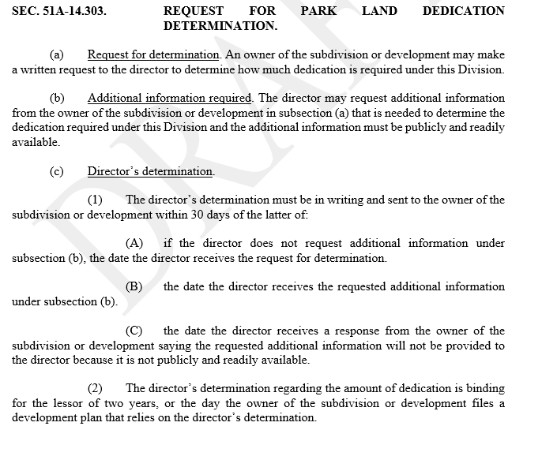
Draft Ordinance Language
DCA234-002(LG)

Slide 25
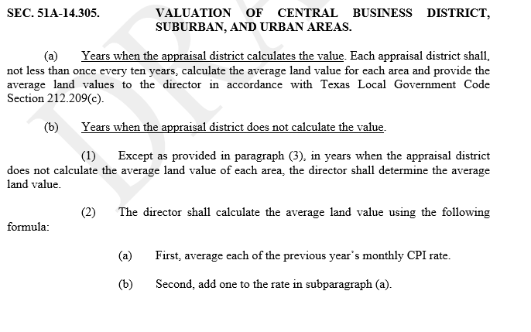
Draft Ordinance Language
DCA234-002(LG)

Slide 26
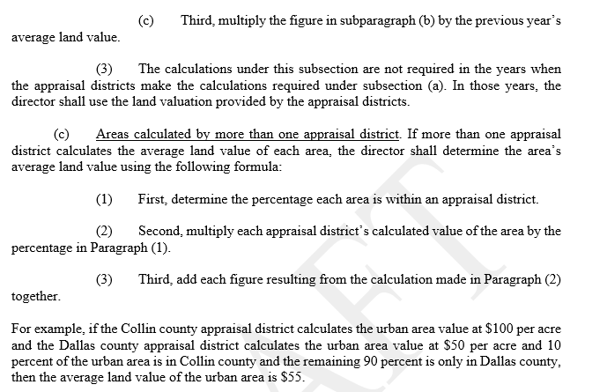
Draft Ordinance Language
DCA234-002(LG)

Slide 27
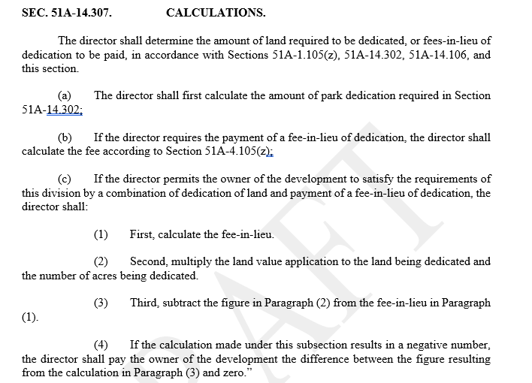
Draft Ordinance Language
DCA234-002(LG)

Slide 28
Proposed Changes made since 10/16/2024
Include clause exempting affordable housing units from parkland dedication fees
Change low fee to flat fee throughout the ordinance
Update proposed ordinance to reflect 1% for one bedroom units and 2% for two or more bedroom units
Land dedication requirements will be in letter of determination

Slide 29
Next Steps
Work with Planning and Development (PDV) on parkland dedication designation map to ForwardDallas Plan
Work with PDV, Housing (HOU) and all private development City staff to update the plan application process to reflect the new park land dedication ordinance
Work with DEV to add the new parkland dedication calculations in Accela and Cartegraph (scheduled for launch in 2025)
Ensure development community and residents are aware of the upcoming changes to ordinance
Create a webpage on the Park and Recreation website providing information about parkland dedication
Share draft ordinance with stakeholders and public to start the adoption process for the new ordinance
Approval process: ZOAC→ CPC → City Council
DCA234-002(LG)

Slide 30
Staff Recommendation
Approval, subject to conditions as briefed.
DCA234-002(LG)

Slide 31
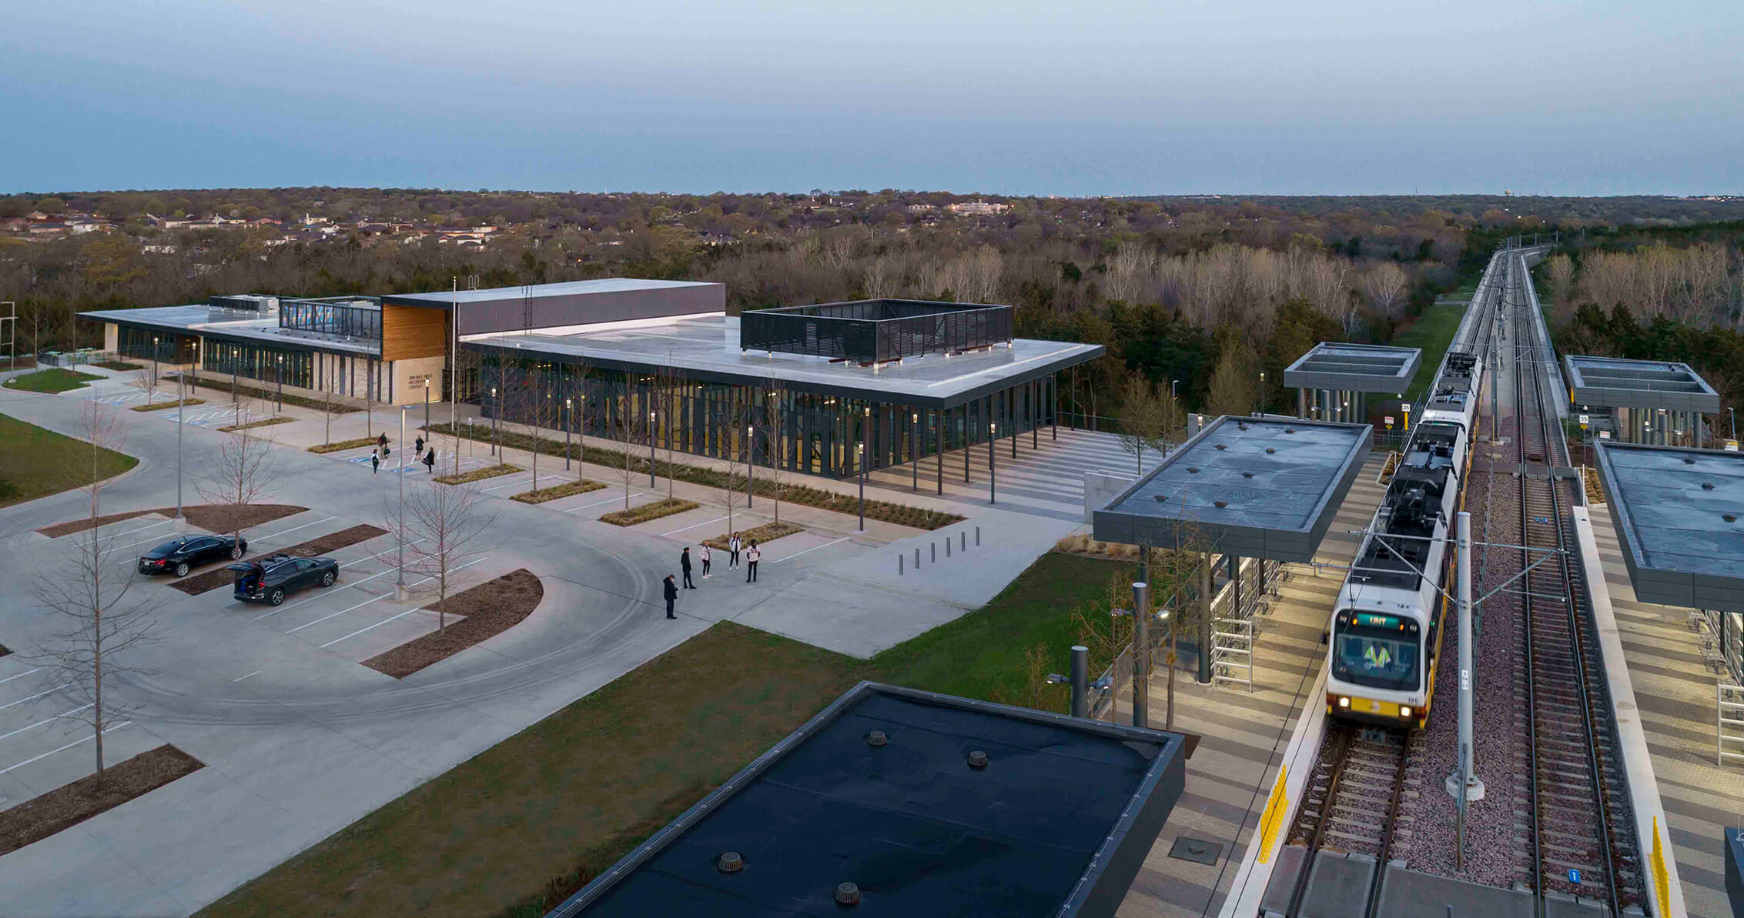
Questions and Comments
Photo: Singing Hills Recreation Center taken by Perkins and Will
DCA234-002(LG)

Slide 32
Web Page and Staff Contact Information
Link to webpage:
  https://dallascityhall.com/departments/pnv/Pages/Park-Land-Dedication-2024.aspx
Staff Contact:
  La'Kisha Girder, Manager – Parks Planning
  Dallas Park and Recreation Department
  lakisha.girder@dallas.gov
DCA234-002(LG)

Slide 33
DCA 234-002(LG)
Zoning Review Team
August 6, 2024
La'Kisha Girder
Manager-Parks Planning
Partnership and Strategic Initiatives
Dallas Park and Recreation

Slide 34
Appendix C-Sample Project Fee Calculations
 | Urban (250 Apartments, 2 or more bedrooms) | % Increase or Decrease | CBD (250 Hotel/Motel Rooms) | % Increase or Decrease
Current Ordinance | (250 x $600) + (250 x $317) = $229,250 | N/A | (250 x $327) + (250 x $173) = $125,000 | N/A
Proposed Ordinance | 250 x $1,308 = $327,000 | 42.64% | 250 x $654= $163,500 | 30.8%
DCA234-002(LG)

Slide 35
Appendix D-Fee Calculations Per Dwelling Unit
 | Single Family | Multifamily (1 bedroom) | Multifamily (2 or more bedrooms) | Hotel/Motel
Current Ordinance | Fee-in-lieu: $762/DU Park Dev. Fee: $403/DU Total: $1165/DU | Fee-in-lieu: $299/DU Park Development Fee: $158/DU Total: $457/DU | Fee-in-lieu: $600/DU Park Development Fee: $317/DU Total: $917/DU | Fee-in-lieu: $327/DU Park Development Fee: $173/DU Total: $500/DU
Proposed Ordinance | 0.02 x $65,400= $1,308/DU | .01 x $65,400= $654/DU | 0.02 x $65,400 = $1,308/DU | .01 x $65,400= $654/DU
Percent Increase | 12.27% | 43.11% | 42.64% | 30.80%
DCA234-002(LG)

