Slide 1
Transportation-for-Hire Announcements

Slide 2
ATTENTION
ALL TRANSPORTATION NETWORK/DIGITAL NETWORK COMPANIES AND DRIVERS, GOVERNED BY THE STATE OF TEXAS, NEED NOT APPLY FOR THE CITY OF DALLAS TRANSPORTATION-FOR-HIRE COMPANY OPERATING AUTHORITY OR DRIVER PERMIT!
ALL DRIVERS WORKING UNDER A TRANSPORTATION FOR HIRE (TFH) COMPANY PROVIDING TRANSPORTATION FOR HIRE SERVICES IN THE CITY OF DALLAS MUST OBTAIN A DRIVER’S PERMIT AND A VEHICLE PERMIT TO BE IN COMPLIANCE WITH CITY OF DALLAS CHAPTER 47A TRANSPORTATION FOR HIRE ORDINANCE
EXCLUDING ALL TRANSPORTATION NETWORK COMPANIES AS DEFINED BY TEXAS HOUSE BILL 100.
FOR MORE INFORMATION, PLEASE READ TEXAS HOUSE BILL 100 REGARDING TRANSPORTATION NETWORK COMPANIES:

Slide 3
ATTENTION
Transportation-for-Hire vehicle decal permits and other regulatory affairs are conducted:
8:30 a.m. – 12:30 p.m.
MONDAY and Tuesdays
Cash only
Company check
Money order
All fees are non-refundable

Slide 4
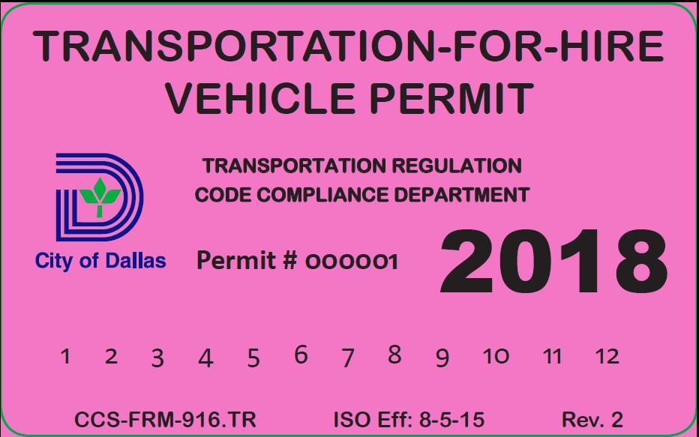
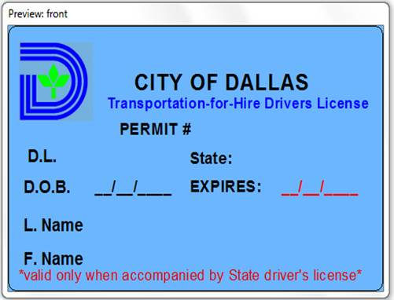
Requirements for a vehicle permit
A transportation-for-hire driver permit
The vehicle must be registered in the AVI-Transportation Regulation TFH system
A current state inspection
A state vehicle registration
Proof of valid operating authority insurance
Vehicle must be insured and registered with a valid TFH operating authority
Individual or driver insurance is unacceptable

Slide 5
Public Safety Advisory
Only take a ride in a licensed transportation-for hire vehicle operated by a permitted driver. The City ensures a background check has been completed on drivers and transportation-for-hire Company’s insurance has been checked.

Slide 6
Public Safety Advisory cont . . .
Four key things to look for before taking a ride in a hailable/taxi vehicle, limousine, rideshare or shuttle vehicle in the city of Dallas:
The vehicle has a current permit on the passenger’s side of the front windshield.
A display visible to passengers inside the vehicle which clearly shows the driver’s first name, picture, driver permit number and vehicle permit number.
Hailable/Taxi vehicles must have a roof mounted top light (example below) and the following information on at least one door on each side of the vehicle: the name of the operating authority company, vehicle permit number and rate of fare.
All transportation-for-hire drivers must have a City issued permit to operate a transportation-for-hire vehicle.

Slide 7
Fare and Rate Requirements
Hailable vehicles shall not charge any fare for providing transportation-for-hire service in the city that exceeds the maximum rates of fare authorized by the following schedule:
General fares.Initial meter drop $2.25
Each 1/9 mile $0.20
Traffic delay time/waiting time, per 1- 1/2 minutes $0.45
Each extra passenger (up to manufacturer’s rated seating capacity) $2.00
Love Field Airport fares.Each passenger-carrying trip departing from the airport (in addition to the general fare) $0.50
Minimum charge for each trip departing from the airport $8.00
Flat rate for each trip either originating at the airport and terminating at a location within the Dallas Central Business District area or originating at a location within the Dallas Central Business District area and terminating at the airport $21.00
Flat rate for each trip either originating at the airport and terminating at a location within the Dallas Market Center area or originating at a location within the Dallas Market Center area and terminating at the airport $18.00

Slide 8
Fare and Rate Requirements
Dallas-Fort Worth International Airport fares.
Minimum charge for each terminal transfer $7.00
Minimum charge for each trip that requires exiting the Airport parking plaza and terminates inside of airport property $14.50
Minimum charge for each trip that requires exiting the Airport parking plaza and terminates outside of airport property $17.00
Flat rate for each trip either originating at the airport and terminating at a location within the Dallas Central Business District area or originating at a location within the Dallas Central Business District area and terminating at the airport $45.00
Flat rate for each trip either originating at the airport and terminating at a location within the Dallas Market Center area or originating at a location within the Dallas Market Center area and terminating at the airport $37.00
Gasoline surcharge.A gasoline surcharge approved by the director may be added to a hailable vehicle fare when the average weekly retail price of regular grade gasoline in the State of Texas exceeds $2.00 per gallon as determined by the United States Department of Energy, Energy Information Administration.
The gasoline surcharge will be calculated in $0.50 increments and applied per trip. For every $0.50 increase or decrease in the average price per gallon of gasoline above the $2.00 threshold, the per trip surcharge fee will be adjusted $0.50 up or down to reflect the change in the average gasoline price.

Slide 9
Additional Hailable Requirements
Each driver of a hailable vehicle shall charge the rates of fare in accordance with the following terms and conditions:
The Dallas Central Business District, which is the area bounded by Woodall Rodgers Freeway on the north, Central Expressway on the east, R. L. Thornton Freeway on the south, and Stemmons Freeway on the west; and all points located within 1,000 feet of the Dallas Central Business District boundaries:
The Dallas Market Center, which is the area bounded by Medical District Drive on the northwest, Harry Hines Boulevard on the northeast, Oak Lawn Avenue on the southeast, and Irving Boulevard on the southwest
All points located within 1,000 feet of the Dallas Market Center boundaries
Extra passengers” means the total number of passengers, less one, riding in the same vehicle whether or not going to the same destination.
Traffic delay time” is that time, as set and determined by the meter, during which the vehicle is stopped in traffic or proceeding at a speed of less than 11.5 miles per hour due to traffic conditions.
Waiting time may be charged only when a passenger or party requests a vehicle to wait and be held exclusively for the use of that passenger or party.
Passengers in the same vehicle traveling between the same points must be considered as one trip, and a multiple fare may not be charged. The only extra charge permitted for additional passengers is the $2.00
A passenger or party must reimburse the driver for all lawful tolls paid during the time of engagement only if the passenger or party was notified of the toll route beforehand by the driver and did not object to the toll route.
All credit card payments must use a secure credit card processing method that encrypts information transmitted to authenticate a credit card payment transaction for approval.

Slide 10
Permitted Driver
Dallas Transportation Regulation has issued you vehicle permit(s) for the vehicle(s) you plan to use to provide transportation-for-hire services. The City of Dallas vehicle permit alone does not authorize you to operate in the City of Dallas as a transportation-for-hire service.
You must also: (1) have a valid City of Dallas transportation-for-hire driver’s permit and (2) be working for a valid City of Dallas transportation-for-hire operating authority. Providing transportation-for-hire service without a valid driver permit or without authorization from a valid operating authority can subject you to criminal penalties, ad result in towing and impoundment of your vehicle. If you do not have a valid driver permit or if you do not know if your operating authority is authorized by the City of Dallas, please contact our office for assistance at the number below. The relevant sections of the City of Dallas Transportation-for-hire ordinance are enclosed for your reference.

Slide 11
Relevant Sections of the City of Dallas Transportation-for-Hire Ordinance
SEC. 47A-2.3.1. VEHICLE PERMIT REQUIRED.
No vehicle may be used to provide transportation-for-hire services without a valid permit for that vehicle issued under this article.
SEC. 47A-2.3.4. DISPLAY OF VEHICLE PERMIT.
(a) A person commits an offense if he:
(1) operates a transportation-for-hire vehicle with an expired vehicle permit or with no vehicle permit affixed to the vehicle;
(2) attaches a vehicle permit to a transportation-for-hire vehicle not authorized to operate as a transportation-for-hire vehicle;
(3) forges, alters, or counterfeits a transportation-for-hire vehicle permit required by this section; or
(4) possesses a forged, altered, or counterfeited transportation-for-hire vehicle permit required by this section.
(b) A transportation-for-hire vehicle permit assigned to one vehicle is not transferable to another.

Slide 12
Relevant Sections of the City of Dallas Transportation-for-Hire Ordinance cont…
SEC. 47A-2.2.1. DRIVER PERMIT REQUIRED.
(a) A person may not drive a transportation-for-hire vehicle without a valid driver permit issued under this article.
SEC. 47A-2.1.1. OPERATING AUTHORITY PERMIT REQUIRED.
(a) A person may not operate a transportation-for-hire service inside the city without operating authority granted under this chapter.
(b) A person may not transport a passenger for hire inside the city unless the person driving the transportation-for-hire vehicle or another who employs or contracts with the driver has been granted operating authority under this chapter.

Slide 13
Relevant Sections of the City of Dallas Transportation-for-Hire Ordinance cont …
SEC. 47A-4.3. TOWING AND IMPOUNDING.
A vehicle shall be towed and impounded if determined by the director or any peace officer to be operating as a transportation-for-hire vehicle without:
(1) the operating authority required by this chapter,
(2) a driver permit required by this chapter,
(3) a vehicle permit required by this chapter, or
(4) the insurance required by this chapter.
SEC. 47A-4.7. CRIMINAL OFFENSES.
(a) A person commits an offense if he violates or attempts to violate a provision of this chapter, or a rule or regulation established by the director under this chapter, that is applicable to the person. A culpable mental state is not required for the commission of an offense under this chapter unless the provision defining the conduct expressly requires a culpable mental state. A separate offense is committed each day in which an offense occurs.
(b) Prosecution for an offense under Subsection (a) does not prevent the use of other enforcement remedies or procedures applicable to the person charged with or the conduct involved in the offense.

