Slide 1

Landscaping Dallas
Philip Erwin, Chief Arborist
Land Development Division
Development Services Department
City of Dallas
November 16, 2022
Development Services Training Center
400 S. Zang Blvd, C95
Dallas, TX 75208

Slide 2

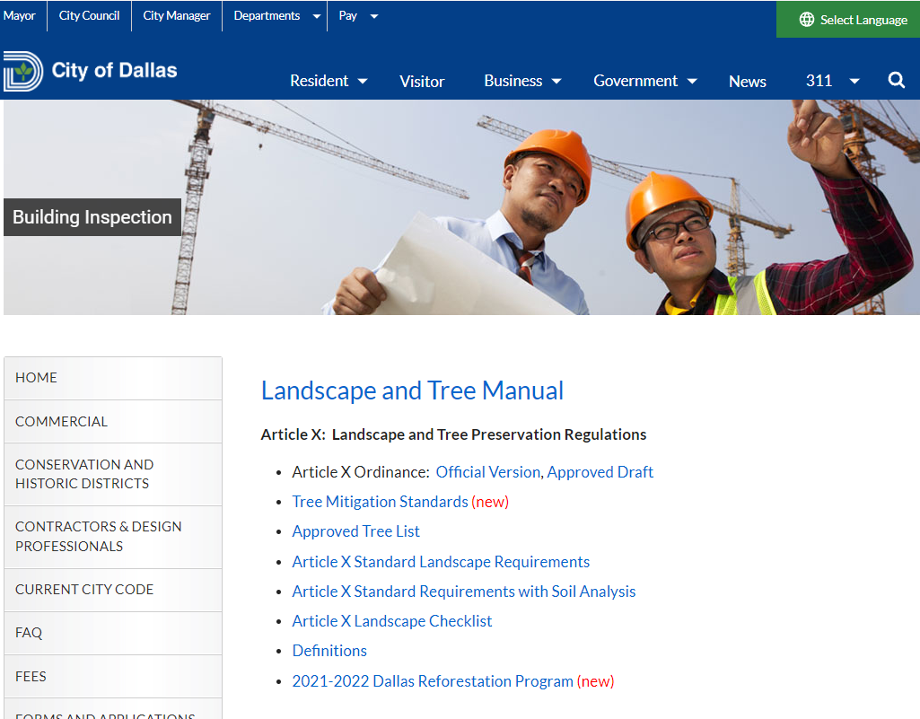
Arborist Staff
Landscape and Tree Manual is online!
https://dallascityhall.com/departments/sustainabledevelopment/buildinginspection/Pages/landscape-and-tree-manual.aspx
Phil Erwin – Manager
Clay Walker (SW)
Tina Standeford (SE)
Tony Johnson (NE)
Jessie Farris (NW)
Mark Soliva (Q-Team)

Slide 3
Presentation Overview
Landscaping since the 1980’s.
Today’s ordinances and focus.
Landscaping principles guiding ordinance.
Landscaping the residential uses.
Landscaping for all other uses.
Finding our Dallas forestry resources.
Questions need answers.

Slide 4
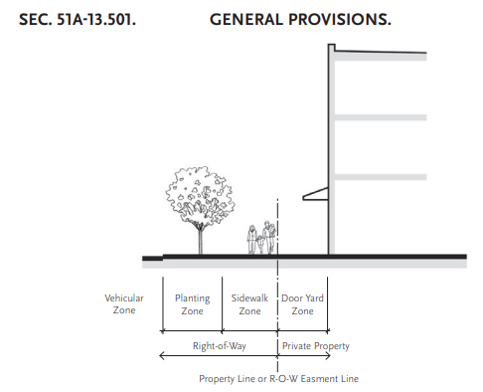
Background/History
Pre-ordinance landscapes by PD or SUP.
PD 193 Oak Lawn code led to the city-wide Article X landscaping code in 1986.
1994 Article X revision and later amendments.
2008+ Article XIII Form District ordinance.
2018 Article X amendments

Slide 5
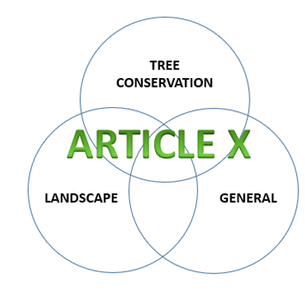
Background/History
Article X
1986
1994
2003
2018 ….
Other Ordinances
PD 193 (Oak Lawn SPD)
PD 317 (Cedars SPD)
PD 714
PD 741, etc., etc., etc.
Also…
Specific Use Permits
Board of Adjustment approvals
Planned Developments
Article X-based
Other standards
With LA plans
Without LA plans
Article XIII
2008 ….

Slide 6
Principles of Article X Landscaping
Provide essential soil volume and quality.
Avoid and amend city infrastructure.
Plan the properly-scaled landscaping for 30 to 60 years of growth.
Preserve large healthy canopy trees when able.
Landscaping conforms to the development.

Slide 7
Article X Landscape Review
Single family and duplex (10.125(a) ONLY)
Shared access developments (10.125(a) ONLY)
Other uses (everything else)
10.100 General Division applies throughout.
10.130 Tree Conservation Division applies to all properties, with stated exceptions.

Slide 8
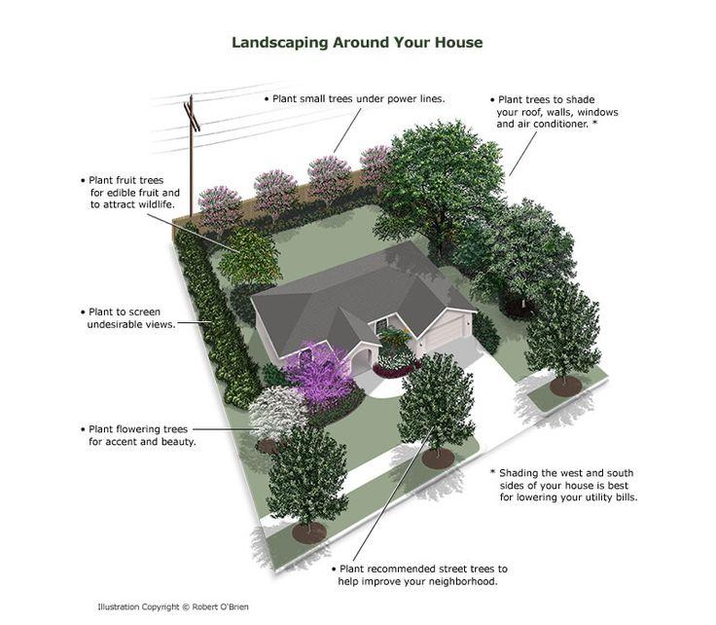
Article X: Single family and Duplex
Lots 7,500 sf or greater:
  3 large/medium NEW trees (min. of 2 in front yard)
Lots 4,001 sf – 7,499 sf:
  2 large/medium NEW trees (min. of 1 in front yard)
Lots 4,000 sf or less:
  1 large/medium NEW tree
Residential plan review – Building Inspector inspection

Slide 9
Article X: Shared Access Development
Landscape plan must be approved before a grading permit or private development contract is approved.
Apply 1 tree per 4,000 sf of SAD total area.
Landscape area is determined by the number of units:
  Up to10 lots must have 10% LA
  11-36 lots must have 15% LA

Slide 10
Article X: Other Uses – Triggers for LA
Adding 2000 sf of ‘nonpermeable coverage’
Permit for new floor area (35% or 10,000 sf)
Permit for new height and story increase
10.125(b) – Mandatory Provisions
10.126 – Landscape Design Options

Slide 11
Article X: Application - 10.121
CA (Central Area) districts apply Article X, but Article X excepts CA districts.
Some PD’s (Deep Ellum, Oak Lawn, Arts District) are automatically excepted.
Aviation can override Article X requirements.
City Council must impose landscaping in compliance with 10.104 and 10.123.

Slide 12
Artificial Lots
Sec. 10.122 – Artificial lots on sites > 2 acres.
  Building official approves when the AL does not violate the spirit of the regulations.
  It must wholly include the workspace area.
  Must not exceed 50% of the entire building site.
  Include paving areas (may except walkways).
  Include the Street Buffer Zone within 60’ of front.
  Include the Residential Buffer Zone within 60’.
  Area is not platted but shown on building plans.

Slide 13
Landscape Submission
Sec. 10.123 – Landscape submission
  Standard information (Scale, names, etc.)
  Natural formations, utilities, utility easements
  Plant materials
  Existing tree locations and transplants
  Proposed watering methods
  Use for all new council approved LA plans.

Slide 14
Landscape Review and Revisions
NEW to 2018 amendments:
10.124- Minor revisions can occur to plans that otherwise comply with Article X for:
  Substitutions to appropriate plant species, OR
  Revisions required by utility conflicts, OR
  Locations of plant materials up to 10 feet.
Revisions must further the spirit and intent of the ordinance (may alter locations of planting, but not reduce required amount.)
Not applicable to 10.125(a): SF/Du and SAD’s.

Slide 15
But first….Section 10.104: Key to Art. X
Soil resource plan or assessment is required.
Planting area requirements for tree size
  Small: 25 sf of open soil area minimum
  Large/medium: 160 sf of open soil AREA minimum
Distance from pavement
Soils or engineered conditions for the tree
Landscape protection (curbs, etc.)
Planters must meet 10.104 soil conditions

Slide 16
Except that….
Legacy trees require more soil area and space.
Urban streetscapes and planting above structures (i.e., garages) requires less area.
  Small: 25 sf of open soil area
  Large/medium: 25 sf open & 240 cubic ft. (VOLUME) of combined open, covered, root path, engineered for the tree.
A waiver may be granted to a landscape architect who certifies that alternative conditions support the healthy and vigorous growth of the plants.

Slide 17
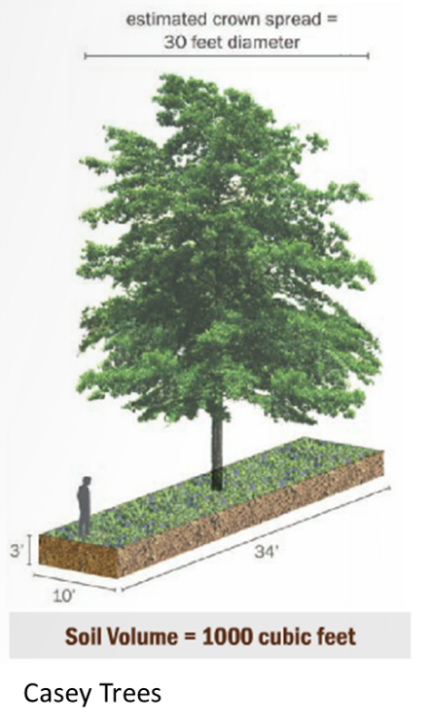
Tree Locations - Distances
10.104
The 2018 ordinance established minimum distances for trees from property boundaries, utilities, light posts, and pavement while establishing baselines for distances between small, medium and large trees from each other, and from electrical lines, and other structures.
These are required to be followed but may be subject to further review under specific conditions presented by the landscape architect.

Slide 18
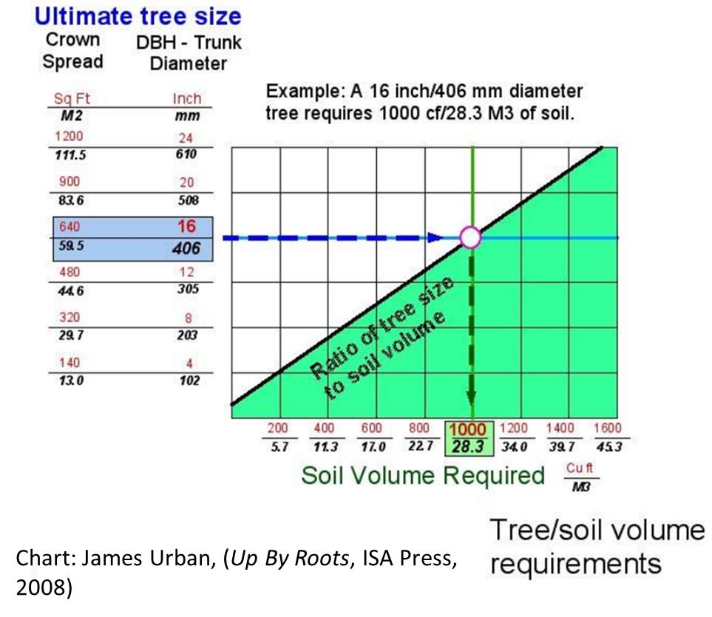
Article X: Other Uses - Mandatory
Street Buffer Zone (SBZ)
Residential Buffer Zone (RBZ)
Interior Zone
  Surface parking lots
  Additional provisions:
    Screening/off-street loading
    Site trees

Slide 19
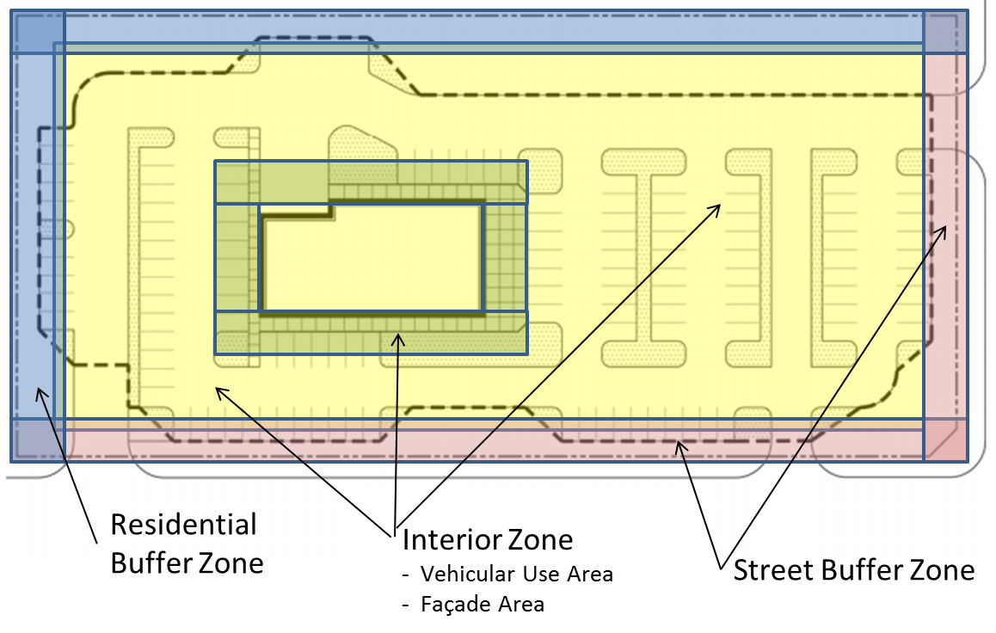
Article X: Mandatory Provisions
Street Buffer Zone (SBZ)
Residential Buffer Zone (RBZ)
Interior Zone
  Surface parking lots
  Additional provisions:
    Screening/off-street loading
    Site trees

Slide 20
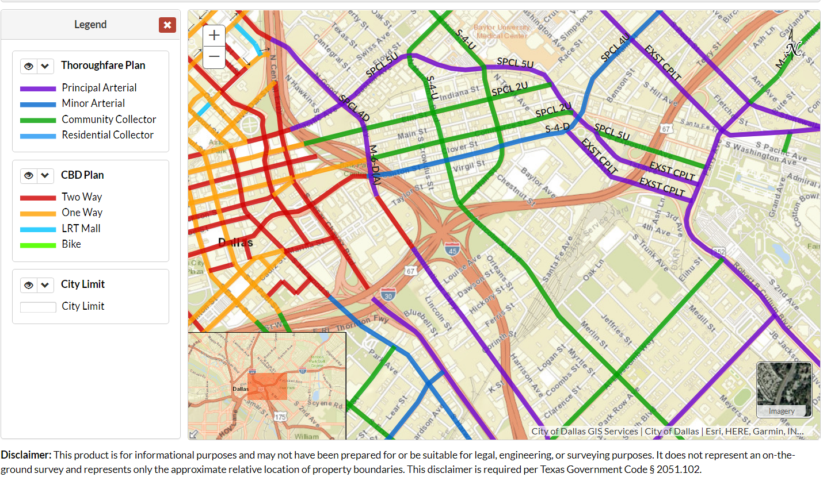
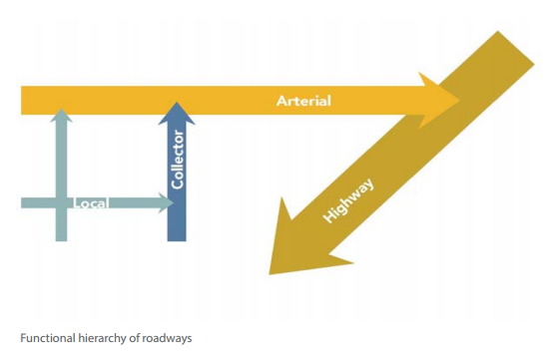
Article X: Street Buffer Zone (SBZ)
Right-of-way
Average Depth Minimum Depth Maximum Depth
Freeways (open highway; no frontage road access)
15 feet 5 feet 50 feet
Arterials and community collectors (thoroughfare)
10 feet 5 feet 30 feet
Local and residential collectors (minor streets)
7.5 feet 5 feet 25 feet
The Thoroughfare Plan is available at Dallas.gov.

Slide 21
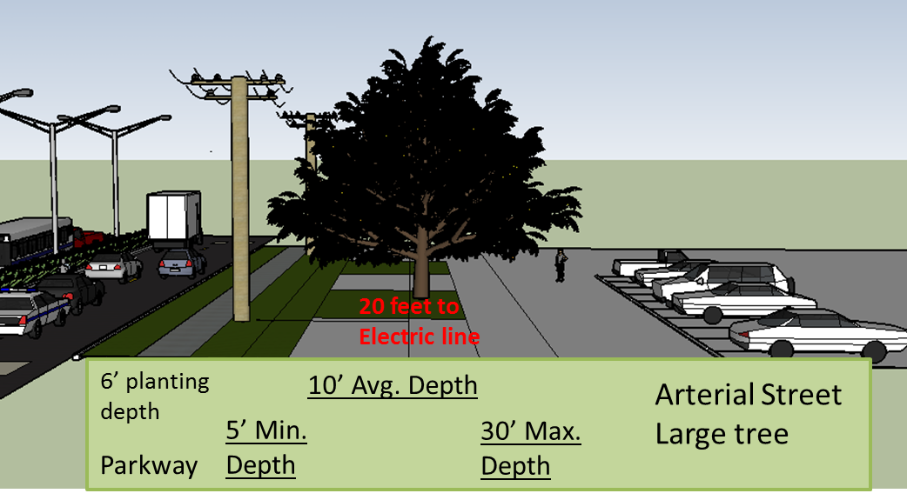
Article X: Street Buffer Zone (SBZ)
Urban Streetscape
Right-of-way uses
Required planting
Buffer zone reductions for small lots

Slide 22
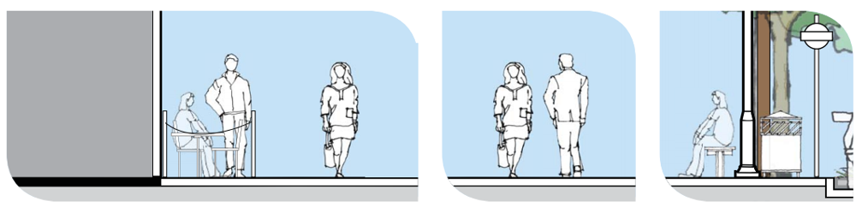
SBZ: Urban Streetscape
URBAN STREETSCAPE means the pedestrian-oriented street environment between the back of curb and building facade for frontages that have a required front yard of 15 feet or less in depth.

Slide 23
SBZ: Urban Streetscape
The BO may approve…
Minimum 6’-wide planting area with 10.104 soil requirements
Open and/or covered soil areas
Planting area measured from property line or curb based on physical restraints.
1+ design options required in urban streetscape
Urban streetscape concept is similar to Article 13 conditions for the combined ROW and property street pedestrian frontages.

Slide 24
SBZ: Additional provisions
ROW used if minimum of 5’ open soil depth along the property, utility locations will allow, suitable planting locations, and permit and license requirements.
3” large/medium trees at 1 per 40’ of frontage, or 2 small trees for each 1 L/M tree, with electric conflicts.
Buffer zones reduced for lot size, and plantings eliminated for frontages < 20 linear feet.

Slide 25
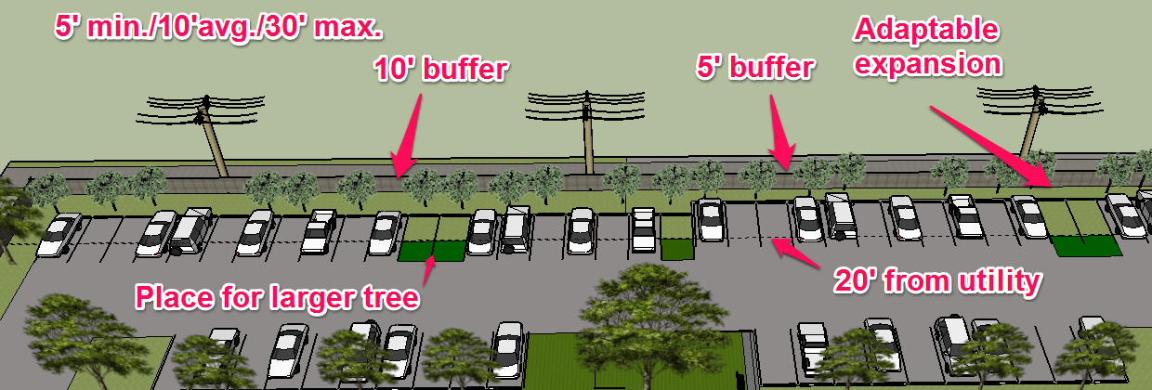
Article X: Residential Buffer Zone (RBZ)
Residential adjacency requires a 10’ average RBZ. 1 plant group per 40 feet of frontage.
Screening required: 1 large/medium tree/40’.
Screening not required: 1 plant group (trees & shrubs).
Small trees may be provided for electric line conflicts.

Slide 26
Article X: Interior Zone – Surface Parking
Large and medium trees
3” caliper minimum
Planting in landscape area
Center of trunk must be at least 4-feet from pavement.
Individual landscape area is 160 sf minimum, width of 8’ minimum.

Slide 27
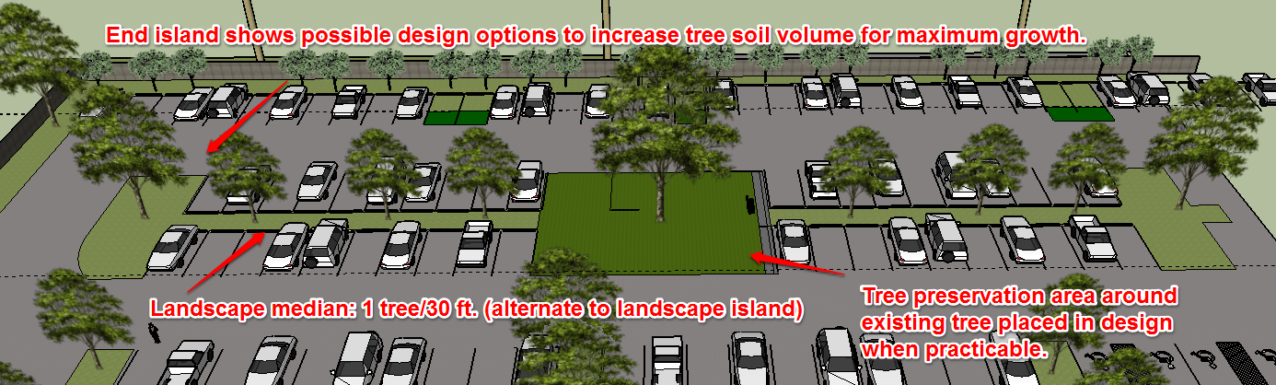
Article X: Interior Zone – Parking Lots
21-100 parking spaces
  No more than 70’ from large/medium tree
101 or more parking spaces
  Same as above, and
  Landscape islands (or alternative medians) used at end of parking rows with large/medium trees.
  Alternative for IM/IR districts and industrial/warehouse uses with intensive SBZ planting above standard.

Slide 28
Article X: Interior Zone – Parking Lots
Landscape island conditions may be waived for tree preservation and for protecting natural features.
Parking islands are not required adjacent to handicap spaces.

Slide 29
Article X: Additional Provisions
Screening/ off-street loading spaces
Site Trees
  1 tree per 4000 sf, or 1 per 6000 sf for IM/IR districts with industrial/warehouse uses.
  Trees must be min. 2”.
  Existing site trees obtain additional credit if provided on landscape plan.
Site tree credit is ONLY a process for site trees in landscaping in 10.120. It does not apply to tree conservation purposes in 10.130.
CALIPER OF RETAINED TREE NUMBER OF SITE TREES CREDIT
Less than 2 inches 0
2 inches or more but less than 8 inches 1
8 inches or more but less than 14 inches 2
14 inches or more but less than 20 inches 4
20 inches or more but less than 26 inches 8
26 inches or more and less than 32 inches 10
32 inches or more but less than 38 inches 18
38 inches or more 20

Slide 30
Article X: Landscape Design Options

Slide 31
Article X: Landscape Design Options

Slide 32
Article X: Landscape Design Option Points
Lot Size Points Required
0 to 999 sf 0
1,000 sf to 1,999 sf 1
2,000 sf to 9,999 sf 2-9
(One point for every 1000 sf)
10,000 sf to 19,999 sf 10
20,000 sf to 39,999 sf 15
40,000 sf to 2.99 acres 20
3 acres to 9.99 acres 30
10 acres to 19.99 acres 35
20 acres to 49.99 acres 40
50 acres and greater 50

Slide 33
Article X: Landscape Design Options
11 categories of landscape design options
  Buffer zone enhancements
  Application of engineered solutions for soil volume
  Screening (of off-street parking)
  Building façade (foundation planting)
  Pedestrian uses
  Pavements

Slide 34
Article X: Landscape Design Options (cont.)
  Conservation
  Low-impact development
  Parking lots (most options)
  General
  Plant material bonus (first is last)
    “Points may be provided for plant materials added to the landscape design when the required amount of points for a standard design option is deficient by five points or less.
    All added plant materials must be provided in the front yard.
    The maximum number of points allowed per building site for the plant material bonus is five.”

Slide 35
Article X: Landscape Design Options (cont.)
  1) Plant material bonus 5 points maximum. Plant materials added to the
  landscape design when the required amount of points for a standard design option is deficient by five points or less. All plant material must be placed in the front yard.
  Added
  ___ Large shrub 0.25 pts.;
  ___ Small tree 0.5 pts.;
  ___ Large/medium tree 1 pt.

Slide 36
Article X: Landscape Design Options (cont.)
(2) Buffer zone enhancements -20 points maximum–Each required buffer zone depth may be increased by a minimum number of feet. It is not available where the street buffer zone is reduced to no more than 5% of lot area.
Options:
_____ Large enhanced buffer zone
(5 feet): 5 pts.
_____ Small enhanced buffer zone
(2 feet): 2 pts.

Slide 37
Article X: Landscape Design Options (cont.)
  (3) Engineered solutions for soil volume
  10 points maximum. Use engineered solutions for providing soil volume for a minimum of 75% of required street buffer trees.
  Options:
  ____ Minimum required soil volume, 5 pts.;
  ____ increase 10% above minimum requirements, 6 pts.;
  ____ + 15%, 7 pts.;
  ____ + 20%, 8 pts.;
  ____ + 25%, 9 pts.;
  ____ + 30% or more, 10 pts.

Slide 38
Article X: Landscape Design Options (cont.)
  (4) Screening.
  20 points maximum. Screen all parking lots on the lot along the entire adjacent public street frontages on a building site or artificial lot, excluding driveways and visibility triangles. Screening must be voluntary.
  Options:
1) ____ Standard design (shrub ht. min. of 2’ at installation), 5 pts.;
2) ____ Enhanced design*, 10 pts.;
  3) ____ Grouped beds, 5 pts.**;
  4) ____ Screening wall or fence (min. ht. of 3’), 5 pts.**;
  5) ____ Berm (min. ht. of 3’), 5 pts.**
*Landscape architect required.
** May complement Option 1 or Option 2.

Slide 39
Article X: Landscape Design Options (cont.)
  (5) Building facade
  15 points maximum. Facade planting areas adjacent to public
  streets or private driveways.
  Options:
  1) ____ Standard design, 5 pts.;
  2) ____ Enhanced design*, 10 pts.;
  3) ____ Additional grouping of medium/small trees, 5 pts.;
  4) ____ One small tree per 30 ft. within 15 feet of facade, 5 pts.
*Landscape architect required.

Slide 40
Article X: Landscape Design Options (cont.)
  (6) Pedestrian uses
  25 points maximum. Provide private or publicly accessible
  pedestrian facilities for at least 5% of the building site.
  Options:
  ____ Urban streetscape (minimum of 2 amenity types):
  ___ Benches;___ Lamps; ____ Enhanced sidewalk(not available for option 7); ___ 8 ft. Unobstructed sidewalk; ____ Water feature;10 pts.
  2) ____ Special amenities in building site, 5 pts. (private), 10 pts. (public);
  3) ____ Habitat restoration adjacency, 10 pts. (private), 15 pts. (public);
  4) ____ Athletic fields, 10 pts., or 20 pts. (on lots over 10 acres).

Slide 41
Article X: Landscape Design Options (cont.)
  (7) Pavements
  15 points maximum. Provide enhanced or special pavement to a
  minimum of 25% of all outdoor vehicular pavement, or 5% pedestrian use pavement, on the lot, as applicable.
  Options:
  1) ____ Enhanced vehicular pavement: Texture 3 pts., Color 3 pts.;
  2) ____ Permeable vehicular pavement, 5 pts.;
  3) ____ Enhanced pedestrian walkways: Texture 3 pts., Color 3 pts.

Slide 42
Article X: Landscape Design Options (cont.)
  (8) Conservation
  25 points maximum. Provide conservation programs on the property. It must occupy at least 5% of the lot area.
  Options:
  1) ____ Tree preservation in development impact area, 2 pts. for each tree
  up to 10 pts.;
  2) ____ Habitat preservation and restoration (native grassland or woodland), 5 pts.;
  3) ____ Habitat preservation and restoration active management plan, 10
  pts.;
  4) ____ Habitat preservation and restoration adjacent to primary natural
  areas, 15 pts.

Slide 43
Article X: Landscape Design Options (cont.)
  (9) Low Impact Development
  20 points maximum . Improve the property with design to manage stormwater flow and provide surface heat abatement.
  Options:
  1) ____ Rain garden, max. 6 pts.;
  2) ____ Bioswale , max. 10 pts.;
  3) ____ Water-wise plant materials and planting beds; max. 10 pts.

Slide 44
Article X: Landscape Design Options (cont.)
  (10) Parking Lots
  30 points maximum for DIA 10 acres or larger; 20 points maximum for DIA
  less than 10 acres.
  Options:
  1) ____ Pedestrian pathway, 5 pts.;
  2) ____ Parking islands maximum of 10 parking spaces between landscape islands, 5pts.;
  3) ____ Parking islands increase landscape area a minimum of 200 sf for each large/medium tree.
  ____ +50% of required islands, 5 pts.
  ____ +75% of required islands, 10 pts.
  4) ____ Parking islands increase landscape area a minimum of 300 sf for each
  large/medium tree.
  ____ +50% of required islands, 7 pts.
  ____ +75% of required islands, 12 pts.
  5) ____ Parking islands each additionalparking island provided, 3 pts.

Slide 45
Article X: Landscape Design Options (cont.)
  (10) Parking Lots, continued
  6) ____ Landscape medians provide a minimum of 10 ft. wide landscape median with large/medium trees for a minimum of a 12-space parking row, 5 pts.
  7) ____ Landscape medians provide a minimum of 12 ft. wide landscape median with large/medium trees for a minimum of 12 space parking row, 10 pts. for each full median for a maximum of 20 points on the lot.
  8) ____ Landscape medians provide a minimum of 16 ft. wide landscape median with large/medium trees for a minimum of 12 space parking row, 15 pts. for each full median for a maximum of 30 points on the lot.
  9) ____ Large trees located in minimum of 500 sf dedicated open soil area, 2 pts. for maximum of 20 pts.
  10) ____ Pocket park. Provide a minimum of 2,500 sf of contiguous open soil surface area, 20 pts.

Slide 46
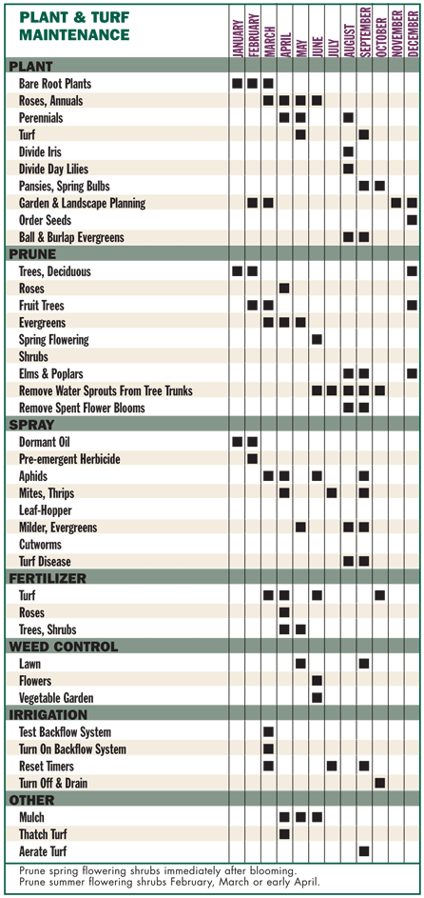
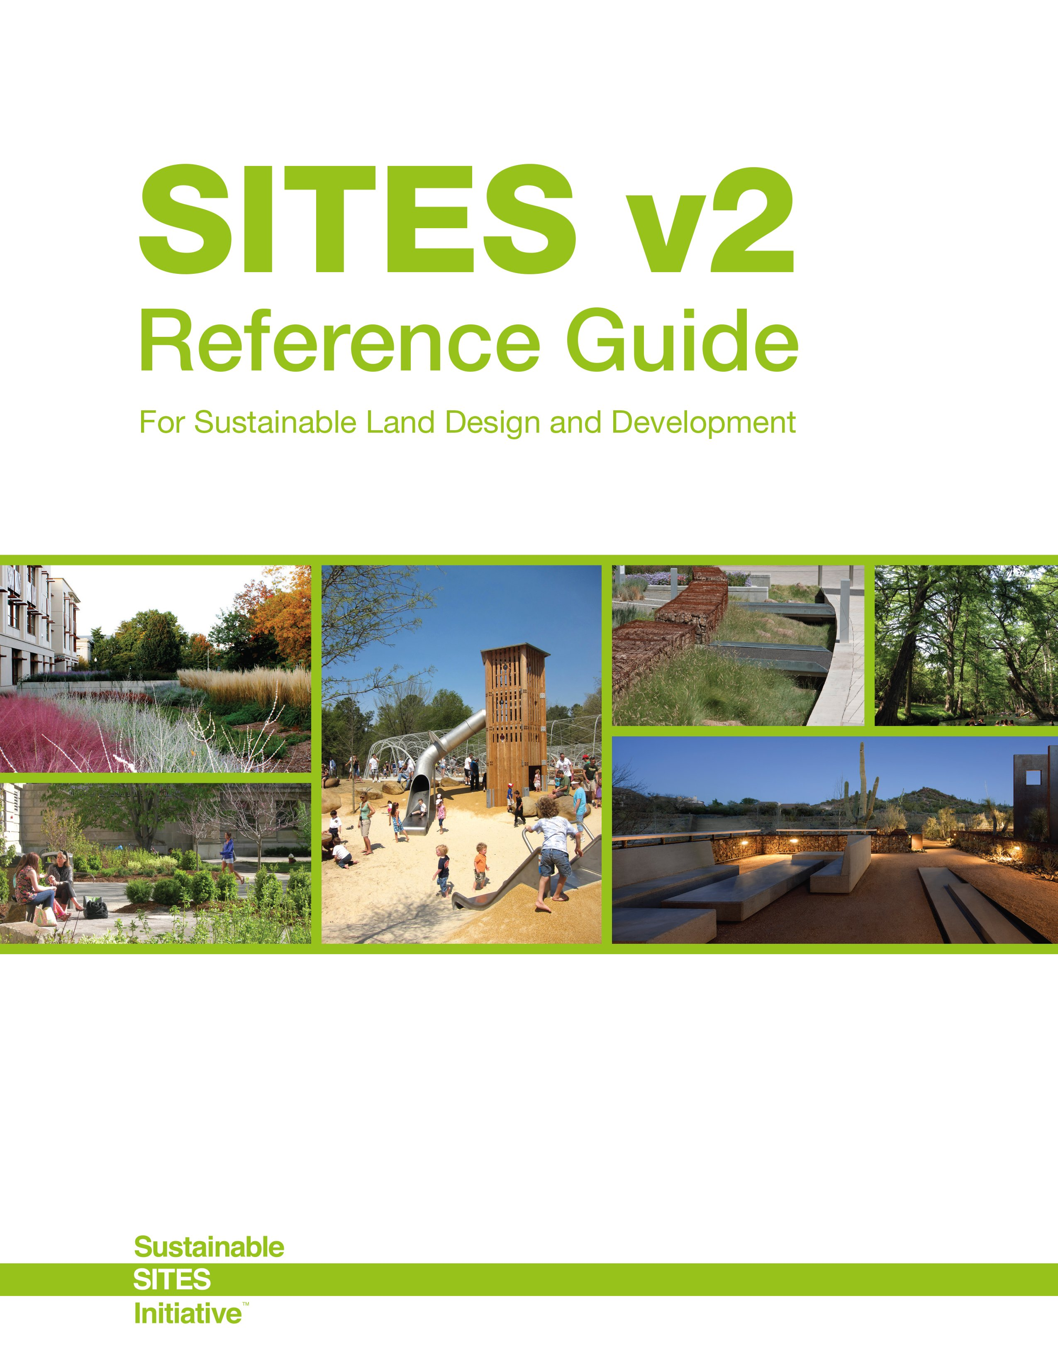
Article X: Landscape Design Options (cont.)
  (11) General.
  Provide documentation and demonstrate ability to achieve any of the following conditions.
  Options:
  1)____ Provide SITES (Sustainable Sites Initiative) documentation and
  demonstrate ability to attain SITES certified level (65 points) or greater, 10 pts.
  2)____ Provide and implement a landscape maintenance plan for a
  minimum of a 3-year period, 3 pts.

Slide 47
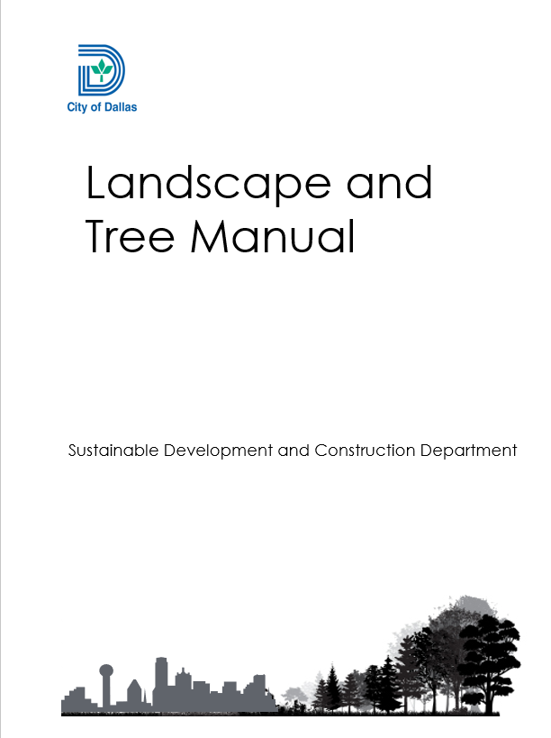
Landscape and Tree Manual
The supplemental manual is available on the Dallas.gov website. You can find it in several locations including the Forestry page and under Resources.
Includes the updated Approved Tree List which has removed all ash species.
Ordinance amendments in the appendix.

Slide 48
Landscaping Dallas
November 16, 2022
Philip Erwin, Chief Arborist
Development Services Department
City of Dallas

