Slide 1

A Brief Introduction to the City of Dallas Engineering Division Review & Approval Process
Water/Wastewater & Paving/Drainage Engineering Outreach Lunch-and-Learn Presentation
M. Samuell Eskander, PE, CFM, Assistant Director
Linda Velez, PE, Engineering Program Administrator
Development Services
City of Dallas

Slide 2
Who We Are
Development Services – Land Development Team
Engineering Division
Represent Department of Public Works and Dallas Water Utilities by reviewing Engineering Plans, Permit Drawings, and Survey Documents to verify compliance with City of Dallas code, standards, and policies as it relates to Private Development.
Andrew Espinoza – Director
Sam Eskander, PE, CFM – Assistant Director
Linda Velez, PE – W & WW Engineering Program Administrator
Thuc Pham, PE – P & D Engineering Program Administrator
Brandie McKenzie – Manager Development

Slide 3
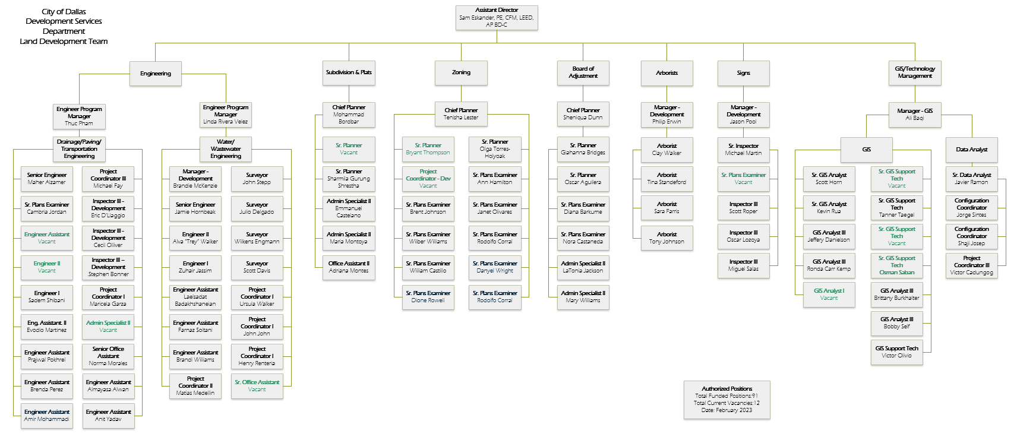
Land Development Org Chart

Slide 4
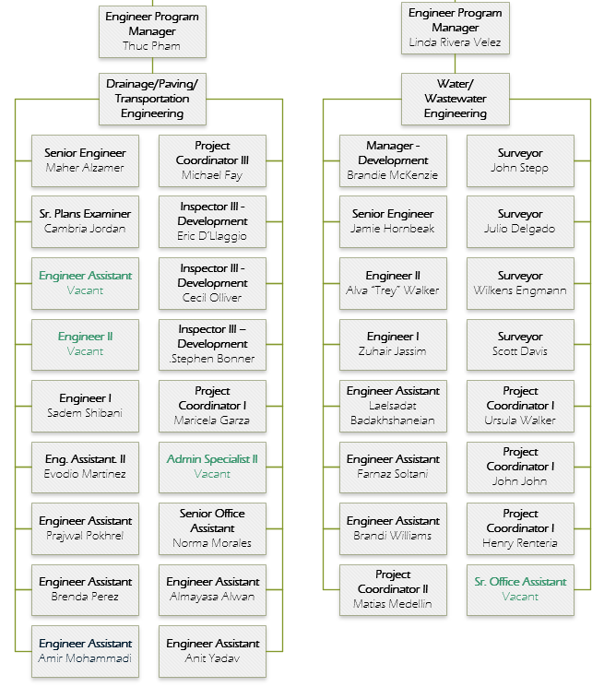
Engineering Division Organization Chart

Slide 5
Agenda
Introductions
  Although we follow DWU & PBW standards, we are a separate department that focuses on water/wastewater & paving/drainage improvements related to Private Development projects (i.e., We are not DWU – Main St).
Objective
  Discuss the process for an efficient plan submittal.
General Overview Permit Review Process
  Review the Water/Wastewater & Paving/Drainage checklist to ensure all necessary items are addressed.
  Review the process for submitting field notes for separate instrument easements and backflow agreements.
  Discuss the “hot zones” for construction around Dallas, and the process for submitting plans in these areas.
Water/Wastewater Engineering Process & Tips
Paving/Drainage Engineering Process & Tips

Slide 6
Our Objectives for Today’s Class
GOAL – Partner with the development community and professional consultants to improve the review and approval experience.
Strengthen communication between the development team and the City.
Provide guidance on:
  the engineering plan review and permit process.
  common mistakes and repetitive review comments.
Improve the efficiency of project reviews.

Slide 7
Engineering Plan Review Submittal Process
If platting, must have an approved preliminary plat before you can submit Civil Plans (Reference 51A-8.404)
Verify the CPC Conditional Approval Letter requirements
Note: Paving/Drainage and Water/ Wastewater Engineering submittals require separate reviews and fees.

Slide 8
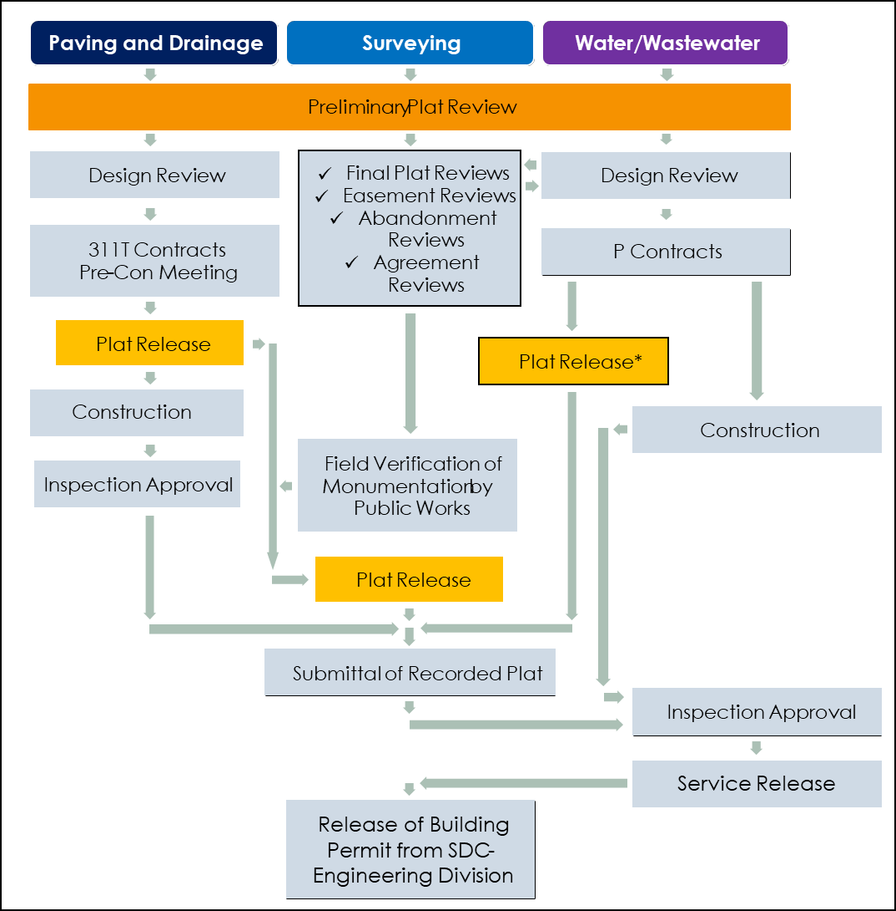
Engineering Flow Chat
The following flow chart exhibit is a general guideline for the development process as it relates to Development Services, i.e., Paving/Drainage, Water/Wastewater, and Surveying.
Each project’s review process contains multiple variables which affects its critical path.
*** Easements and Agreements by Separate Instrument MUST be recorded prior to any plat and permit release. It is the developer’s & engineer’s responsibility to plan and manage the project schedule accordingly. Failure to do so does not warrant any variance from this Section’s policy.

Slide 9
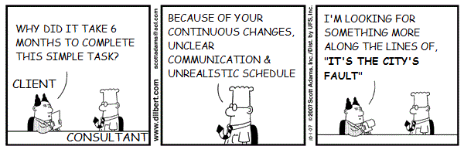
Quality Submittals = Efficient Review Process
CREDIT: CARTOONSTOCK.COM

Slide 10
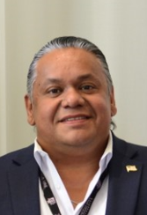

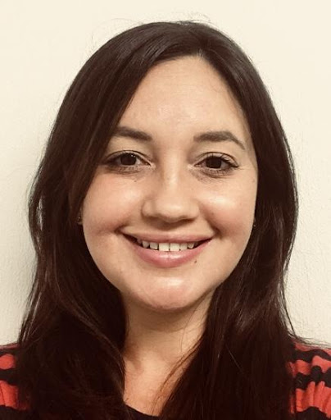

Who We Are
Andrew Espinoza
Director
Sam Eskander
Assistant Director
Linda Velez
Water/Wastewater Engineering
Program Administrator
Thuc Pham
Paving/Drainage Engineering
Program Administrator

Slide 11

Who We Are, Con’t
Administrative Staff:
  Charmae Robertson – Senior Office Assistant
  Norma Morales – Senior Office Assistant
Manager Development:
  Brandie McKenzie
Contract Administrator:
  Michael Fay
Permit Reviewers :
  Henry Renteria
  Mathew John
  Ursula Walker
Dallas Fire & Rescue Representative:
Ricky Butler – Room 204
  Monday – Thursday
  (469) 323-5980
Fire Protection Engineering (Sprinkler/meter):
Nicholas Pippin – Room 210

Slide 12
What We Do
In addition to reviewing Water and Wastewater Design Plans for private development projects:
W/WW Availability Letter
W/WW Easement Coordinating
W/WW “Permit-Only” Review
Wastewater Capacity Flow Test
Wastewater Private Flow Test/Condition Check Processing
Water meter permit “Pink Card”
Water Pressure Test
Water Size on Size Request
Building Permit Processing
Preliminary Plat Review

Slide 13
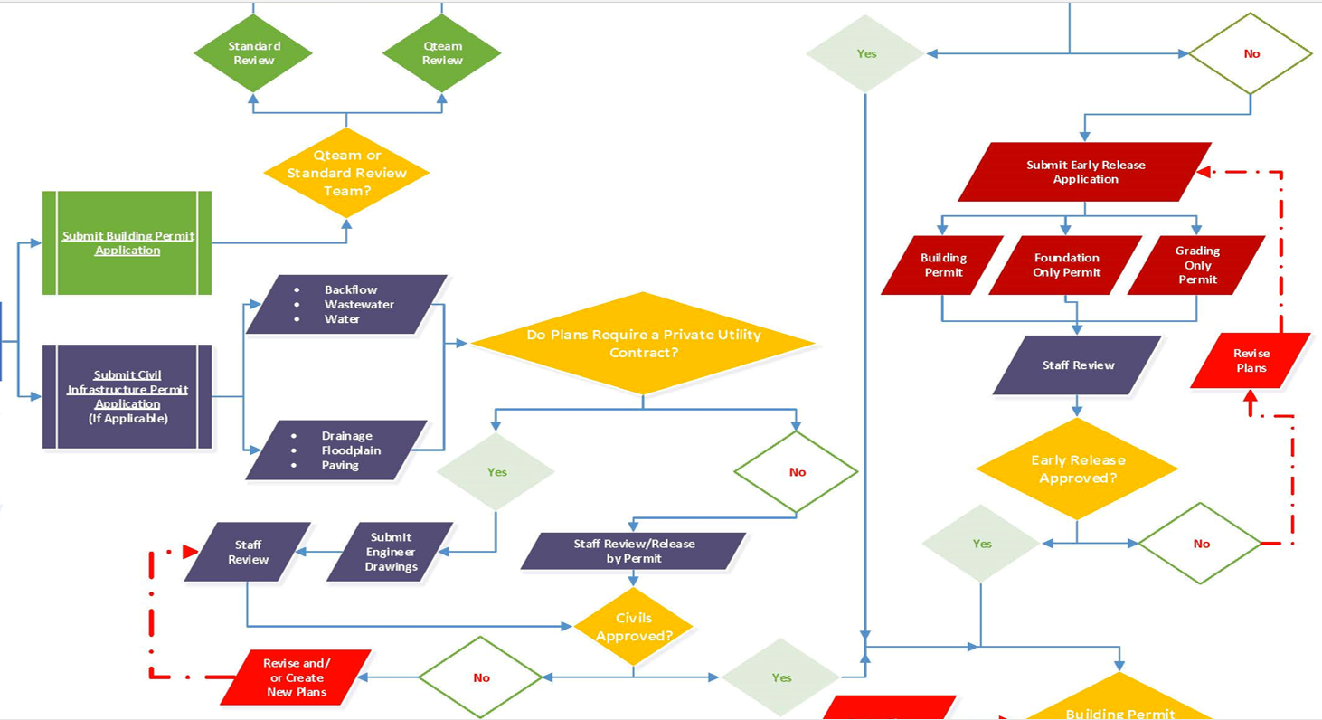
Dallas Development Process
We are just one piece of the overall process.

Slide 14
Types of W/WW Reviews (Room 200)
1. Permit Only Review
    Fee determined with Permit Application in Room 118
    Service design not required by Private Development Contract
    No FH or WWMH proposed
2. Private Development Engineering Plan Review
    Plans requiring more than 100 ft. of construction of W/WW mains
      $1, 500 Design Review Fee
    Plans requiring less than 100 ft. of construction of W/WW mains
      $500 Design Review Fee
With PDox you can now do your payment online.

Slide 15
When is a P-Contract Required?
If the service installation meets ANY of the following criteria, a Private Development Contract will be required:
Located in the Central Business District (area bound by I-45, Woodall Rogers, Stemmons and R. L. Thornton)
Water and /or wastewater main is more than 20 feet deep
Water and/or Wastewater main extension is required
Service length is greater than 60 feet as measured from the connection at the existing water main to the centerline of the meter vault
Service length is greater than 25 feet in a Principal Arterial/Minor Arterial or State Highway
Paving over substandard main involved
Wastewater Manhole is required
  WW connection to trunk main (18” or larger) will require a gas sealed WWMH
  10” WW Lateral or larger will require WWMH
Railroad easement is required
Water main is reinforced concrete cylinder pipe
Water main is larger than 16 inches in diameter
Suspended water vault required
Fire Hydrant is required

Slide 16
What to Know Before Submitting
Initial Coordination
Coordinate your fire protection requirements prior to submitting plans with Ricky Butler in Room 204.
  May require a P-Contract if FH is required. Better to know before starting the process instead of a hold during construction.
  NOTE - Private Plumbing Fire Protection (Room 210) approval does not equate to fire meter permit approval.
Review all as-built drawings:
  Room 215 for the DWU Vault – Water/Wastewater Plans
  Room 314 for the Survey Vault – Paving/Drainage Plans

Slide 17
What to Know Before Submitting
Initial Coordination
Come talk to us in Room 200! We have an open-door policy.
  Please be sure to include the entire plan/concept.
  Provide the address/total site boundary for what you are designing.
  Any future phases could be discussed.
    The earlier we are aware of the overall development, the more we can plan accordingly to avoid having to replace brand new infrastructure.
Sealing Engineer is responsible for QC;
  City Reviewers are responsible for verifying conformance to standards, NOT to provide design layouts and labels.

Slide 18
What to Know Before Submitting
Fire Coordination Certificate
As part of the water/wastewater review process, the Engineer of record (EOR) shall submit a Fire Coordination Certificate, which states that they have done all required due diligence and the plan meets fire code requirements.
The EOR can choose to meet with Ricky Butler in Room 204 first to review the plan and make sure the design complies with fire code.
The EOR is responsible for signing the Certificate and submit it along with the plans via Project Dox.

Slide 19
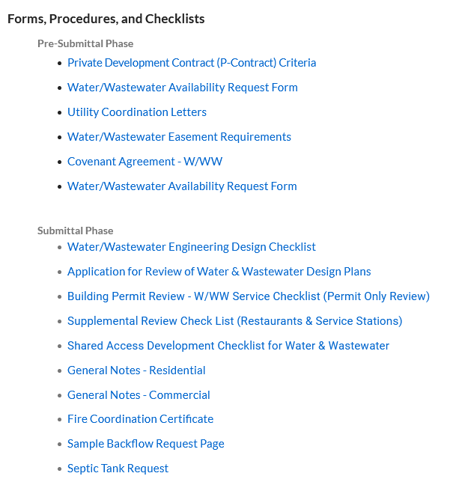
What to Know Before Submitting
Checklists and Manuals
www.DallasCityHall.com
Departments → All Departments → Development Services → Land Management → Engineering/Survey Forms, Procedures and Checklists
https://dallascityhall.com/departments/sustainabledevelopment/land-management/Pages/engineering-forms.aspx

Slide 20
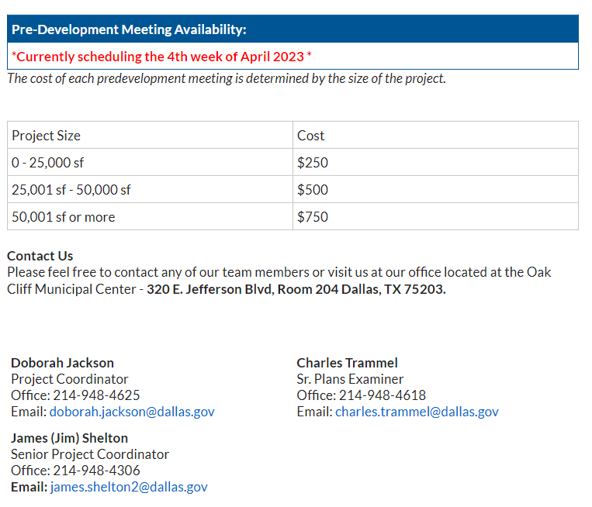
What to Know Before Submitting
Pre-development Meeting

Slide 21
Research at the DWU Vault
The DWU Vault can be located in Room 215 at OCMC.
In addition to checking the existing water and wastewater mains, the following items can also be verified:
  Condition of existing mains
  Any pending Capital Improvement Projects and Bond Projects.
  Historical Water / Sewer Maps (Most accurate info for plans prior to 1980s)
  Water main pressure zones.
  Red-ups and As-built drawings.
You can email DWUVault@dallascityhall.com for additional inquiries.

Slide 22
What to Know Before Submitting
Review Drafting Standards
Review the Drafting Manual:
  https://dallascityhall.com/departments/waterutilities/DCH%20Documents/pdf/PipelineDrafting_standards_july2012.pdf
Review the Design Checklist:
  https://dallascityhall.com/departments/sustainabledevelopment/Engineering/DCH%20Documents/W-WW%20Engineering%20Design%20Checklist.pdf
Select the correct general notes (Updated as of 06/19):
  Single Family / Shared Access – Residential General Notes
  Commercial / Multi-family – Commercial General Notes
Be sure to include the new Title Block

Slide 23
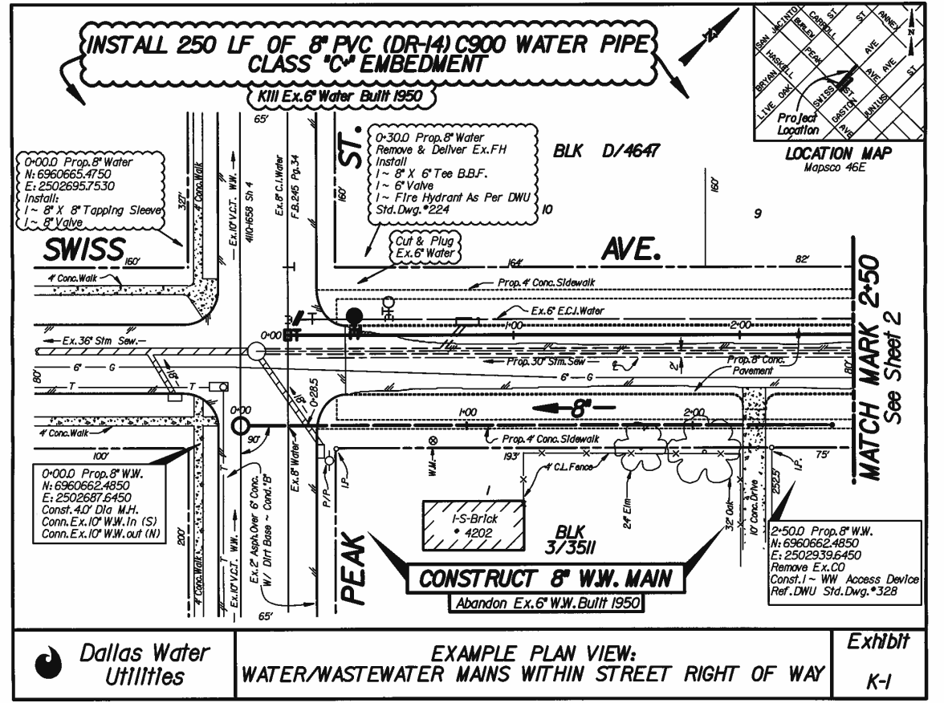
Water Main
Solid and bold linetype
Callout notes clouded.
Use “Install” and “Connect to”
Existing lines are “Killed” (include year built)
Number gate valves on mains and FH leads only.
Wastewater Main
Dashed and bold linetype
Callout notes boxed.
Use “Construct” and “Connect to”
Existing lines are “Abandoned” (include year built)
N/E callouts, provided for all Structures.
Provide flow arrows for existing / proposed mains
Show FFE and Show/Label controlling WWMH Rim Elevation.
Label all W/WW demand in GPM.
Size, Pipe Material,
411Q # and Yr Built
Surrounding Utilities
Show and label all existing and proposed franchise utilities, water and wastewater mains surrounding project. Dimension all utilities to the property line.

Slide 24
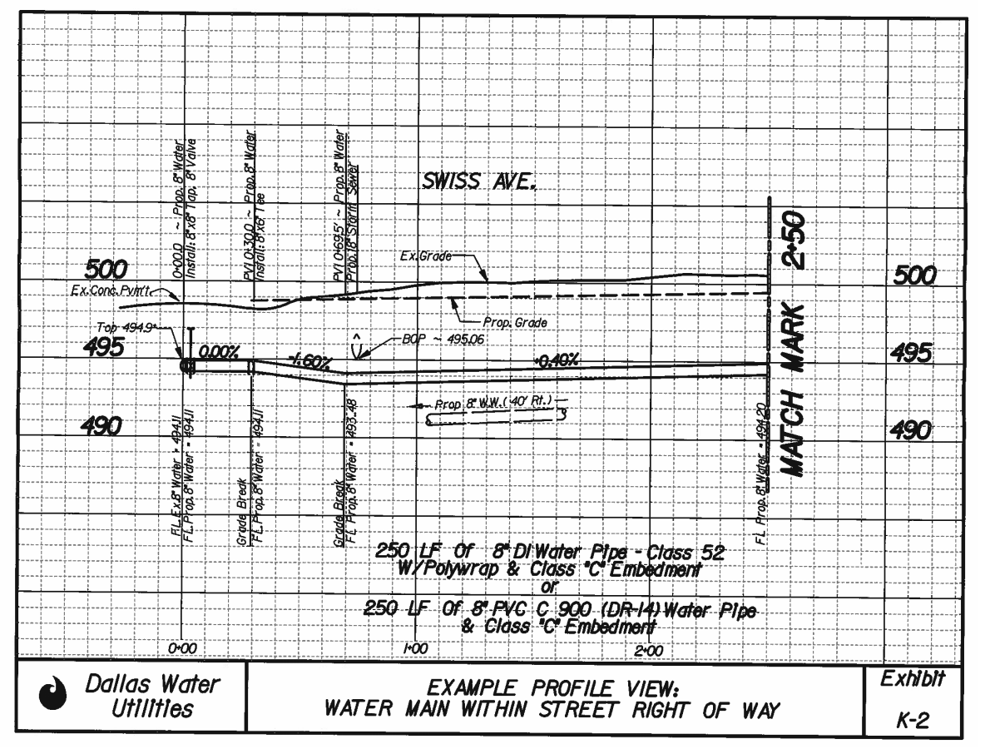
Water Main Profiles:
Call out proper embedment type
Include horizontal off-set distances for all parallel mains and existing utilities.
High Points require air release valves where fire hydrants or large services cannot provide air release.
Greater than 0.00% slope.
Vertical bends/offsets should be shown on plans.
Vertical Scale: 1”=6’

Slide 25
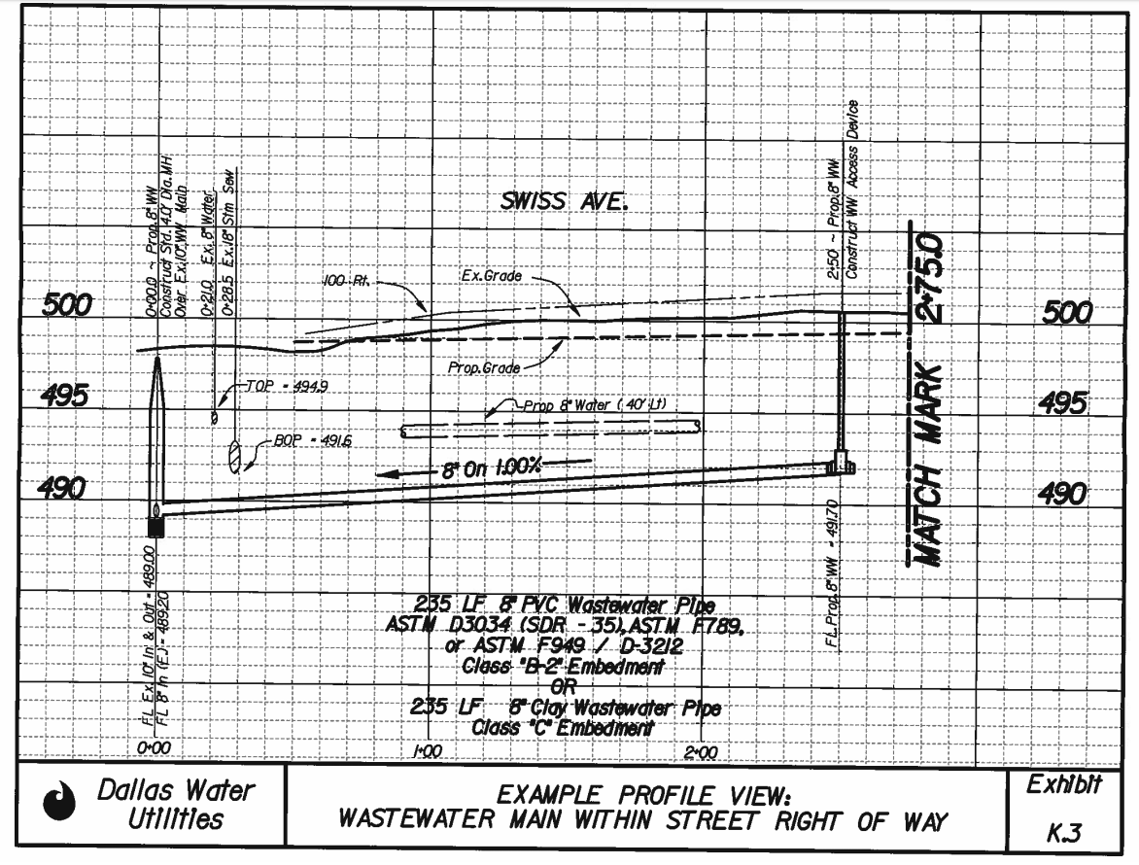
Wastewater Main Profiles:
Call out proper embedment type
Include horizontal off-set distances for all parallel mains
Include the following information:
  Velocity (min 2 fps) - V75/Vprop
  Qexist (in gpm)
  Qprop (in gpm)
  Q75= 75% of full flow capacity (in gpm)
Vertical Scale: 1”=6’
Drop in manholes should be 0.2’.
Provide FL(In)/(Out) and flow directions
Include vertical separation at all crossings

Slide 26
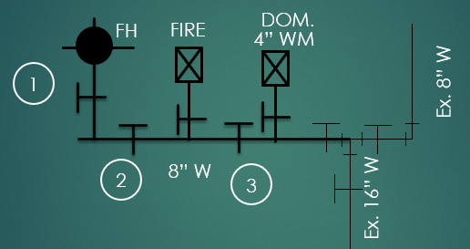
Water Main Design
Valve separation is needed between other large services and fire hydrants and other intersecting main lines.
Provide valve numbers ONLY on Fire Hydrant leads and on mains.
Large meter services (>2”) are not allowed
  Inside buildings
  Areas not accessible by a service truck
  Drive patterns
  Or in parking areas (unless protected by bollards)

Slide 27
Tap Connections
On Large water meters a Tapping Sleeve (“Tap”) is allowed with mains under 40 years old, otherwise a Tee is required.
Tap is not allowed on large service if valve separation is needed between adjacent services and/or fire hydrants.
Tap is not allowed for size-on-size connections.

Slide 28
Reviewing the Checklist
The DWU Engineering Design Checklist can be found at:
https://dallascityhall.com/departments/sustainabledevelopment/Engineering/Pages/engineering-forms.aspx
Checklist items that tend to get overlooked include:
  Two Benchmarks per design sheet (One benchmark must be an approved DWU benchmark) (DFT 3-9)
  Property and Easement alignments and bearing & distance shown on Plat must match the design plans.
  Mains and easements are aligned so that on-street and on-site parking spaces do not encroach.
  Mains are no closer than 3-feet from the edge of ROW without an easement.
  Minimum 20’ spacing from structures to water; 10’ min. for wastewater main.
  Water services & wastewater laterals must be at least 1 pipe size smaller than main (MNL 2.4.3 & 4.4.3).
  No trees within 10’ of water/wastewater mains and no trees within water / wastewater easements.

Slide 29
Reviewing the Checklist – cont’d
Checklist items that tend to get overlooked include (cont’d):
  Replace mains if pipe is over 40 years old, sub-standard in size or condition (MNL 2.3 & 4.3).
  If paving over mains, replace pipe if over 40 years-old, sub-standard in size or condition (MNL 2.3 & 4.3)
  Water taps over 16” are not allowed (MNL 2.4.1).
  Verify that water connections do not cross pressure zones (MNL 2.2.4).
  Dead end main with FH and no services must be less than 100’ in length or loop the main to avoid stagnant water in dead end main. (Only 1 FH allowed on a dead end main) (MNL 2.12).
  Minimum of one (1) water service to each lot with no service crossing lot lines (MNL 2.13.1).
  No size-on-size meters allowed without special approval from DWU Distribution.
    Reviewer shall facilitate this request.
  No service taps are allowed on 18” and larger mains without approval and requires gas-sealed manhole (>18”) (MNL 4.4.1 & 4.11, DWG 307).
  WW lateral sizing per (MNL 4.12.3); have 2% slope (1% min.) and 2’ cover min. (MNL 4.12.4).
  Building finished floor elevation must be ≥ 18” above Controlling WWMH rim elevation or provide a recorded Covenant Agreement for Backflow protection (Forms 11.10 and 11.26). **NOTE: failure to start the process immediately may result in the delay of your project schedule. It is the developer’s responsibility to manage the project’s schedule and plan accordingly.

Slide 30
Easements/Backflow Agreements
      Survey Field Notes/ Backflow Agreement by Separate Instrument Routing
      Submit Field Notes as quickly as possible. This will usually be critical path item!
        Submit package to your Reviewer
            1 copy of the SPRG Checklist
            3 copies of the field notes
            1 copy of warranty deed
            1 copy of closure sheet
      The Reviewer submits package to City Surveyor
        The City Surveyor will coordinate with Private Surveyor (1–2-week turnaround)
      Once field notes are approved, the City Surveyor will route the field notes to Real Estate Division.
          Owner submits documents required.
          Owner , Owner’s Attorney, and the City Attorney. (2–3-month turnaround)
          Real Estate –> Documents Recorded.
      *** NO Permit nor Construction Release will be provided until field notes are recorded and recording info. labeled on plans.
      NOTE, City attorney WILL NOT accept any changes to verbiage of public easement dedication.

Slide 31
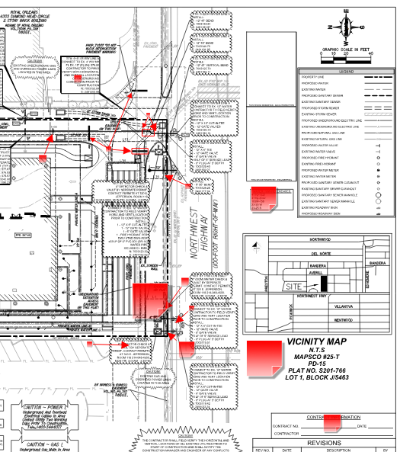
Provide Comment Responses
Provide a written response, confirmation and/or clarification to each comment on Project Dox.
  Just stating “Ok” or “addressed” does not help the reviewer understand the intent or clarifies any question made.
If a meeting is needed to clarify the comments, please coordinate it with the assigned reviewer, before resubmitting the plan.

Slide 32
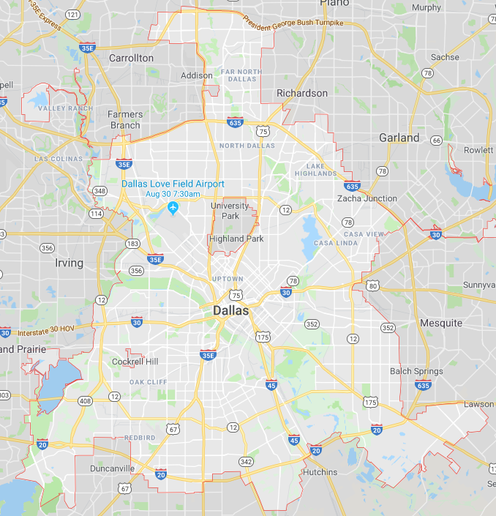
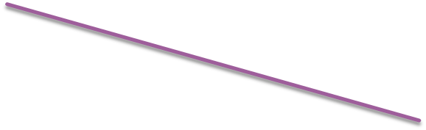


“Hot” Areas in Development
Uptown
Design District
Singleton/Commerce
Lower Greenville
Deep Ellum
Bishop Arts District

Slide 33
Lower East Bank Interceptor (LEBI)
The City of Dallas' Lower East Bank Interceptor is currently at 100% capacity.
Any proposed development that discharges to the LEBI must be reported to DWU.
EOR to submit the following information to engineer reviewer to facilitate coordination with DWU:
  Exhibit of the location of the Project.
    Location of the proposed ww laterals and the existing wastewater main to which they will be discharging to.
  Description of proposed development.
  Total proposed Wastewater Peak Flow (gpm).
    If more than one (1) ww lateral, specify flow per each of them.
A WW report, analysis, and modeling of the wastewater system from the interceptor to the project site must be submitted to this office.
NOTE engineering plans will not be release until it is confirmed that the system will not have adverse surcharge in peak conditions and that it can safely convey wastewater flows without the risk of backflow into existing connections and that the HGL will not be less than 3 ft below the Rim elevation of the downstream wastewater manholes.

Slide 34
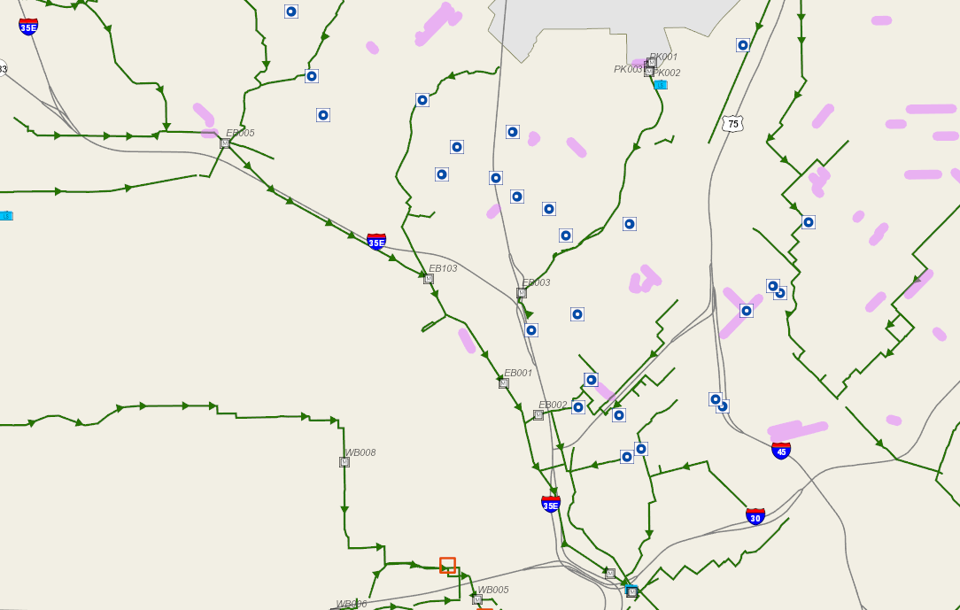
Lower East Bank Interceptor (LEBI)

Slide 35
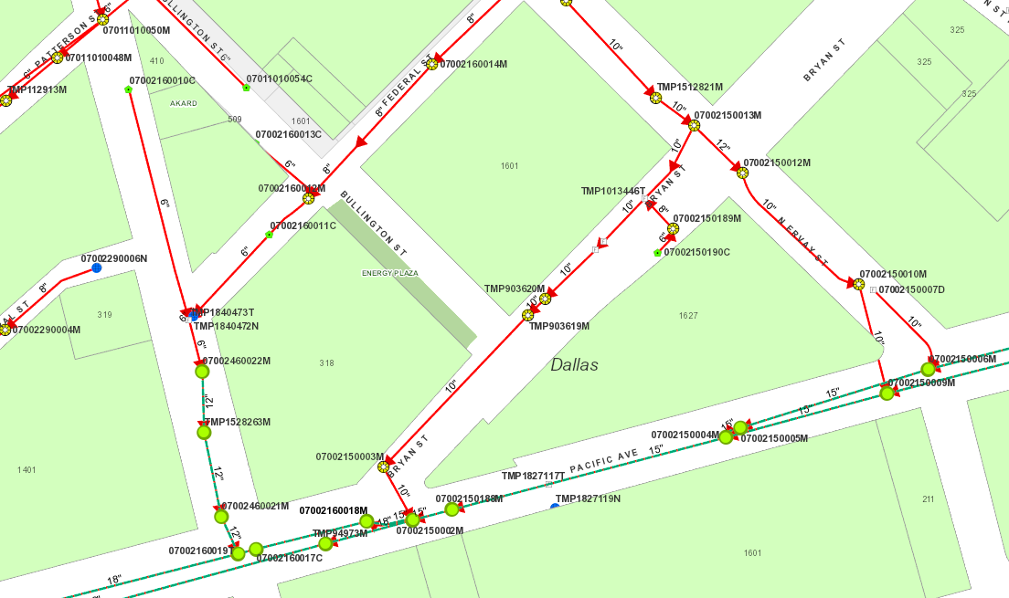
Lower East Bank Interceptor (LEBI)

Slide 36
Final Inspection and Certificate of Acceptance (COA)
  All water and wastewater appurtenances have been adjusted to their final position and a final inspection for the P-Contract has been successfully completed and;
  The final plat has been filed with the County (if applicable) and matches the design plans and;
  All fees owed to the City have been paid and;
  A pay affidavit sent to Private Development stating that the contractor has been paid in full.

Slide 37
Drainage & Paving Engineering Review

Slide 38
Who We Are
Administrative Staff:
  Norma Morales – Senior Office Assistant
  Cambria Jordan – Senior Plans Examiner
  Maricela Garza – Project Coordinator I
Private Development Contract Administrator:
  Michael Fay – Project Coordinator III
Plan Reviewers:
  Maher Alzamer – Senior Engineer
  Sadem Shibani – Engineer I
  Evodio Martinez – Engineer Assistant II
  Brenda Perez – Engineer Assistant I
  Prajwal Pokhrel – Engineer Assistant I
  Almayasa Alwan – Engineer Assistant I
  Anit Yadav – Engineer Assistant I
  Amir Mohammadi – Engineer Assistant I
Inspectors:
  Eric D’Llaggio – Inspector III
  Cecil Oliver – Inspector III
  Stephen Bonner – Inspector III
Plat & Field Note Reviewers:
  John Stepp - Surveyor
  Julio Delgado - Surveyor
  Wilkens Engmann - Surveyor
  Scott Davis - Surveyor
  Matias Medellin – Project Coordinator II

Slide 39
Submittal Process
Types of Submittal:
  1. Grading Only (A fee is associated with Subdivision’s Application)
    Smaller plat projects, little to no public improvements required
    Often required by Building Inspections for permits
    Should address OVERALL drainage
  2. Full Engineering ($1,500 associated with submittal to Engineering)
    Assigned DP-number
    May or may not require 3-way contracts
Credit Card or Check should be made payable to City of Dallas

Slide 40
Submittal Process Cont’d
Review the PD and provide highlighted section that may apply to your civil design
Engineering Plans are now submitted electronically via Project Dox.
Always provide Letter of Transmittal clarifying your submittal intent with appropriate file number

Slide 41
Average Review Times
1st Review = 48 Business Days
1st Review Goal = 15 Business Days
Subsequent Review = 30 Business Days
Subsequent Review Goal = 10 Business Days

Slide 42
DP-Full Engineering Submittals
Fees:
  $1,500 covers 2 reviews
  $500 for each subsequent review
Note: Plans will not be routed to reviewers until payment balance is current
Plan Review Submittal Procedures and Checklist
  Pay attention to what you are certifying to on the check list.

Slide 43
General Overview of Permit Process: Paving & Drainage – Shared Access
Preliminary Plat Submittal/Approval
Submit Civils for Review and Approval (include SWPPP)
Execute Private Development Contracts - coordinate with Michael Fay Reference 51A-8.612
Pre-Construction Meeting → Reference 51A-8.702
Developer’s Surety Bond, Letter of Credit, or Cash Deposit
Batch stamp final plans
Final Plat Release – Note: Shared Access Area Agreement must be recorded first.
Construction (paving & drainage included in 3-way contracts)
Inspection Approval & Acceptance
Submittal of Recorded Plat
Release of Building Permit

Slide 44
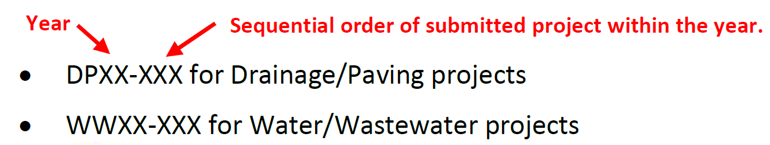
Electronic Plan Review
ProjectDox
https://plansubmittal.dallascityhall.com
Submittal guidelines will be uploaded to the City website
Be sure to follow the proper naming convention when submitting plans.
  If the plans are renamed, and do not proper naming convention, Project Dox will recognize this as a new sheet, and not as an updated version of the old sheet.
Please be sure to use the correct title block, 3-way contract blocks, and the blank space for the batch stamp. A .dwg file is available on the City forms website link.

Slide 45
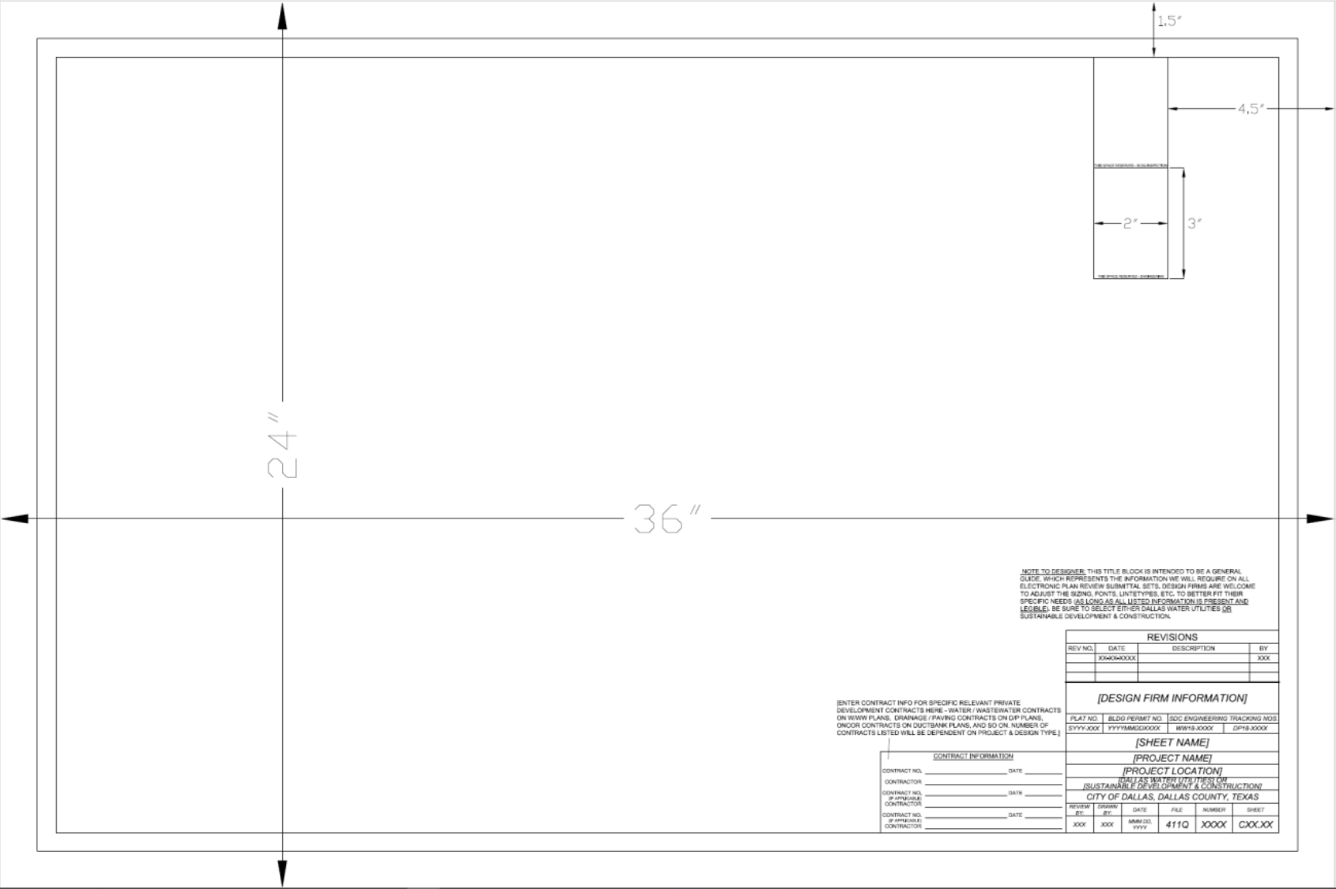

Slide 47
Drawings Folder

Slide 48
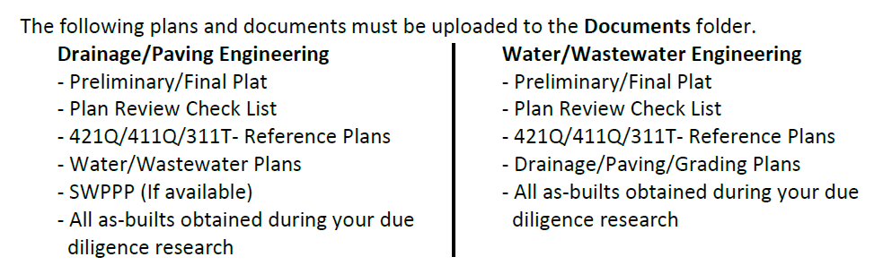
Documents Folder

Slide 49
What to Know Before Submitting –
Initial Coordination
Existing/proposed street and driveway widths - Coordinate with Ricky Butler in Room 204.
  Pavement width must be 26’ when the structure exceeds 30’ in height.
Review all as-built drawings:
  Room 314 for the Survey Vault – Paving/Drainage Plans
  Room 215 for the DWU Vault – Water/Wastewater Plans
Come talk to us in Room 200! Please be sure to include the entire plan/concept

Slide 50
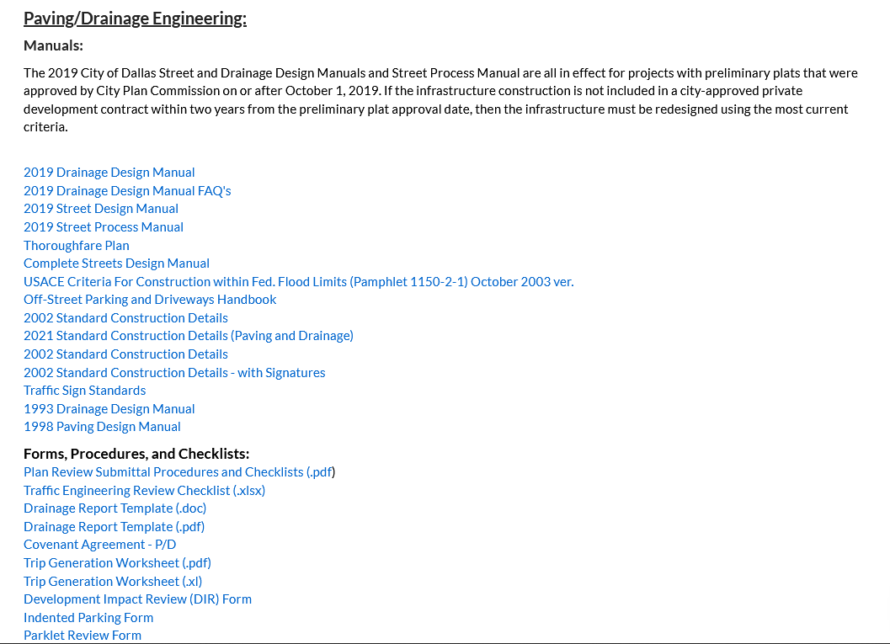
What to Know Before Submitting –
Checklists and Manuals
www.DallasCityHall.com
Departments → All Departments → Development Services → Land Management → Engineering/Survey Forms, Procedures and Checklists
https://dallascityhall.com/departments/sustainabledevelopment/land-management/Pages/engineering-forms.aspx

Slide 51
Common Errors: Infrastructure Notes
City of Dallas Infrastructure Notes should be placed on respective design drawings (Paving, Grading, Drainage)
  Recommend not to place in General Notes nor Cover
  Helpful for your clients’ contractor and for you
Use the verbiage provided to you from our provided attachment

Slide 52
Common Errors: Easements
Applicable existing easements & proposed dedications must be shown & labeled on Site, Paving, Drainage, Grading Plans
  ROW Dedications
  Drainage Easements (public/private)
  Detention Area Easements / Detention Area Access Easements
  Water/Wastewater Easements, etc.
“By separate Instrument No. ____________”
  Private easement or if not platting
“By This Plat”
  Public Easements or ROW dedication

Slide 53
Common Errors: Visibility Triangles
Shown & labeled on Site, Paving, Grading, & Landscaping Plans
For pedestrian and vehicular safety
Not a sight easement nor corner clip
May also need sight distance analysis at roadway curves

Slide 54
Common Errors: Visibility Triangles Cont’d
20’ x 20’ at driveway locations
  Measured along face of roadway curb and edge of driveway
45’ x 45’ at street intersections
  Measured along face of roadway curbs
30’ x 30’ at street intersections within CBD (and some PD’s)
  Measured along face of roadway curbs

Slide 55
Common Errors: Driveway
Private pavement design ends at R.O.W. or public easement
Remember Pedestrian Crossings
  Barrier- Free Ramps (BFR)
  2% max. cross-slope
    General labels may not reflect design
Provide spot elevations for critical design points
TxDOT approval required if adjacent to state roadway

Slide 56
Common Errors: Driveway
6” min. thick concrete pavement for single family drive apron
8” min. thick concrete pavement for all others
  98% subgrade compaction
  No. 3 rebar ; No.4 rebar for >8”
  Subgrade stabilization
  -2% to +4% Optimum Moisture
Recommend separate hatching
In lieu of subgrade stabilization, 2” of concrete may be added to thickness;
  Clarify pavement x-section/legend with note

Slide 57
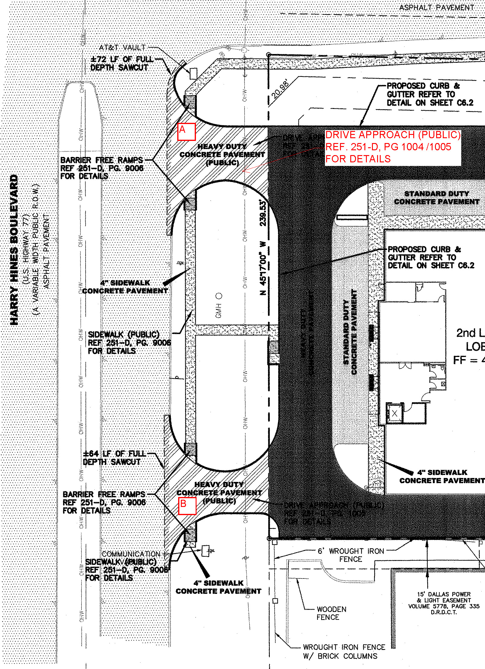
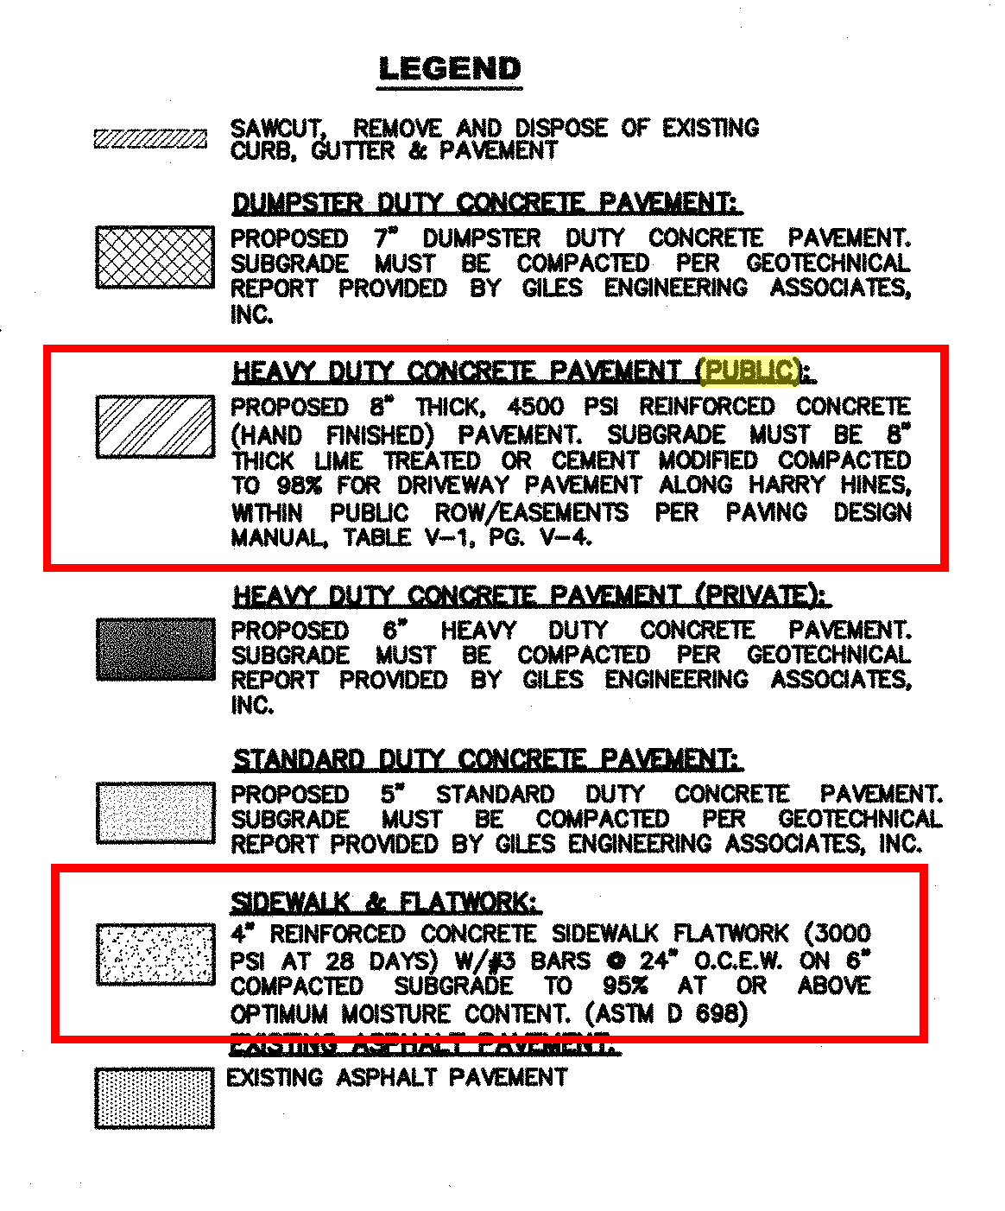
ROW Pavement:
Concrete Thickness
Concrete Strength
Subgrade Preparation & Compaction
Location of Sidewalks/BFR
Rebar Size
Expansion Joints
Connections to Existing Pavement
References to 251D-1 Standard Construction Details

Slide 58
Common Errors: Signage & Marking
Prepare signage & striping plans for review by Department of Transportation(TRN)
  Must clearly show street name and addressing block numbers – this is not the same as Lot/Block number
    Contact: Victor Olivo: victor.olivo@dallas.gov
  May be included in Paving Plan if illustrated clearly
Allows TRN to be proactive in preparing work order for any signage
Allows TRN to have a head start in releasing holds

Slide 59
Common Errors: Retaining Wall
Retaining Wall designs should include cross-section that shows:
  the relation between property line and footing;
  max. height of wall measured form bottom of footing and;
  wall material
≥ 4-feet in height (from bottom of footing) requires permit and sealed drawings
If referencing Geotechnical Report, please provide a PDF copy for use in future Retaining Wall Permit Review/Approval

Slide 60
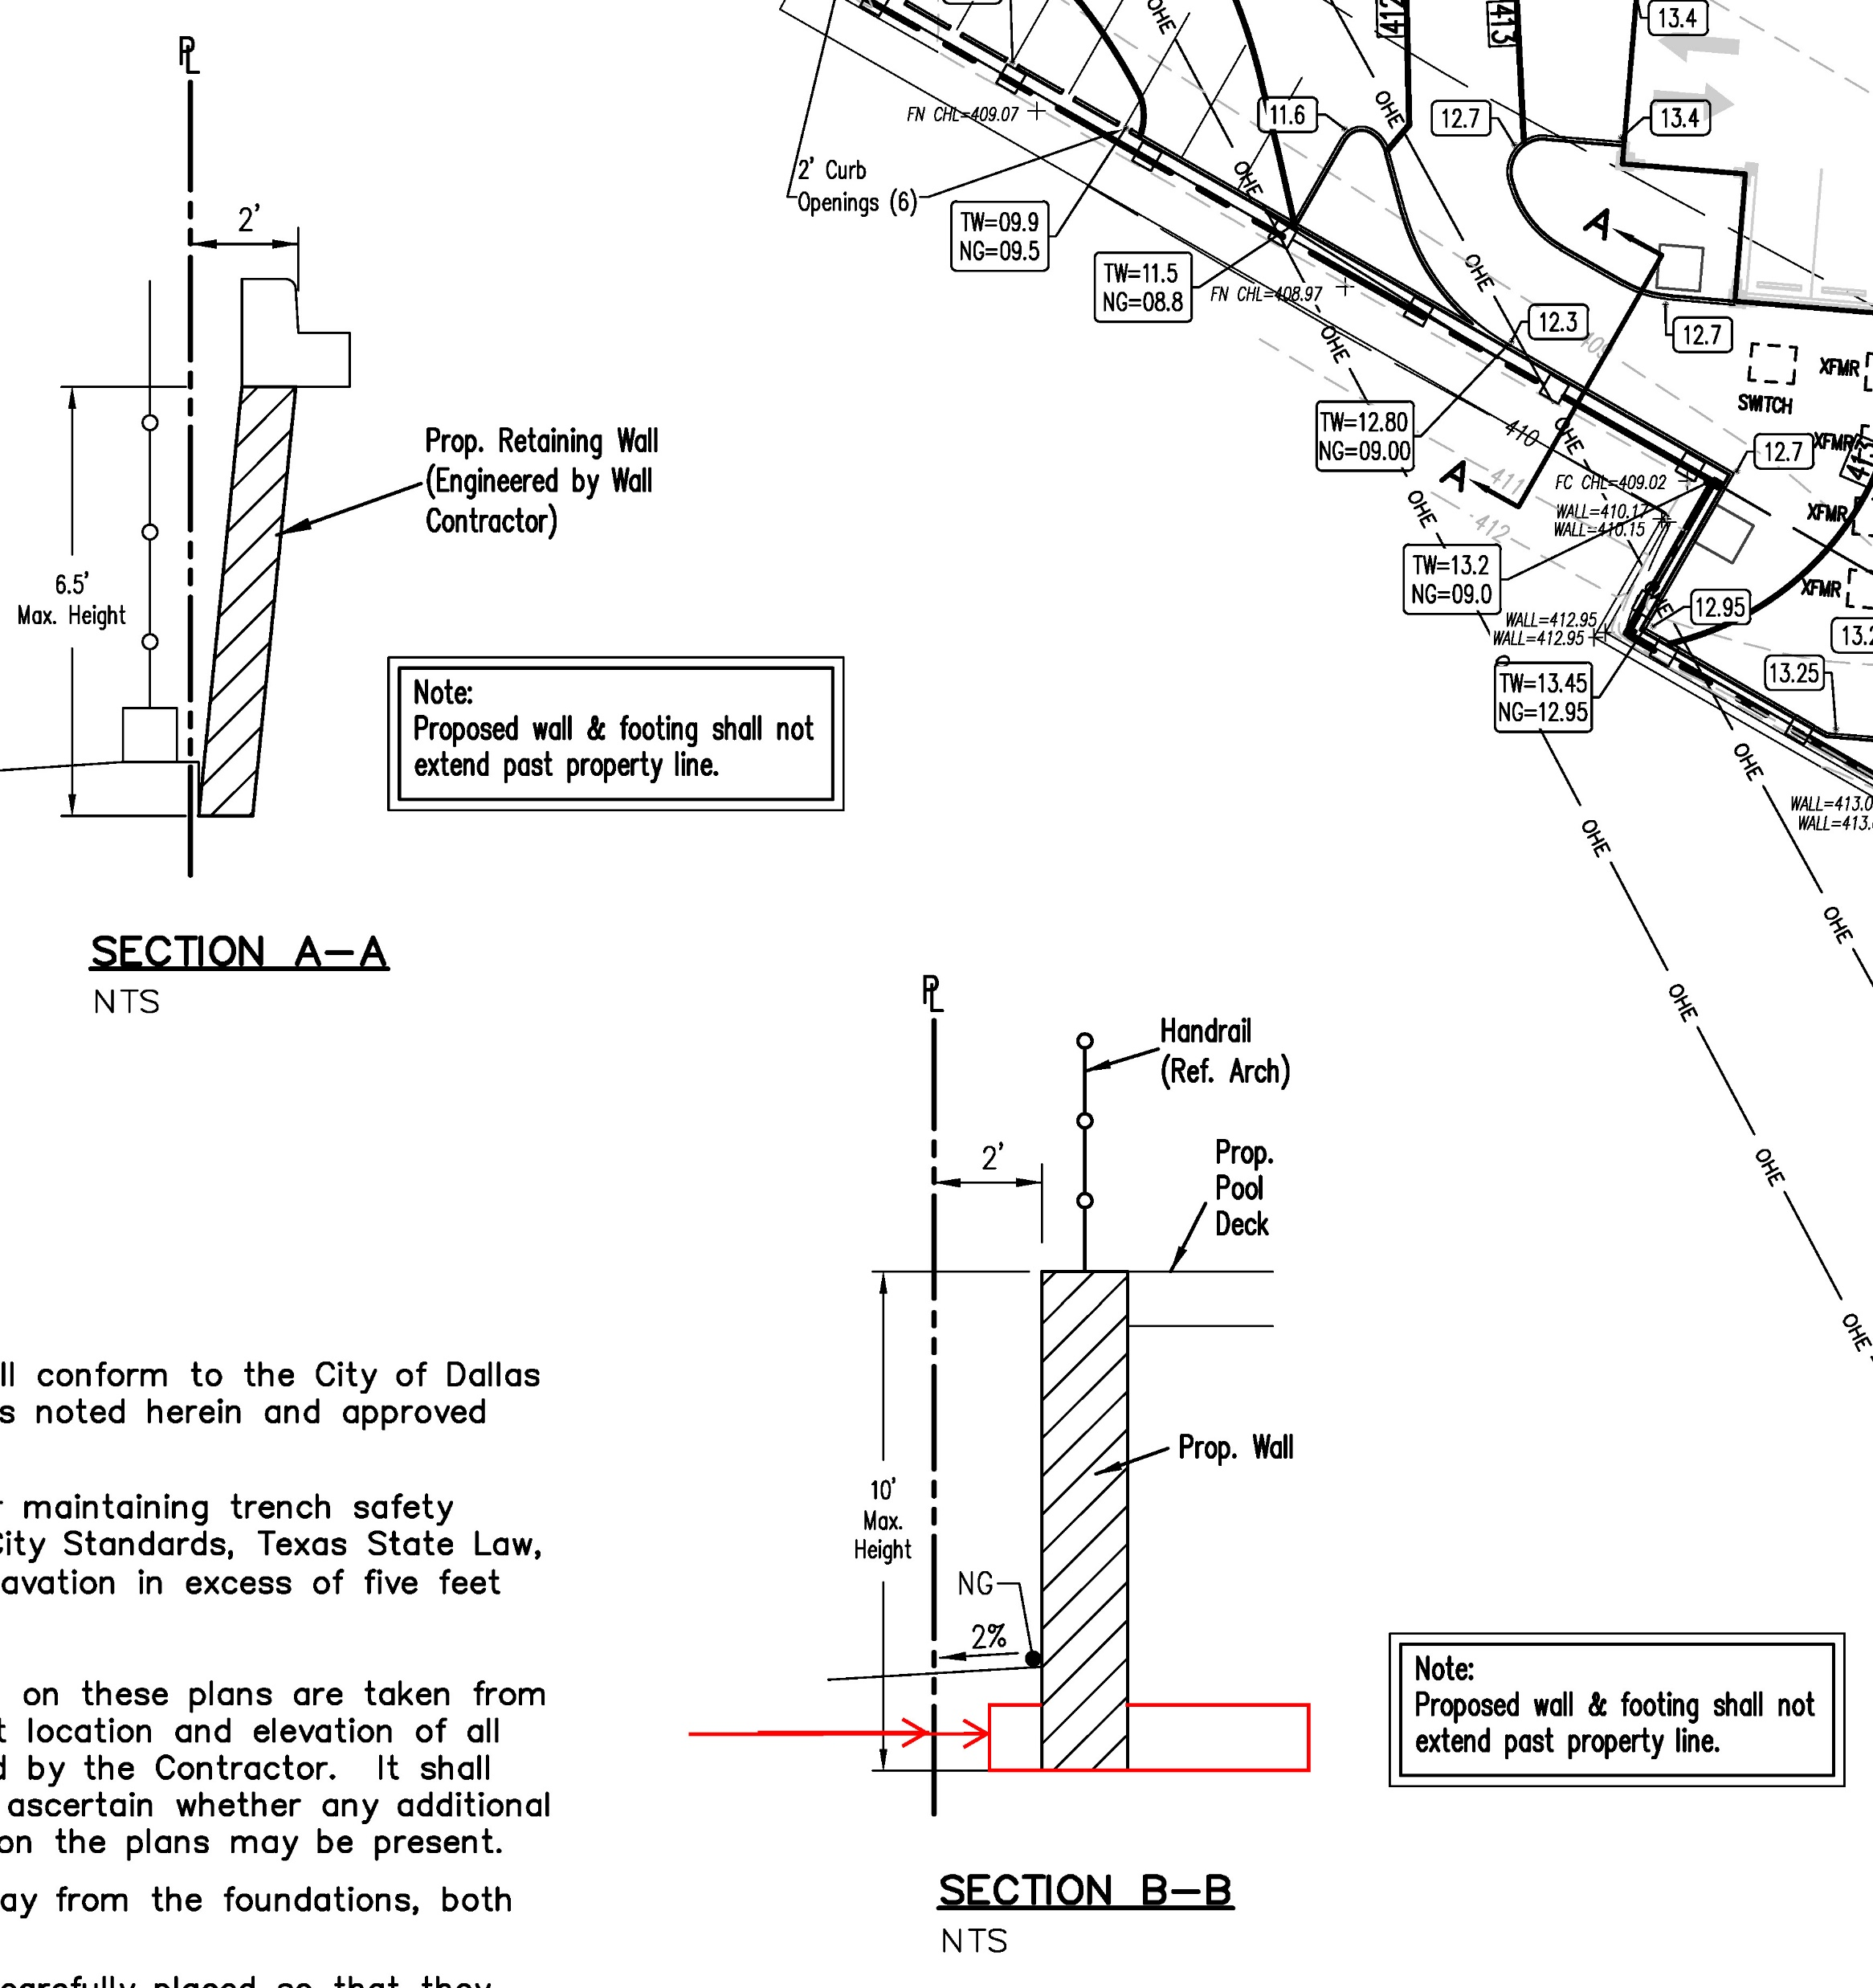
RETAINING
WALL EXAMPLE

Slide 61
Common Errors: Retaining Walls in Shared Access Developments
Permits cannot be issued in Shared Access Developments until the Final Plat has been filed and recorded at the County.
Retaining walls sometimes need to be constructed to perform utility work.
Be sure to include walls in cost estimate for 3-way contract package.

Slide 62
Common Errors: Drainage Area Map
Provide Existing Drainage Area Map
Show flow Arrows
Label key discharge points
Existing hydrologic calculations based on existing drainage system design

Slide 63
Common Errors: Drainage Area Map
Show existing and proposed storm drainage system on respective existing and proposed drainage area maps
Label critical information of drainage system (size, manhole location, material, 421Q/311D or T if existing)
Show and label drainage easements

Slide 64
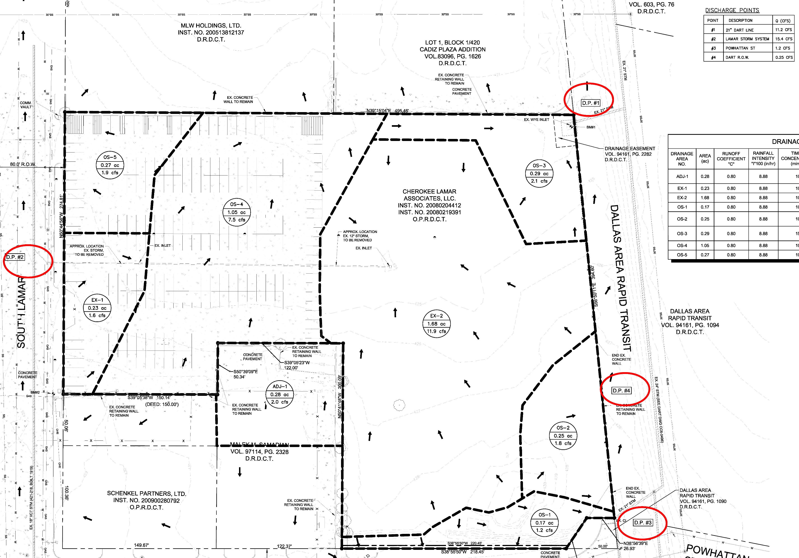
EX: Drainage Area Map Example

Slide 65
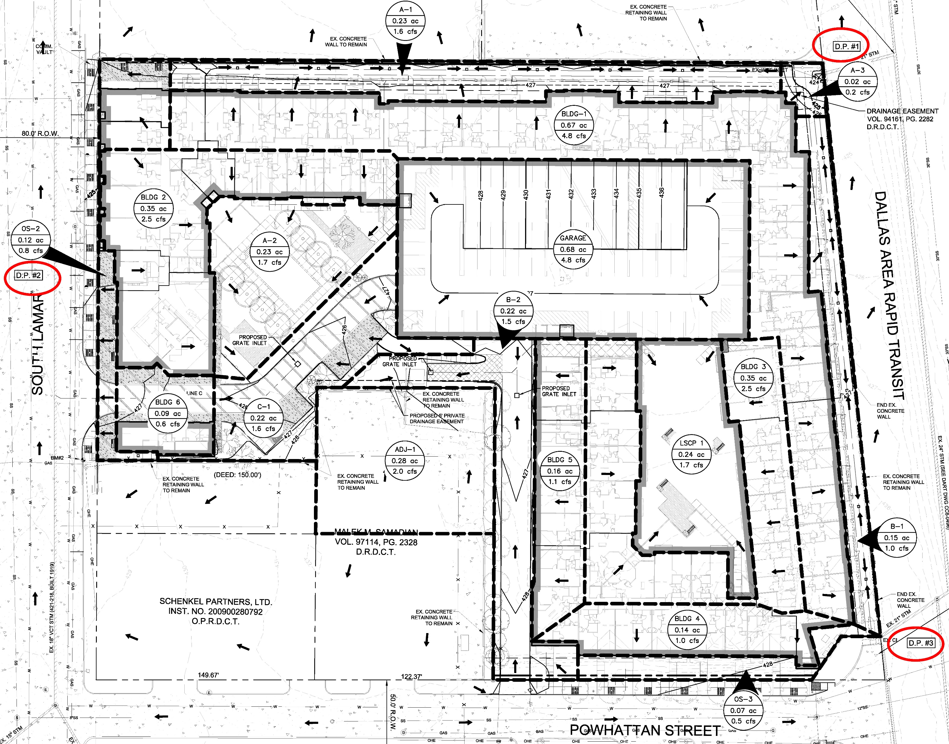
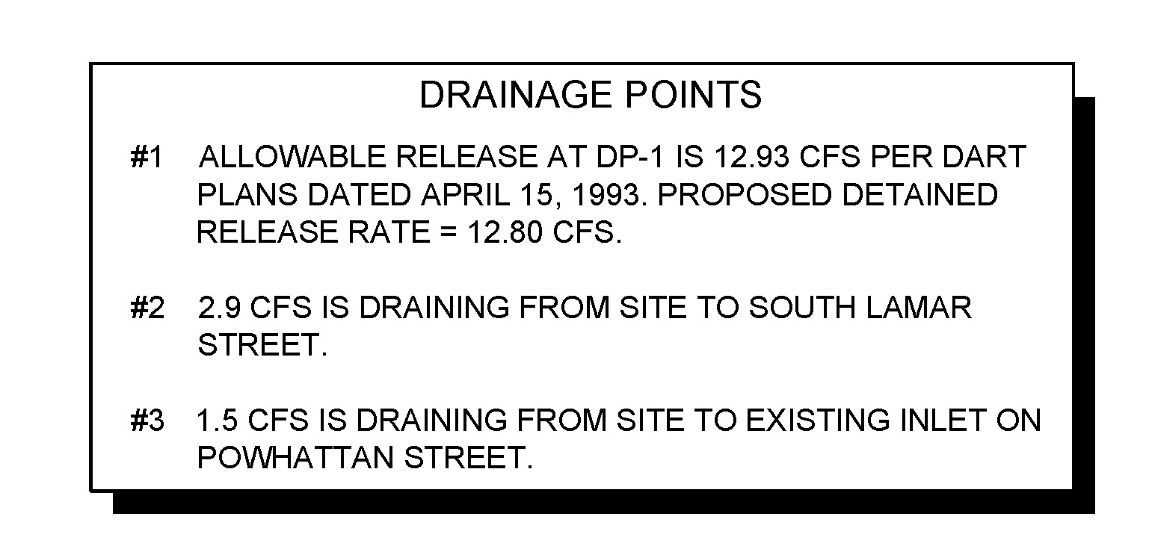
Drainage Area Map Example

Slide 66
Common Errors: Drainage Easement
Drainage Easements should be dedicated for all public storm sewer lines located within private property.
Typical easement widths are as follows:
  15 feet for 39” and under;
  20 feet for 42” through 54”;
  25 feet for 60” through 66” and;
  30 feet for 72” through 102”.
For storm drain facilities that are deeper than 20 feet, increase storm drain easement width by 4 feet for each additional foot of depth.
Private drainage easement required for any lot-to-lot drainage regardless if it was an existing condition prior to development

Slide 67
Common Errors: Drainage Calculation
Existing & Proposed C-value based on weighted runoff coefficients – pervious / impervious areas.

Slide 68
Common Errors: Drainage System
Delineation / labeling of proposed storm line - End public, begin private
  Helps contractor identify DP- contract work
Pay attention to conversion of sheet flow to point discharge to adjacent property
Provide critical flow data on profiles and inlet on plans
  Q₁₀₀, Q_{CAP}, V₁₀₀, S_{f}, HGL, etc.

Slide 69
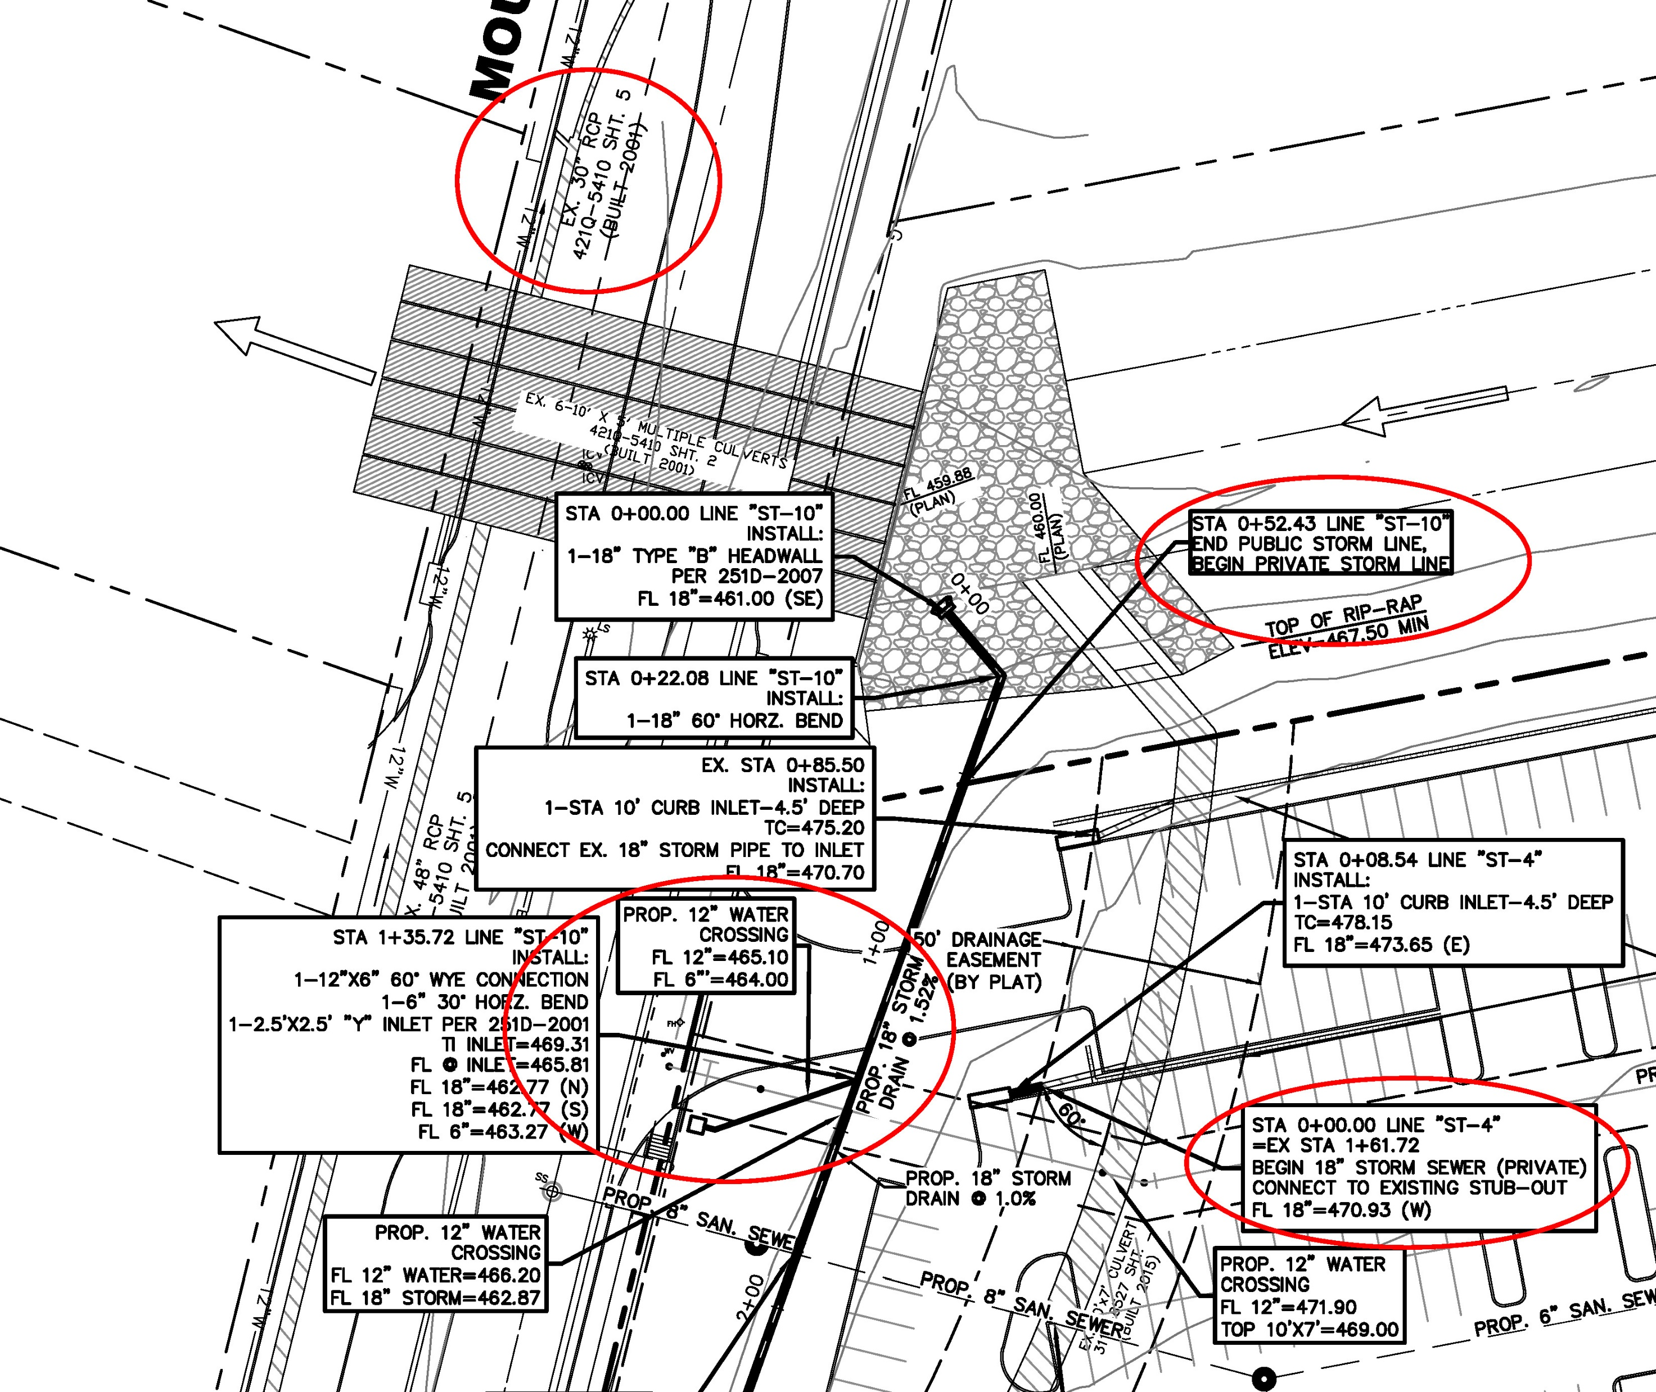
DRAINAGE
SYSTEM
EXAMPLE

Slide 70
Is Detention Required?
Acceptable 100-year Outfall?
Yes
No
Detention Not Required
Detention is Required

Slide 71
Common Errors: Detention
Detention may be required if the capacity of available outfall is not adequate to carry the developed runoff.
  Reference 51A 8.611(e)
Diversion of drainage areas to different storm systems is not allowed without detention unless justification of design capacity is provided.

Slide 72
Common Errors: Detention
  Detention Area Easements & Detention Area Access Easements are required to be shown on the plat and on all civil construction sheets.
  All easements outside of the limits of the subject platted lot must be dedicated by separate instrument.

Slide 73
Common Errors – Final Tips
Review City of Dallas standards before starting your design
Take advantage of meeting with us prior to submittal; Open door policy
Sealing Engineer is responsible for QC;
City Reviewers are responsible for verifying conformance to standards, not to provide the design layouts and labels.

Slide 74
Common Errors – Final Tips
City Website
  www.dallascityhall.com
Dallas City Code
  http://dallascityhall.com/government/Pages/city-codes.aspx
  City Code (Volumes 1-3) → View Code
Construction Codes
  http://dallascityhall.com/departments/sustainabledevelopment/buildinginspection/Pages/construction_codes.aspx

Slide 75
Feedback?

