Slide 1
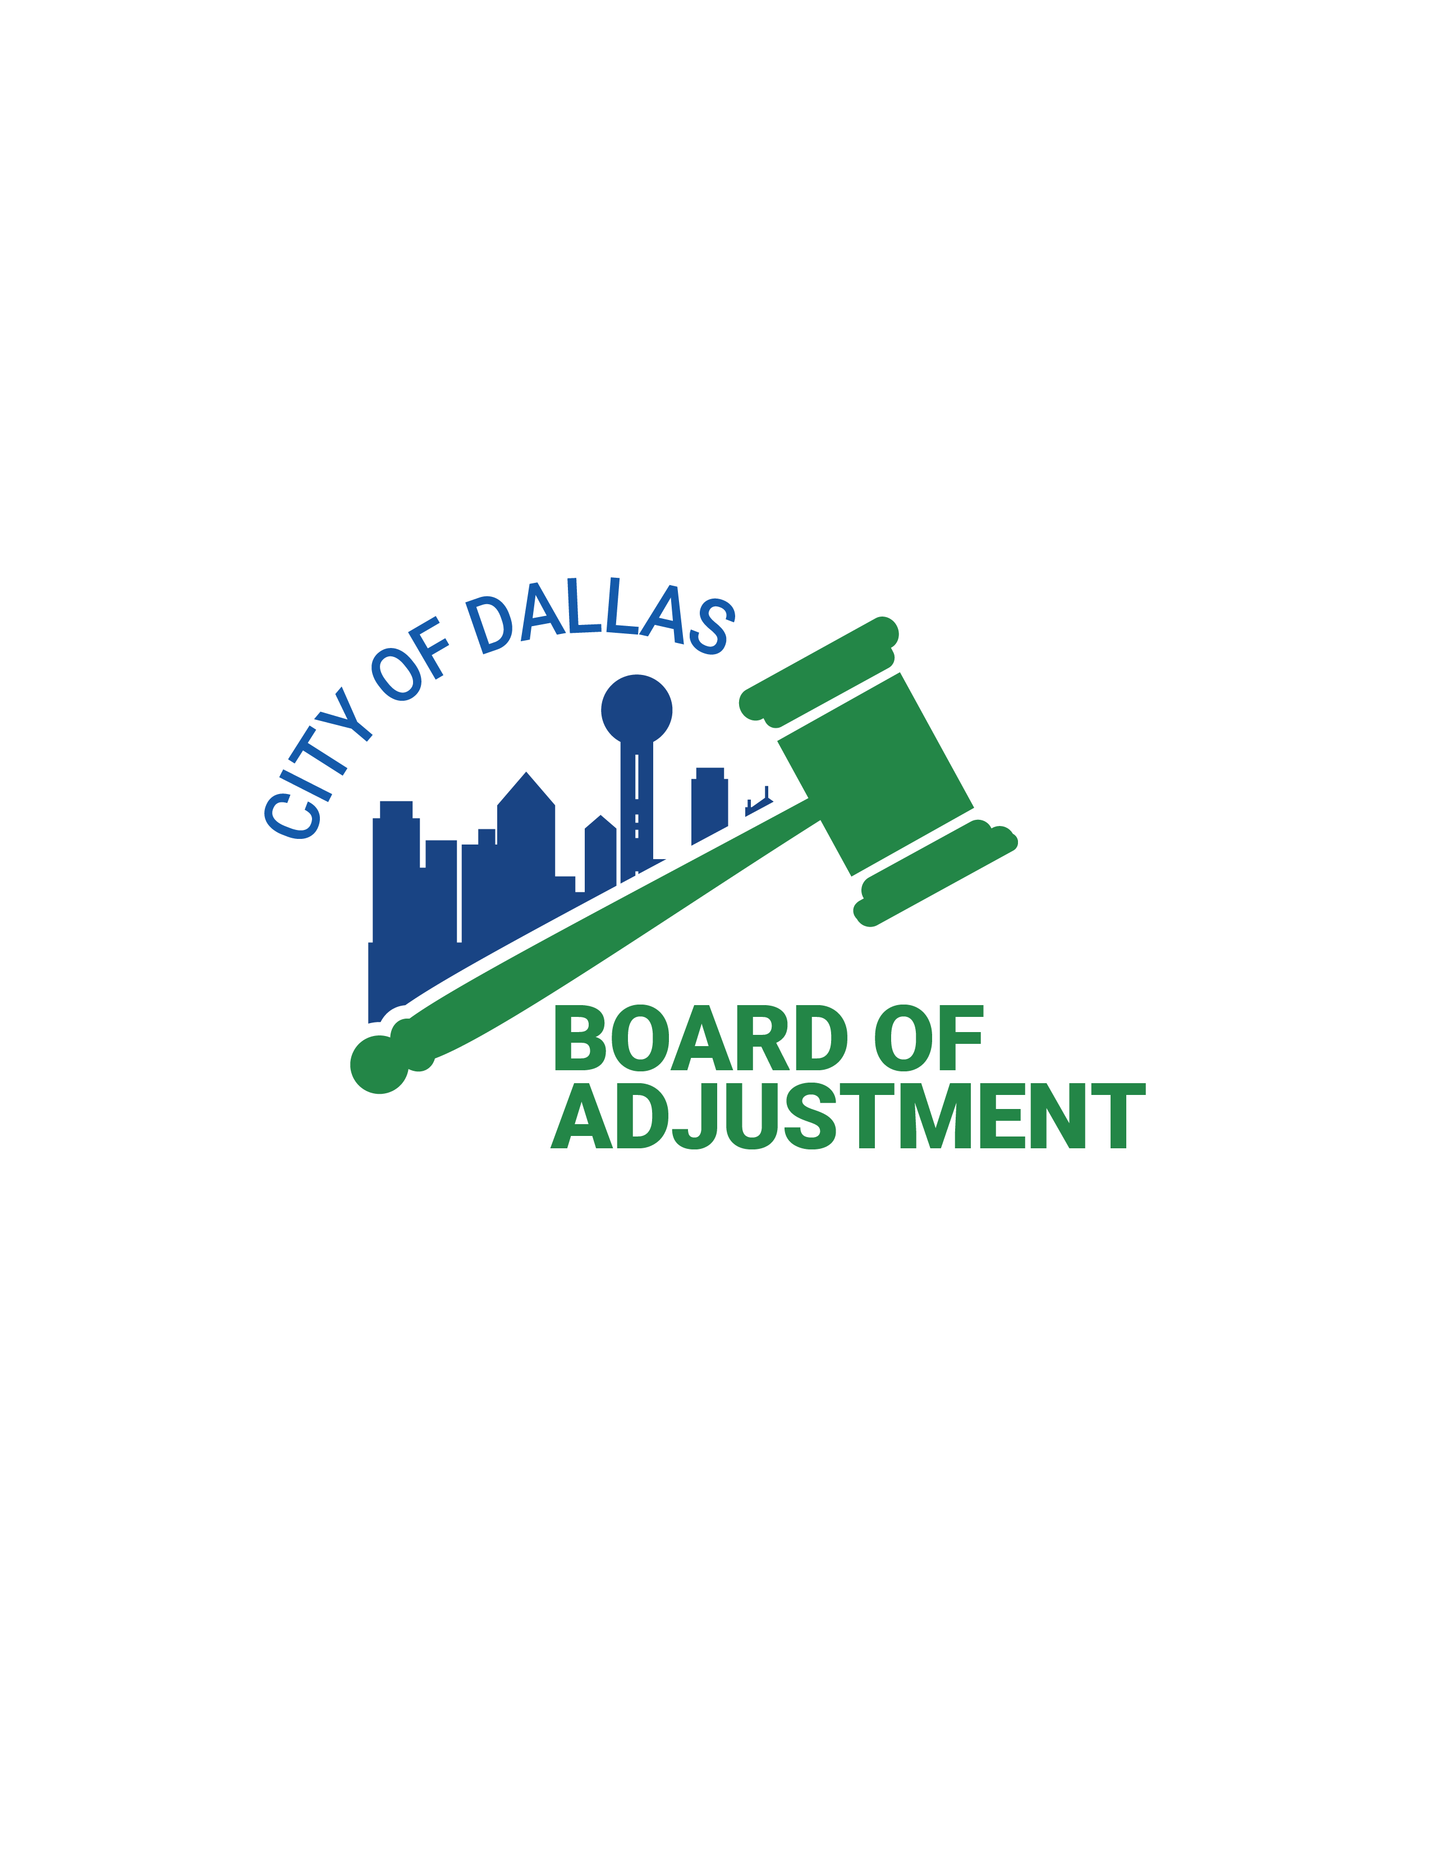
PRESENTS
How To Win A Board Case
BDA Session #2 of Lunch & Learn
August 31, 2023
Nikki Dunn, Chief Planner
Dr. Kameka Miller-Hoskins, Senior Planner
Diana Barkume, Project Coordinator-Development
Development Services
City of Dallas

Slide 2
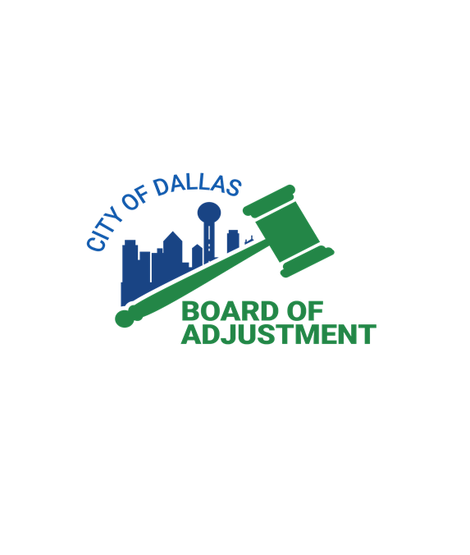
Presentation Overview
Board of Adjustment Staff
Nikki Dunn
sheniqua.dunn@dallas.gov
Dr. Kameka Miller-Hoskins
kameka.mhoskins@dallas.gov
Diana Barkume
diana.barkume@dallas.gov
Mary Williams
mary.williams1@dallas.gov

Slide 3
Presentation Overview
Variances & Special Exceptions
Burden of Proof
Documentary Evidence
Variance Standards

Slide 4
Why Are Variance Standards Earmarked Versus Special Exceptions?
What is the difference between a Special Exception and a Variance?
A Special Exception is expressly provided in the ordinance for specific permitted land improvement that may be allowed if subjected specified development standards in the ordinance are met; certain criteria must be met ensuring that negative impacts will not occur
When in the opinion of the board
A Variance can be applied when a specific requirement of the zoning ordinance is prohibited or impossible to meet due to a unique circumstance; permission is requested to use a specific piece of property in a more flexible manner than allowed by the ordinance
List standards to be met

Slide 5
What is burden of proof
Burden of proof is a legal standard that requires parties to provide information to demonstrate that a claim is valid
Who has the duty of providing burden of proof
The applicant has the burden of proof to establish the necessary facts to warrant favorable action of the board.

Slide 6
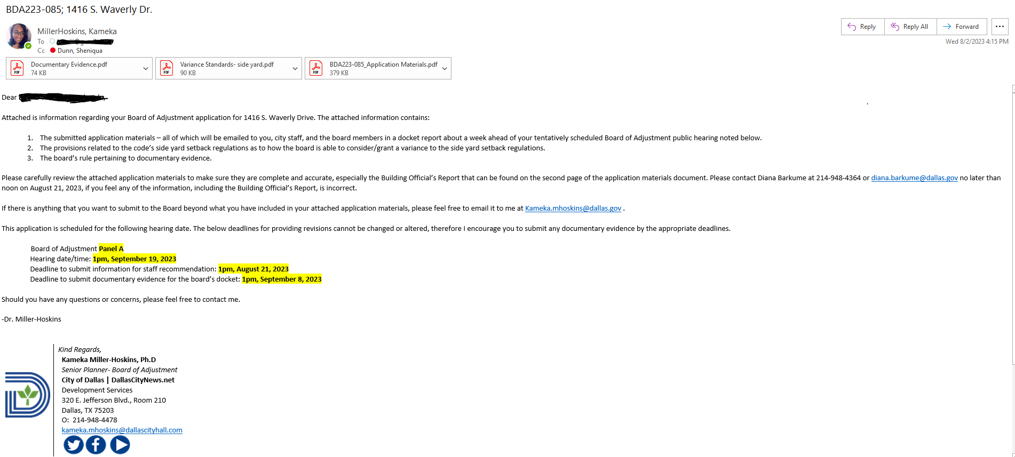
Documentary Evidence

Slide 7
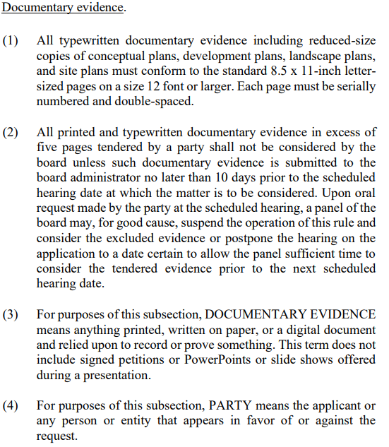
Documentary Evidence

Slide 8
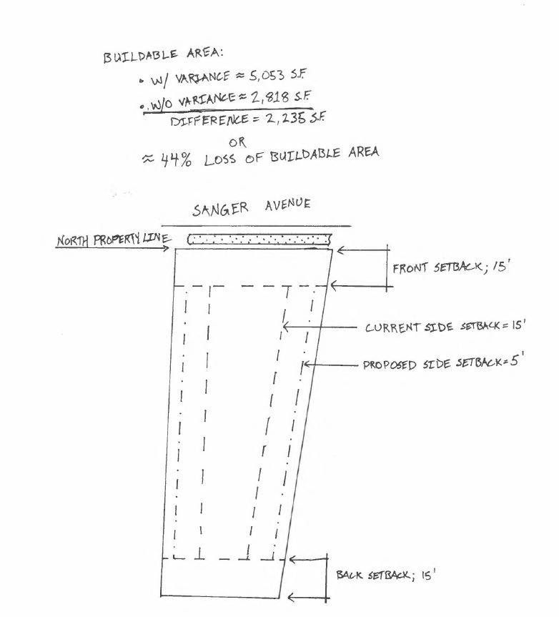
Documentary Evidence

Slide 9
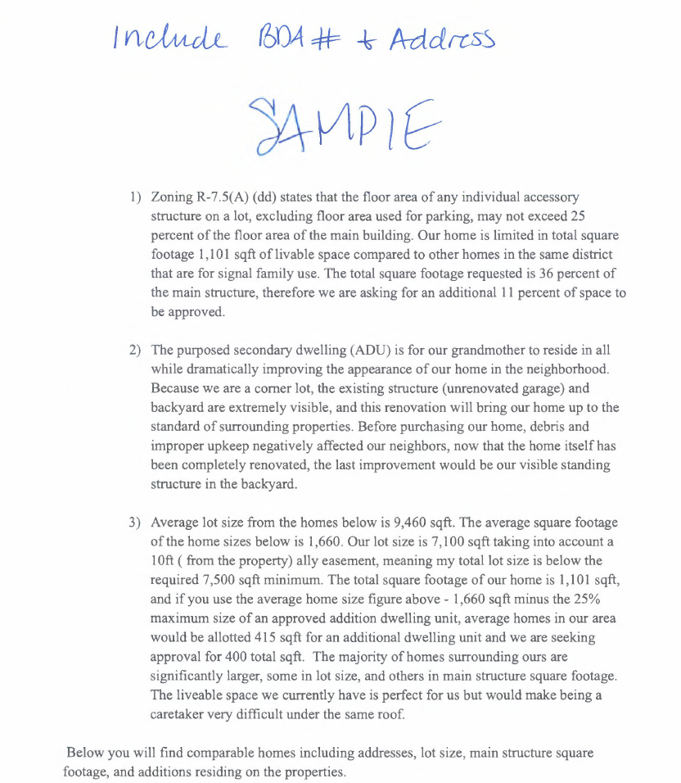
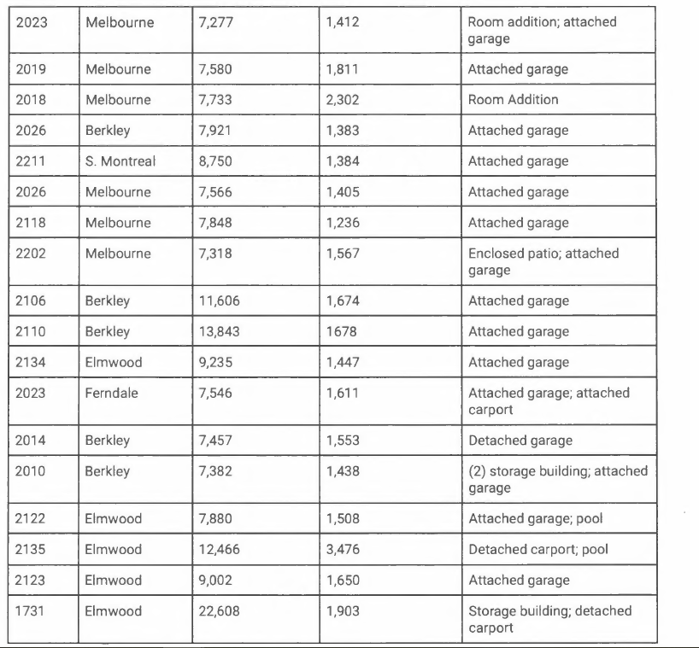
Documentary Evidence

Slide 10
Standards for a Variance
The applicant has the burden of proof in establishing the following standards have been met.
not contrary to the public interest when, owing to special conditions, a literal enforcement of this chapter would result in unnecessary hardship, and so that the spirit of the ordinance will be observed and substantial justice done;
necessary to permit development of a specific parcel of land that differs from other parcels of land by being of such a restrictive area, shape, or slope, that it cannot be developed in a manner commensurate with the development upon other parcels of land with the same zoning; and
not granted to relieve a self-created or personal hardship, nor for financial reasons only, nor to permit any person a privilege in developing a parcel of land not permitted by this chapter to other parcels of land with the same zoning.

Slide 11
Not Contrary To Public Interest
Not Contrary To Public Interest

Slide 12
Not Contrary To Public Interest
Not contrary to the welfare or well-being of the general public……
What is…..
Opposition
Anything that does not meet minimum life-safety standards
Anything that would harm or impede
Anything that could possibly cause financial burden
Anything that materially and substantially disrupts the cohesiveness/integrity of the neighborhood

Slide 13
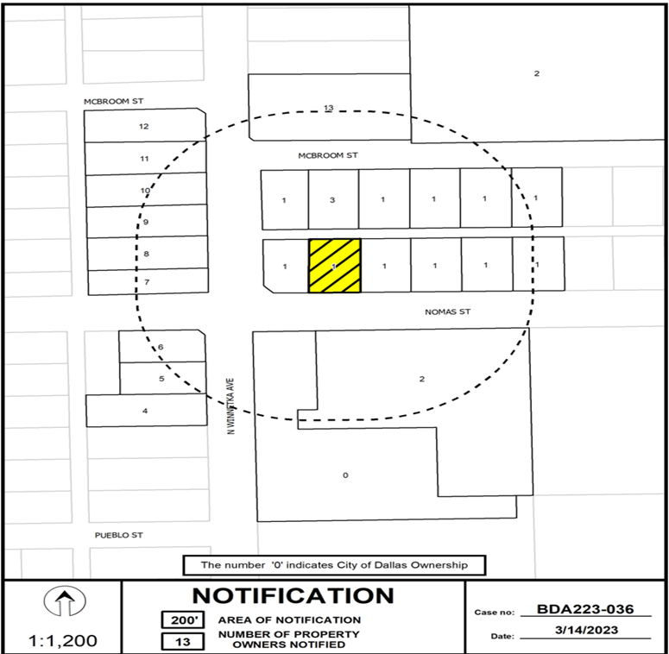
Notification area of city

Slide 14
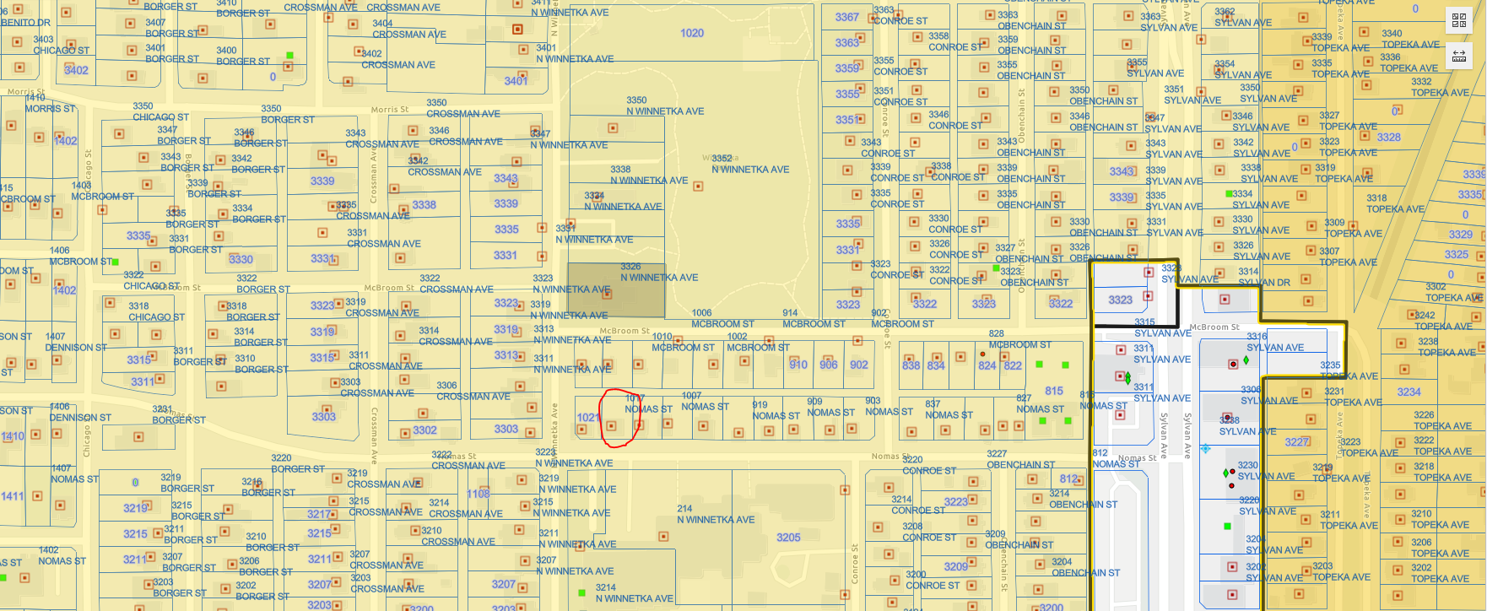
Notification area of appellant

Slide 15
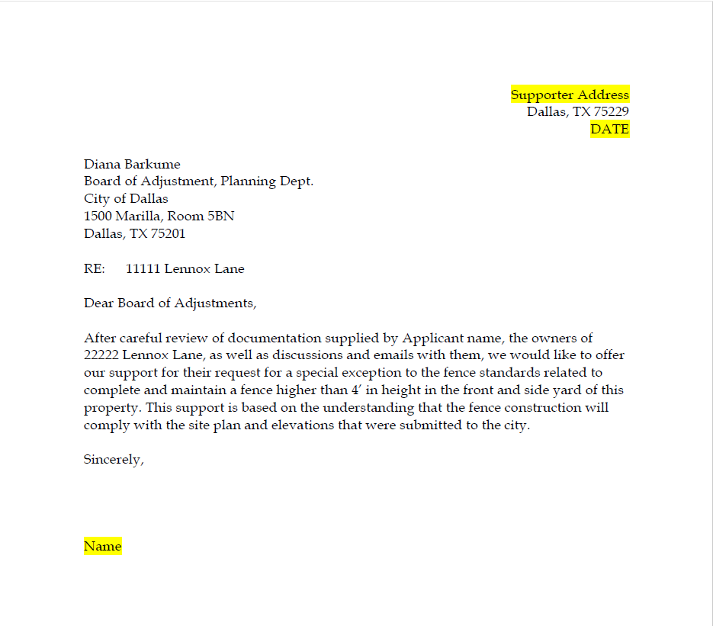
Sample Support Letter

Slide 16
Restrictive Area, Shape, or Slope
Not Contrary To Public Interest

Slide 17
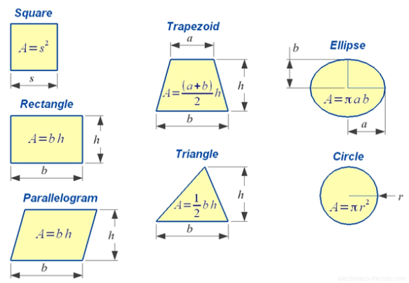
Restrictive Area

Slide 18
Restrictive Shape

Slide 19
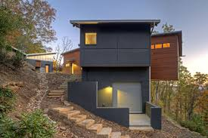
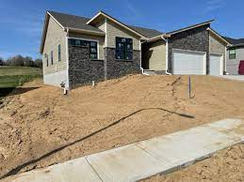
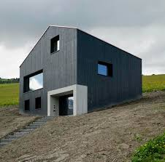
Slope

Slide 20
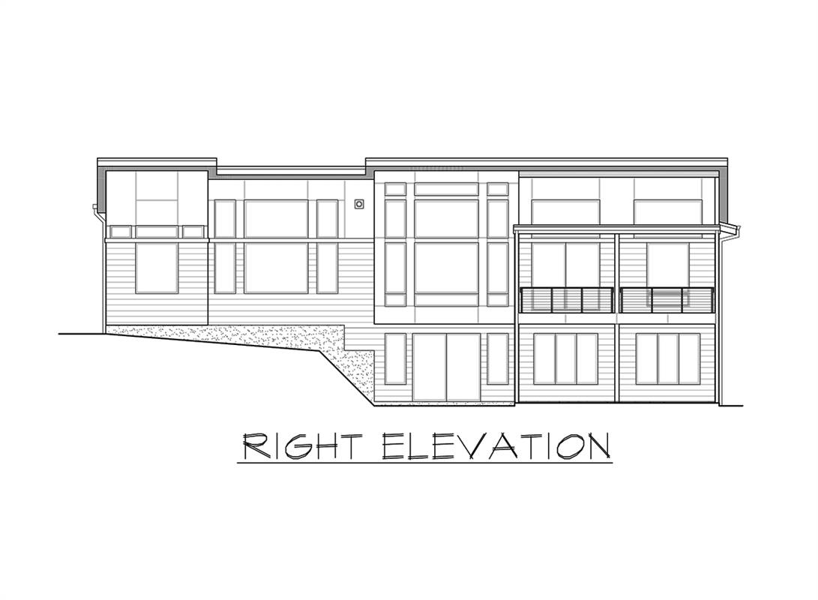
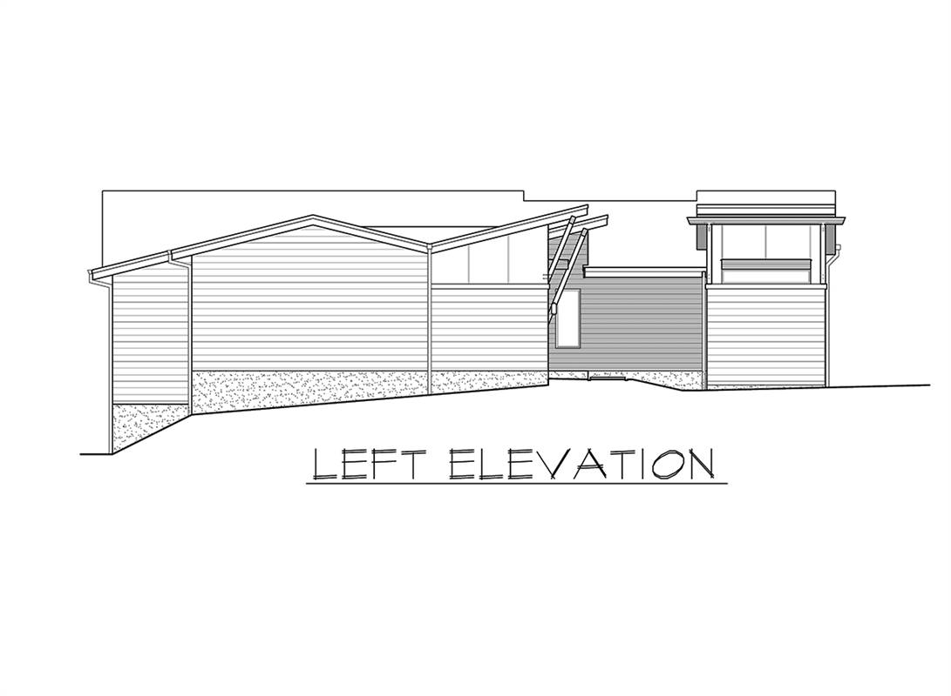
Slope

Slide 21
Self-Created or Personal Hardship
Not Contrary To Public Interest

Slide 22
Self-Created or Personal Hardship
New build, addition, or no structure present and plans and show overbuilding is taking place
Purchasing a home or property of non-disclosed code violations
Allowing handicapped persons equal opportunity to use and enjoy a dwelling
Initiating work without a permit
A permitting oversight

Slide 23
Ask Yourself?
Did you go out and talk to your neighbor ?
Are you asking for permission or forgiveness?
Was your notification sign properly posted?
How did you get to the board?
Did you exercise alternative methods to alleviate yourself from coming to the board?
Did you provide invoices and tax rolls?
Did you take pictures of a vehicle actively in the visual obstruction areas to gauge possible hazards in the visibility triangle?
Did you go back and look at archive board hearings?
Did you include pictures of your dog?

Slide 24
Foundational Institution
Comply with the code
51A-3.102 of the Dallas City Code asserts that, “to the greatest extent practicable, the panels must reflect geographic and ethnic diversity of the city”. Representation and diversity of panels matter. Who knows your neighborhood better than you.

Slide 25
THANK YOU!
QUESTIONS…….

